Slide 1
ENG 528: Language Change Research Seminar
Sociophonetics: An Introduction
Chapter 12: Lateral Transfer
and Associated Articles

Slide 2
Don’t Forget!
Fill out the class evaluation
https://classeval.ncsu.edu
Let’s see if we can do better than the spring 2010 class, for which only two out of thirteen students filled out the form

Slide 3
Format for Oral Presentations
Give them from the front of the class
You’ll have a limit of 12 minutes total, including questions
Plan to talk for 9 minutes and allow 3 minutes for questions; I’ll hold up cards showing time left
You may use a PowerPoint file, the document camera, handouts, or any other format, but you should provide some sort of visual displays
It’s better to talk from your visual displays than to read off a paper

Slide 4
Weinreich, Labov, & Herzog (1968)
This is considered the founding theoretical paper of quantitative sociolinguistics
It was published three years after Labov finished his dissertation and a year after Weinreich died of cancer
Labov and Herzog had to finish writing the paper, but Weinreich wrote the earlier parts
Not everything in the earlier parts agrees completely with Labov’s later interpretations of it

Slide 5
Weinreich, Labov, & Herzog (1968)
Orderly Heterogeneity: a very important concept in Labov’s work
Linguists had previously called unexplained variation “free variation”
Generativists abstracted this variation out of their scope
WLH said that, if you take style, socioeconomic class, gender, etc. into account the unexplained variation falls into neat patterns
Moreover, WLH say that knowledge of these patterns is part of a speaker’s competence—it’s not multidialectalism or performance

Slide 6
Weinreich, Labov, & Herzog (1968)
They list five issues, that, according to them, you have to explain to understand linguistic change
this is the part of WLH that I want you to pay the most attention to

Slide 7
Weinreich, Labov, & Herzog’s Five Issues (1)
Constraints: What changes are possible and impossible?
This led to Labov’s interest in the principles of vowel shifting

Slide 8
Weinreich, Labov, & Herzog’s Five Issues (2)
Transition: What are the intervening states when a sound change takes place?
This could mean intermediate phonetic variants, but Labov was more interested in the progression of a change through a community; his S-curve model resulted

Slide 9
Weinreich, Labov, & Herzog’s Five Issues (3)
Embedding: How is a change related to other linguistic and social changes?
I.e., what else is going on at the same time?

Slide 10
Weinreich, Labov, & Herzog’s Five Issues (4)
Evaluation: What effect does a change have on linguistic structure (e.g., vowel dispersion), on communicative efficiency (q.v. functional load, mergers), and on the social standing of speakers (among other things)?

Slide 11
Weinreich, Labov, & Herzog’s Five Issues (5)
Actuation: Why does a change happen where and when it does? —Labov considers this question to be the most intractable one.
We’ve already seen what Thomason & Kaufmann and Ohala had to say about this issue.
Labov tended to omit the “where and when” part from his later definitions of actuation

Slide 12
Weinreich, Labov, & Herzog (1968)
After that, WLH go into some history to show the deficiencies in their predecessors’ ideas.

Slide 13
Weinreich, Labov, & Herzog (1968)
Hermann Paul was the guy who (1880) really set the Neogrammarians’ ideas down on paper
Paul put a lot of emphasis on the role of individuals and what we’d now call idiolect
He also recognized Sprachusus, or “Language Custom,” which represented a sort of average of everybody in the speech community’s speech
Note that Paul sounds a lot like Ohala in locating linguistic change with language learners. WLH say that Paul doesn’t provide any observed pattern of learning failures, but it’s also true that the study of language acquisition didn’t exist in Paul’s day
Paul relies on the principle of least effort, which we’ve discussed before
WLH say that Paul not only didn’t answer the actuation riddle, he never even formulated it
I think that WLH didn’t like Paul’s dependence on the idiolect because they were more wrapped up in group identity

Slide 14
Weinreich, Labov, & Herzog (1968)
Ferdinand de Saussure: In spite of switching the focus of linguistics from diachrony to synchrony, he didn’t have a different notion of the language as it changed—he still viewed it as homogeneous (and he viewed langue as homogeneous within a community)
Saussure viewed parole (the social uses of language) as heterogeneous, but he didn’t have as much to say about it
Basically, WLH say that Saussure didn’t address the concept of speakers having variation within their own speech

Slide 15
Weinreich, Labov, & Herzog (1968)
Structuralists: Although they were starting to recognize variation within the community, they still ignored variation within a person’s speech.
Note that Bloomfield was thinking about change in terms of prestige (but overt prestige). Also, note that WLH say that the origin vs. diffusion dichotomy was inherited from the Neogrammarians.
Hockett was one of the last of the Structuralists. WLH (and Labov several times later on) quote Hockett’s “eloquently baffled account:”
Sound change itself is constant and slow. A phonemic restructuring, on the other hand, must in a sense be absolutely sudden. … Yet there is no reason to believe that we would ever be able to detect this kind of sudden event by direct observation …
Here’s an earlier quote from Leonard Bloomfield:
… the process of linguistic change has never been directly observed; we shall see that such observation, with our present facilities, is inconceivable.
WLH say (p. 129) that they think the Structuralists improperly distinguish the origin and propagation of a change. That has to do with the fact that Labov thinks that a change isn’t a change until it begins to spread. (This isn’t the same as my idea about why the distinction between origin and spread is artificial.)

Slide 16
Weinreich, Labov, & Herzog (1968)
Generativists: WLH don’t have much to say about them except to say that, by creating the “ideal speaker-listener,” they have the same problem as earlier linguists—they ignore intra-speaker linguistic differences (sort of like Bloch’s definition of idiolect being narrowed to a single interaction)
In other words, Generativists don’t care about structured heterogeneity
p. 144: “the generative model for the description of language as a homogeneous object is needlessly unrealistic”
p. 151: structuredness ≠ homogeneity

Slide 17
Weinreich, Labov, & Herzog (1968)
pp. 163-64: They discuss the “multilayer” approach (wherein speakers switch between dialects/sociolects/etc. as an alternative to “dialect borrowing”
Then they go into variable rules, which are like a generative rule, but with social or stylistic factors entering the picture, producing rules that operate only some of the time.
Variable rules were supposed to be a way of explaining the so-called “free variation” that earlier linguists used as a trash pile for unexplained variation
This led to the development of VARBRUL (Cedergren & Sankoff, 1974)

Slide 18
Weinreich, Labov, & Herzog (1968)
Variable rules have been largely discarded in recent years (see Fasold, 1991, “The quiet demise of variable rules”), for a number of reasons, including:
Generative rules were supposed to show what was possible or impossible in a language, not to predict probabilities.
Variable rules describe, but don’t explain anything.
Variable rules don’t work well for syntactic variation, where almost any change signifies a (maybe subtle) change in meaning or topic.
Phonological theory has moved on from Generativism (and is now trying to explain instead of just describing).
As a result, VARBRUL studies today give factor weightings (probabilities) but rarely give rules

Slide 19
On to Chapter 12
What’s a module?
General definition: some entity with more or less definable boundaries
In psycholinguistics, it’s seen as an encapsulated entity: one with limited inflow and outflow of information
This idea of having limited inflow and outflow of information shows up in a lot of places in linguistics, including some where it probably shouldn’t show up

Slide 20
Examples of Modular Idealizations
Chomsky’s “ideal speaker-listener”
An individual language user or idiolect treated as a “self-contained grammar unit”
The phoneme
Syntax
The human language faculty
A language in the Stammbaum conceptualization
A speech community, network, or community of practice
You could probably think of others

Slide 21
Why do scholars propose modules so often?
Sometimes, there really is something that’s encapsulated
At other times, it’s just a convenient way to isolate a particular phenomenon
Unfortunately, modular idealizations can cause people to forget the ubiquity and importance of interconnections

Slide 22
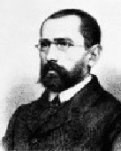
Modularity in Historical Linguistics
August Schleicher (1821-1868) developed the Stammbaum (genetic) model of language change
According to the Stammbaum Theory, Languages develop like branches on a tree and are on independent courses once they diverge
Schleicher was influenced both by Lamarckian notions of biological evolution and by the studies of his teacher, Friedrich Ritschl, on textual copying

Slide 23
Parallels between Biological Evolution and Linguistic Evolution
Recognized as similar processes almost from the start
Some terminology used for both, notably family and parent/daughter/sister (species or languages)
However, there are also problems with the analogy
Factors leading to survival of a species vs. a language are one
More importantly, languages influence each other constantly, whether they’re closely related or not

Slide 24
Current Tree Diagram of Biological Evolution

Slide 25
Lateral DNA Transfer
It turns out that biological evolution doesn’t always work the way Darwin thought
Microbes share DNA all the time
Conjugation
Transformation (from loose DNA, retroviruses, and retrotransposons)
This is one factor that allows bacteria to become resistant to antibiotics rapidly
Multicellular eukaryotes engage in lateral DNA transfer, too; in fact, a lot of our DNA came about this way

Slide 26
Lateral Transfer
Lateral DNA Transfer is much more analogous to language contact processes than traditional Darwinian evolution was
We need to think more in terms of interconnected webs than in terms of modules

Slide 27
Development of an Idiolect
?
?
How many sources does a single individual get their linguistic “knowledge” from?
It’s certainly not all from their parents (as a Stammbaum approach would require)!
?
?
?

Slide 28
Are Phonemes Real? (And were the Structuralists for real?)
Phonemes are a modular conception
Formalized by the American Structuralists (especially Leonard Bloomfield and Bernard Bloch), though the concept had been around longer
Neurological evidence does not appear to favor them
“Loose ends” in phonology create problems for the concept
Allophones could be what language users actually learn
Allophones can shift their allegiances with other allophones fairly easily—a form of lateral transfer

Slide 29
Indexicality
An advantage of Exemplar Theory is that exemplars come complete with both linguistic information and social indexicality
Here, you have transfer of information between the structural-linguistic realm and the social realm
Moreover, the information transfer is constantly updated

Slide 30
Review of General Linguistic Terms
From Saussure:
Langue=grammatical structure; shared by entire community but accessed by studying the language of a single person
Parole=social uses of language; each person has their own parole, but it can be studied only by examining language used in interactions
From Chomsky:
Competence=grammatical structure; each person has their own competence, and it’s accessed by studying the language of a single person
Performance=what a person actually says; not really analogous to parole
Parole was ignored over the years by both Structuralists and Generativists; Labov, Hymes, and others saw their role as reviving the study of parole
Exemplar Theory and what it entails, even in hybrid models, make parole—and with it, sociolinguistics—more central to linguistic theory

Slide 31
Put Social-Linguistic Connections Front and Center
My own intention was to solve linguistic problems, bearing in mind that these are ultimately problems in the analysis of social behavior: the description of continuous variation, of overlapping and multi-layered phonemic systems; the subjective correlates of linguistic variation; the causes of linguistic differentiation and the mechanism of linguistic change. —Labov (1966)
The nature of language is to exhibit flexibility and constant flux
Social indexing is just as important as structural factors

Slide 32
An Interlude: “Sociolinguistic Variables and Cognition”
Here we get into how modular the cognition of language is
Along with that, we’ll consider how sociolinguistic knowledge fits into the cognition of language
First, some ideas you’ve seen before…

Slide 33
Style Shifting
The –ing/-in’ alternation is a marquee variable
There are plenty of other variables with stylistic variation, though
Deletion of taps in American English is an example
How did this speaker “know” when it was all right to delete a tap?

Slide 34
Phasing Rules in Action
By now, you’re probably tired of hearing about Fourakis & Port
Phasing rules also figure into peak alignment in intonation
Here’s another demonstration of the same sort of thing: assimilation of /ð/
Phasing rule is fairly clear for the first speaker, not relevant for the second, but undefined for the third

Slide 35
Differences in Undershoot Again
Just to recap quickly:
Languages, dialects, and idiolects (and probably styles, following the H&H Theory) differ in the amount of undershoot they show
It relates to the compression/truncation issue, with truncation representing more undershoot
Examples:
Compression vs. truncation of intonational contours in various British dialects
Differences across languages in the amount of /a/ undershoot they allow
Degree of truncation of the /ai/ nucleus for the two girls from Johnstown, Ohio
All of this stuff is variable, socially meaningful, and cognitively encoded

Slide 36
Familiarity of Dialects
There’s plenty of experimentation to show that more familiar dialects are more intelligible
People who have more exposure to a different dialect from their own can process it more quickly
Even media can provide sufficient exposure
Impe et al. (2008): Flemings better at processing Netherlandic Dutch than vice versa
Adank et al. (2009): Glaswegians better at processing London English than vice versa

Slide 37
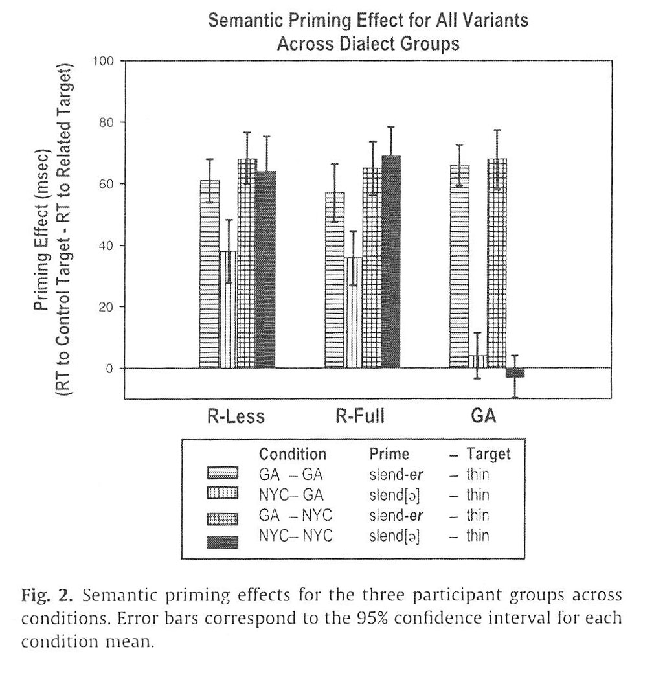
More on Familiarity of Dialects: Sumner & Samuel (2009)
Sumner and Samuel (2009): used rhoticity to show that familiarity results in cognitive differences
Used a prime/target design
New Yorkers could use [beik] as a prime, but outsiders couldn’t; everybody could use an r-ful pronunciation as a prime
Thus, exposure makes a difference

Slide 38
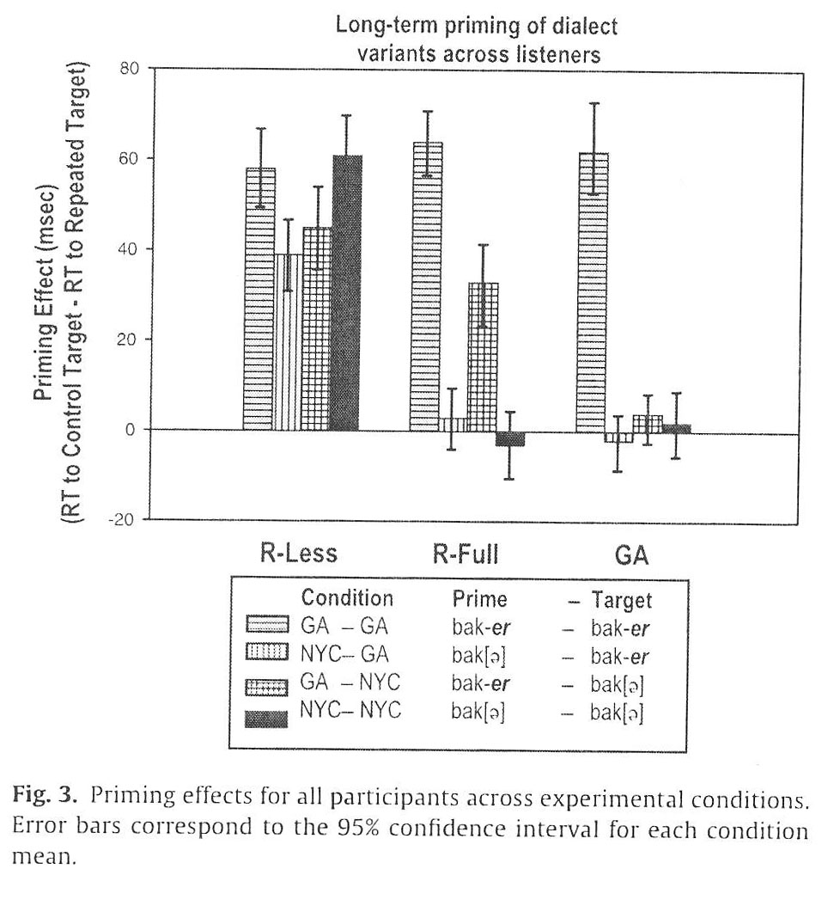
More on Familiarity of Dialects: Sumner & Samuel (2009)
However, a 20-30-minute delay between prime and target rendered r-less forms ineffective as primes for r-ful New Yorkers
They explained it as due to r-ful New Yorkers storing both variants as a single underlying r-ful form, while r-less New Yorkers stored both forms separately
Do you believe that, and does it make any sense?

Slide 39
Adjusting Perception for Different Dialects
Various experiments have shown that listeners adjust their perception subconsciously to match a speaker’s dialect
Rakerd & Plichta (2010): /æ/-// boundary shifted for Detroiters listening to Detroiters or Yoopers
Niedzielski (1999): Detroiters could be fooled if told they were hearing a Canadian
Hay & colleagues (2007, 2010): visual suggestions of Australia vs. New Zealand affected perception
Maye et al. (2008): wecked wetch experiment

Slide 40
Dialect Identification
Lots of studies covering English and Dutch dialects have determined that listeners can identify regional dialects (some better than others)
An even larger number of studies have shown that Americans are usually very good at distinguishing European Americans and African Americans by ear—and can do it very rapidly (that’s important, as we’ll see)

Slide 41
Dialect Identification
A few studies from each group above have tested the amount of exposure listeners had to the relevant dialects
It should come as no surprise that listeners with greater exposure to both opposing dialects were better at identifying them
Yeah, man, hearing dialects does, like, things to your brain!

Slide 42
Upshot of Dialect Intelligibility
People differ in their abilities to understand and identify dialects other than their own
What these experiments all show, however, is that…

Slide 43
Upshot of Dialect Intelligibility
People differ in their abilities to understand and identify dialects other than their own
What these experiments all show, however, is that…
The cognitive connections between sociolinguistic knowledge and structural-linguistic knowledge are strong and constantly updated—this is the lateral transfer part

Slide 44
Modeling Speech Production (1)
Speech production can be slower than perception
This allows speakers to make choices about the linguistic forms they use, depending on the situation and interlocutors
That is, pragmatics are a factor

Slide 45
Modeling Speech Production (2)
Everything is boxed in in the Generative model on the left, representing encapsulization
The model on the right:
Includes sociolinguistic input
Lacks the encapsulization of linguistic levels
Includes feedback loops
Has two-way communication between linguistic levels

Slide 46
Modeling Speech Perception (1)
It has to be fast and reflex-like: no planning possible

Slide 47
Modeling Speech Perception (2)
It has to be fast and reflex-like: no planning possible
Controversy over whether the module is inborn or acquired, and…

Slide 48
Modeling Speech Perception (3)
It has to be fast and reflex-like: no planning possible
Controversy over whether the module is inborn or acquired, and…
The acquired argument has the upper hand now

Slide 49
Modeling Speech Perception (4)
It has to be fast and reflex-like: no planning possible
Controversy over whether the module is inborn or acquired, and…
The acquired argument has the upper hand now
Also a controversy over symbolic vs. connectionist models:
Symbolic=information stored at addresses, like in a computer
Connectionist=information stored in the way neurons are wired together, in arrays

Slide 50
Modeling Speech Perception (5)
It has to be fast and reflex-like: no planning possible
Controversy over whether the module is inborn or acquired, and…
The acquired argument has the upper hand now
Also a controversy over symbolic vs. connectionist models:
Symbolic=information stored at addresses, like in a computer
Connectionist=information stored in the way neurons are wired together, in arrays
There’s no physiological structure known at present that could accommodate addresses for a symbolic model

Slide 51
Modeling Speech Perception (6)
Different ways of conceptualizing a connectionist model:
TRACE—an older (1986) model with both top-down (sentential context→word) and bottom-up (phonetics→phonemes→word) processing and with a localist network
More recent models (2000s)—no top-down processing, no phoneme identification stage, and a distributed network
Recall that Exemplar Theory is very connectionist

Slide 52
Modeling Speech Perception (7)
How does sociolinguistic knowledge interact with perception?
The reflexive nature of perception doesn’t leave much room for sociolinguistic input
I.e., it won’t help you recognize words

Slide 53
Modeling Speech Perception (8)
However, there’s certainly information flow from sounds and words to sociolinguistic knowledge
Experiments show that knowledge built up over time does influence word recognition—think of the wecked wetch and similar studies
Also, some sociolinguistic recognition happens very fast—think of the black/white identification experiments—so that it’s close to being reflexive
In addition, higher-level semantic interpretation probably has some sociolinguistic input
What kinds of experimentation would help here?

Slide 54
Modeling Speech Perception (9)
Here’s a comparison of old (left) and new (right) models of speech perception
The new model lacks encapsulation of linguistic levels but has distributed networks and connections with sociolinguistic knowledge

Slide 55
The Take-Home Message
Sociophonetics and sociolinguistics are all about connectivity—lateral transfer
Let’s get away from thinking in modular terms all the time
Modularity is probably part of how language is stored and processed, but it’s not the only part
Lots of other aspects of language, such as historical developments and the linguistic effects of social networks, are best seen from a lateral transfer perspective, too

Slide 56
Discussion Questions
How do the topics covered in chapter 12 fit into the emerging consensus that mixed (exemplar/abstract level) models best represent the cognitive processing of phonology?
How, from a cognitive perspective, is sociolinguistic knowledge about indexicality integrated into speech production?
Construct an experiment that would investigate how lateral transfer of information between word recognition and social indexing works in speech perception. Is it easier to show whether social indexing influences word recognition or vice versa?

Slide 57
References
The diagram on slide 24 is taken from:
Baldauf, S. L., Debashish Bhattacharya, J. Cockrill, P. Hugenholtz, J. Pawlowski, and A. G. B. Simpson. 2004. The tree of life: An overview. In Joel Cracraft and Michael J. Donoghue (eds.), Assembling the Tree of Life, 43-75. Oxford, U.K./New York: Oxford University Press.
The diagrams on slides 33 and 34 are taken from:
Thomas, Erik R. 2011. “Mental Representation of Sociolinguistic Variables.” Wiley Interdisciplinary Reviews: Cognitive Science 2:701-16.
Other sources:
Adank, Patti, Bronwen G. Evans, Jane Stuart-Smith, and Sophie K. Scott. 2009. Comprehension of familiar and unfamiliar native accents under adverse listening conditions. Journal of Experimental Psychology: Human Perception and Performance 35:520-29.
Cedergren, Henrietta J., and David Sankoff. 1974. Variable rules: Performance as a statistical reflection of competence. Language 50:333-55.
Fasold, Ralph W. 1991. The quiet demise of variable rules. American Speech 66:3-21.
Fourakis, Marios, and Robert Port. 1986. Stop epenthesis in English. Journal of Phonetics 14:197-221.
Hay, Jennifer, and Katie Drager. 2010. Stuffed toys and speech perception. Linguistics 48:865-92.

Slide 58
References (continued)
Hay, Jennifer, Andrew Nolan, and Katie Drager. 2006. From fush to feesh: Exemplar priming in speech production. Linguistic Review 23:351-79.
Impe, Leen, Dirk Geeraerts, and Dirk Speelman. 2008. Mutual intelligibility of standard and regional Dutch varieties. International Journal of Humanities and Arts Computing 2:101-17.
Labov, William. 1966. The Social Stratification of English in New York City. Washington, DC: Center for Applied Linguistics.
Maye, Jessica, Richard N. Aslin, and Michael K. Tanenhaus. 2008. The weckud wetch of the wast: Lexical adaptation to a novel accent. Cognitive Science 32:543-62.
Niedzielski, Nancy. 1999. The effect of social information on the perception of sociolinguistic variables. Journal of Language and Social Psychology 18:62-85.
Rakerd, Brad, and Bartlomiej Plichta. 2010. More on Michigan listeners’ perceptions of //-fronting. American Speech 85:431-49.
Sumner, Meghan, and Arthur G. Samuel. 2009. The effect of experience on the perception and representation of dialect variants. Journal of Memory and Language 60:487-501.
Weinreich, Uriel. 1953. Languages in Contact: Findings and Problems. Publications of the Linguistic Circle of New York, no. 1. New York: Linguistic Circle of New York.

