Slide 1
ENG 528: Language Change Research Seminar
Sociophonetics: An Introduction
Chapter 11: Social Factors and Phonetics

Slide 2
Contributions from Sociology
Various ideas that are part of the basic sociolinguistics lore were adopted from sociology, such as
Sociometric analysis
Density and multiplexity
Communities of Practice (COPs)
We’re interested in how these things relate to phonetics and to cognition
The medium for that interaction is social indexing, or indexicality

Slide 3
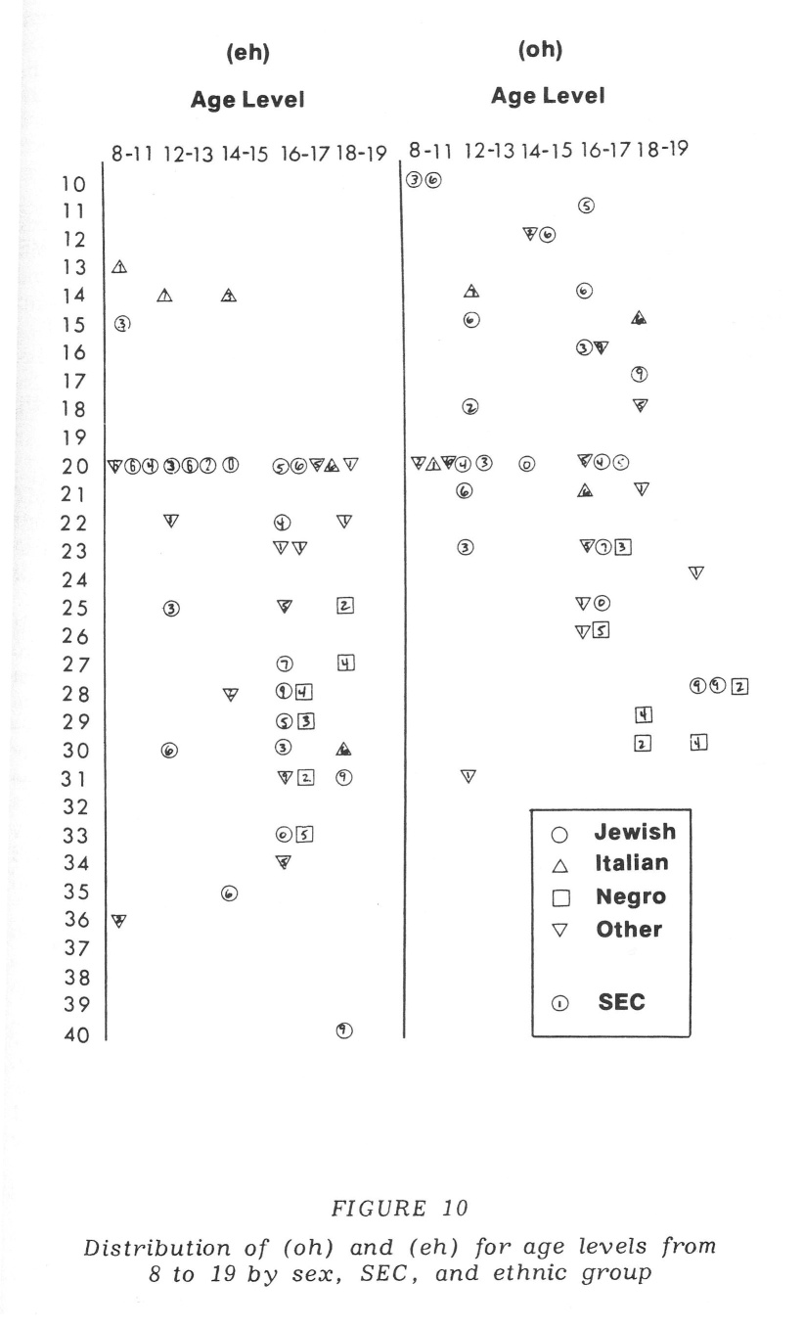
Quantitative Sociolinguists (1)
Old-time sociolinguistics basically just determined how correlated demographic features of speakers were with linguistic features
Here’s a figure from Labov (1966)

Slide 4
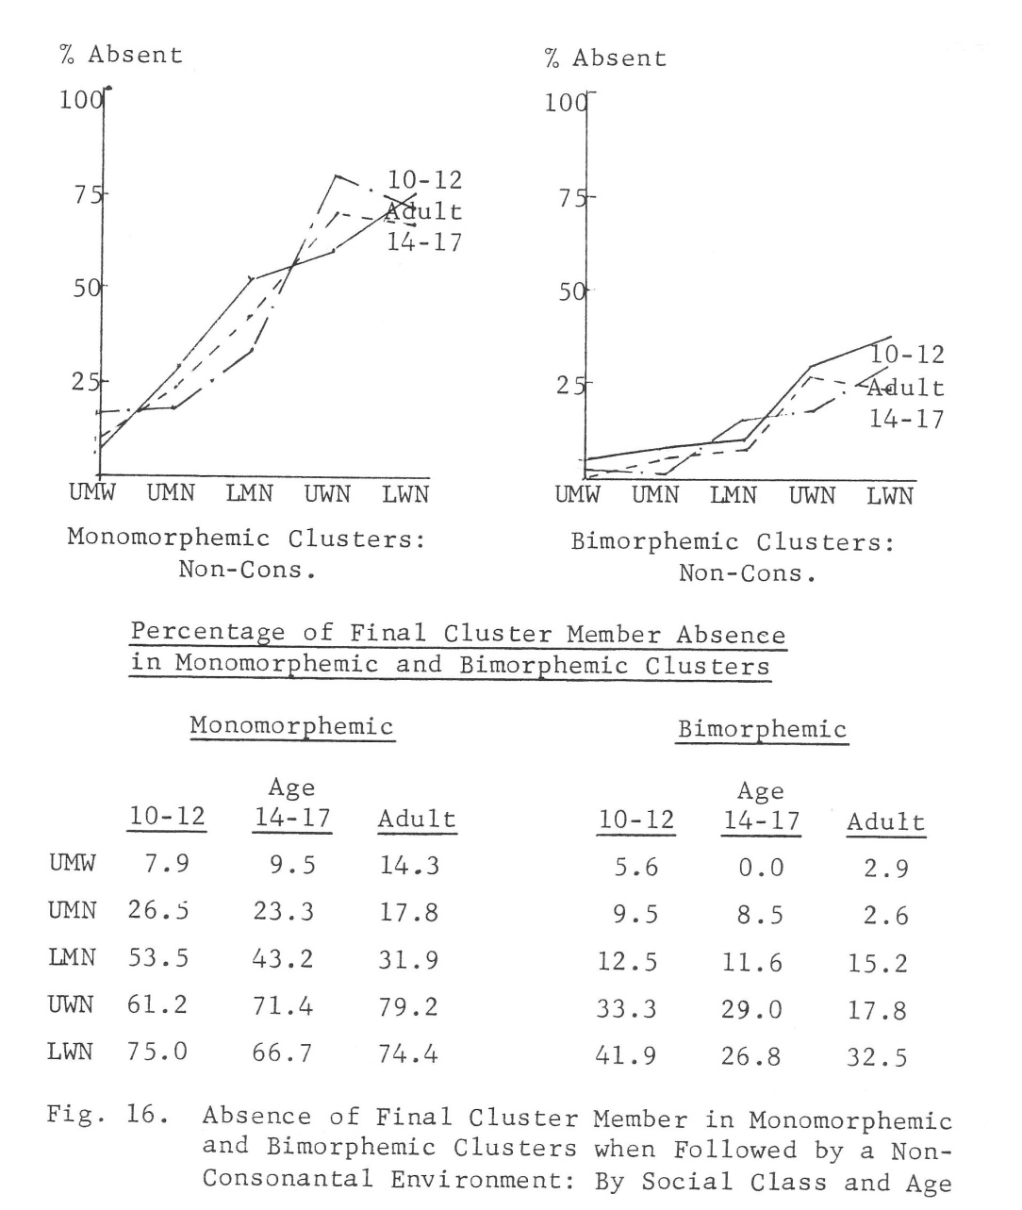
Quantitative Sociolinguistics (2)
New independent variables, such as sex and ethnicity, were introduced
This is from Wolfram (1969)

Slide 5
Quantitative Sociolinguistics (3)
Of course, all demographic scales have problems
Social class is especially problematic
In spite of that, some consistent findings emerged about who leads linguistic change:
Females usually lead males
Lower-middle and upper-working classes usually lead

Slide 6
Labov’s (1972b) Classification of Variants
Indicator: early stage; shows differences among groups, but no stylistic variation; “below the level of social awareness”
Marker: middle stage; shows stylistic conditioning, indicating some sort of awareness by speakers
Stereotype: late stage; people make overt remarks about the variant; variants that reach this stage are usually doomed

Slide 7
Speaking Style (1)
This has been an especially contentious topic
Labov’s (1966) model was based on “attention to speech” and depended on formality
There was some dissatisfaction with the model; Walt likes to discuss how he found Labov’s cues for casual vs. formal conversation to be unreliable

Slide 8
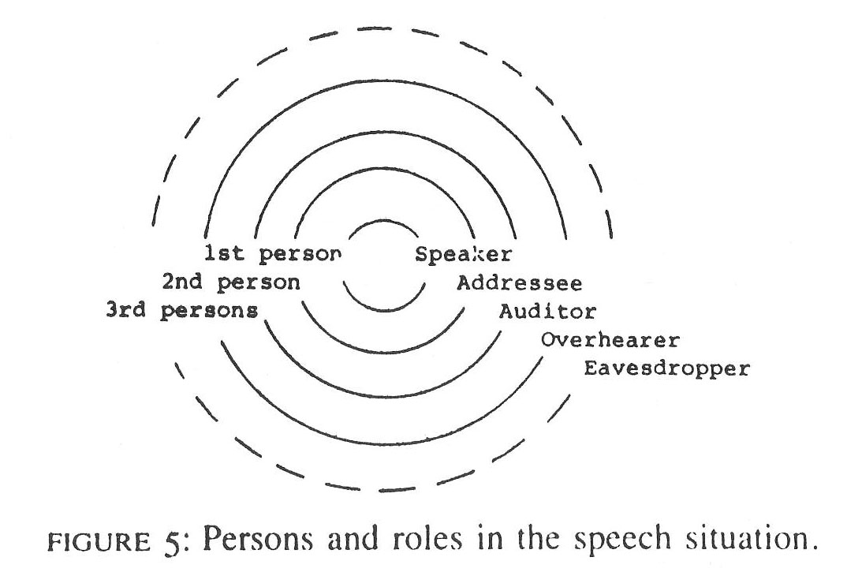
Speaking Style (2)
Bell (1984) finally offered an alternative to attention-to-speech
This was his audience design model
It wasn’t the last word (anybody surprised?)

Slide 9
Speaking Style (3)
The speaker design model was sort of a mirror image of Bell’s audience design
Lindblom’s (1990) H&H Theory came from a completely different angle
It seems to me that all of these factors should be seen as part of the picture, not as competing theories about a single “truth”

Slide 10
Accommodation
Communication Accommodation Theory is associated with Howard Giles (e.g., Giles, Coupland, & Coupland 1991)
Speakers can shift their speech to become more like their interlocutors or less like them
Is this deliberate, subconscious, or both? What’s your intuition about that?
Later versions of the theory allow for both an appropriate behavior component and an identity projection component

Slide 11
The Speech Community
Holmes & Meyerhoff (1999):
Members share norms
They behave similarly toward those norms
One’s identity isn’t important for membership
One doesn’t become part of the group for a purpose
That’s how Labov defined it, anyhow
Actually, there’s been a lot of controversy over the years as to what a speech community is
Bloomfield (1933) first defined it as all speakers of a single language, and other people used the phrase as they saw fit

Slide 12
Social Network Analysis (1)
Holmes & Meyerhoff (1999):
Shared identifications, not shared norms
Membership determined by contrast with other groups
One doesn’t become part of the group for a purpose
Labov’s (1972a) study of Harlem cliques (Jets, Cobras, Thunderbirds) was an important early use
Sociometrics have been a prominent part of it
Eckert’s study of Livonia, MI, used sociometrics (more on that study later)
James & Leslie Milroy’s work in Belfast (e.g., L. Milroy 1987) was key

Slide 13
Social Network Analysis (2)
This was Eckert’s (2000) sociometric analysis for the girls at “Belten High”

Slide 14
Density and Multiplexity
Used by the Milroys for Belfast
Density= how many of one’s associates also associate with each other
Multiplexity= how many places you interact with somebody
High- and low-density networks

Slide 15
Communities of Practice (1)
Holmes & Meyerhoff (1999):
Shared practices, not shared norms or identifications
Members decide who belongs to the group
Members participate in an activity and have to negotiate and agree on the rules/goals
Regarding language, members work out the social meanings of variables
This is a fairly new approach

Slide 16
Communities of Practice (2)
Eckert’s work in Livonia was the main impetus
“jocks” and “burnouts”
Jocks were more white-collar-oriented (participated in school activities) and burnouts more blue-collar-oriented (not into school activities), but there were some crossovers in membership
There were also a lot of “in-betweens”
Burnouts tended to have certain vowel shifts, including a couple of Northern Cities Shift ones, to a greater degree
Other people have tried this approach recently

Slide 17
Communities of Practice (3)
It can be hard to link communities of practice with specific linguistic variables (as in Johnstown)
You can’t generalize the results to society at large—every COP is unique

Slide 18
Individual Variation
In sociolinguistics, “the individual is often anywhere but in the center of interest in practice” (Johnstone 1996)
Labov has put the emphasis on group patterns and group identities, and most other sociolinguists have followed suit
Individual variation for phonetic variables is probably ubiquitous but is hard to prove
Ironically, Labov is the one who’s done the most to pin it down—when he looked for the leaders of sound changes
For dense, multiplex networks, he found that social leaders were the ones who pushed sound changes the farthest (but it didn’t work that way in looser networks)

Slide 19
Cognitive Sociolinguistics (1)
This is a new movement
Mostly based in Europe
Grows out of cognitive linguistics, which is a longer-established tradition (identified with George Lakoff)
Discourse and pragmatics have been the main foci
Pronunciation has gotten some attention, though

Slide 20
Cognitive Sociolinguistics (2)
The important phrase is receptive competence
People associate linguistic variants with social groups, larger categories of people, or speaking styles
This association is very often subconscious
As a result, experimentation is needed to get at it
(“Perceptual Dialectology,” or “Folk Dialectology,” associated with Dennis Preston, mainly gets at stereotypes, which isn’t enough)

Slide 21
Questions for Discussion
Attention to speech, audience design, speaker design, and H&H may all be factors that contribute to style shifting. How can you distinguish their effects in a study? To what degree do their effects overlap?
Design a perception experiment that taps subjects’ subliminal cognitive associations between some linguistic variant and knowledge of what groups use that variant. What differences in the experiments are needed to get at associations with (a) broad demographic groups, (b) speech communities, (c) networks, (d) communities of practice, and (e) individuals?

Slide 22
References
Bell, Allan. 1984. Language style as audience design. Language in Society 13:145-204.
Bloomfield, Leonard. 1933. Language. New York: Holt, Rinehart, and Winston.
Eckert, Penelope. 2000. Linguistic Variation as Social Practice: The Linguistic Construction of Identity in Belten High. Malden, MA: Blackwell.
Giles, Howard, Nikolas Coupland, and Justine Coupland. 1991. Accommodation theory: Communication, context, and consequence. In Howard Giles, Nikolas Coupland, and Justine Coupland (eds.), Contexts of Accommodation: Developments in Applied Sociolinguistics, 1-68. Cambridge, UK/New York: Cambridge University Press.
Holmes, Janet, and Miriam Meyerhoff. 1999. The community of practice: Theories and methodologies in language and gender research. Language in Society 28:173-83.
Johnstone, Barbara. 1996. The Linguistic Individual: Self-Expression in Language and Linguistics. Oxford/New York: Oxford University Press.

Slide 23
References (continued)
Labov, William. 1966. The Social Stratification of English in New York City. Washington, DC: Center for Applied Linguistics.
Labov, William. 1972a. Language in the Inner City: Studies in the Black English Vernacular. Philadelphia: University of Pennsylvania Press.
Labov, William. 1972b. Sociolinguistic Patterns. Conduct and Communication 4. Philadelphia: University of Pennsylvania Press.
Lindblom, Björn. 1990. Explaining phonetic variation: A sketch of the H&H theory. In William J. Hardcastle and Alain Marchal (eds.), Speech Production and Speech Modelling, 403-39. Dordrecht: Kluwer.
Milroy, Lesley. 1987. Language and Social Networks. 2nd ed. Language in Society series 2. Oxford, UK/Malden, MA: Blackwell.
Wolfram, Walter A. 1969. A Sociolinguistic Description of Detroit Negro Speech. Urban language series 5. Washington, DC: Center for Applied Linguistics.

