Slide 1
ENG 528: Language Change Research Seminar
Sociophonetics: An Introduction
Chapter 10: Sound Change
And Related Articles

Slide 2
Linguistic vs. Social Factors
Two common assumptions:
They can be distinguished
They perform different functions:
linguistic factors determine how sound changes get started
social factors determine how they spread
Are they really separable?

Slide 3
Issues from Weinreich et al. (1968)
We’ll return to these when we read the article later this semester:
Constraints
Transition
Embedding
Evaluation
Actuation

Slide 4
Teleology
The word means “happening for a purpose”
Is sound change ever teleological, or does it always happen by accident?
Ohala is staunchly against any teleological account of sound change, but doesn’t that go against sociolinguistic findings that adolescents adopt changes as social markers?

Slide 5
Ease of Articulation
Also called economy of effort
This idea goes back a long, long way (19th century)
It says that changes that make things easier to pronounce are favored
It can be teleological if you assume that saving effort is a goal for speakers: increased efficiency
Conditioned changes usually involve ease of articulation: assimilation, deletion especially
Lenitions of various kinds also involve ease of articulation

Slide 6
Clarity
The opposite of ease of articulation is clarity
Clarity involves making things easier for addressees to understand
That would mean expending a greater effort when speaking
Various fortition processes qualify as improving clarity

Slide 7

Ease vs. Clarity
Various linguists, particularly Maurice Grammont, have seen ease of articulation and clarity as two forces that balance each other

Slide 8
Maximal Dispersion
Related to the clarity position
Notion that sounds tend to become evenly dispersed in the acoustic space
Moulton’s (1962) demonstration of how it applied to long low vowels in Swiss German is an interesting case
Push chains and pull chains are consequences of maximal dispersion

Slide 9
Martinet (1952), “Function, structure, and sound change” (1)
Martinet notes that the causes of morphological, syntactic, and lexical change are often transparent
What about phonological change? Its causes are more opaque

Slide 10
Martinet (1952), “Function, structure, and sound change” (2)
He talks about the development of allophones (conditioned shifts), e.g. OE ceosan, freosan (modern choose, freeze) house/houses, louse/lousy, loss/lose, etc., in which /s/>[z]. In this case, the phonetic explanation is obvious: voiceless consonants often become voiced between vowels (assimilation)
But what Martinet’s really interested in is when a whole phoneme shifts. How does that happen?
That leads him to chain shifts

Slide 11
Martinet (1952), “Function, structure, and sound change” (3)
pp. 6 & 19, he’s critical of the “slot-filling” approach of functionalists
In its place, he talks about “margins of security,” which suggest perceptual factors
That is, when one sound shifts out of the way, “chance deviations … would no longer conflict with communicative needs …”
This would allow the “range of dispersion” to expand into the void
Martinet’s explanation is compatible with Ohala’s aversion to teleology

Slide 12
Martinet (1952), “Function, structure, and sound change” (4)
Note the emphasis on push vs. pull (drag) chains
It’s still a popular topic today, though in my opinion an overblown one
On p. 11, he says that they can be hard to tell apart
In fact, I’m not sure there is a real difference in practice much of the time

Slide 13
Martinet (1952), “Function, structure, and sound change” (5)
discusses functional load—the notion that certain oppositions are more important than others. E.g., there are more minimal pairs for /p/-/b/ than for //-// or /θ/-/ð/ in English
In contrast to the traditional approach to functional load, he says that functional load is dependent on orders and series—what are essentially phonological features (e.g., voiced/voiceless)—not on individual contrasts
This relates to the notion of economy of gestures

Slide 14
Martinet (1952), “Function, structure, and sound change” (6)
“Holes in the pattern:” he says that they tend to be filled. It’s unlikely that you’d find a pattern like this:
p t k
b d
A new /g/ would be likely to develop. Well, maybe… Apparently, there are some languages with that stop inventory.

Slide 15
Martinet (1952), “Function, structure, and sound change” (7)
He shows how this concept applies to Hauteville vowels. Here he seems to emphasize articulation as opposed to perception
He then goes into a discussion of why gaps in the system are ubiquitous: e.g. nasal fricatives are hard to pronounce; nasals can be hard to distinguish from each other (hence // is often absent)
Phonetic factors lead to some asymmetries. E.g. it’s easier for [θ] to turn into a stop than for [f] or [s] to do so
Economy of effort also comes up

Slide 16
Lindblom (1986), “Phonetic universals in vowel systems” (1)
The Crothers study that he mentions was a comparison of the sound systems of 209 languages, with a comparison of how many languages had a certain sound
[a], [i], and [u] are the most common; [❷], [o], [ε], [e], and [i] show up next most often (see table 2.2 on p. 16)

Slide 17
Lindblom (1986), “Phonetic universals in vowel systems” (2)
Principle of Maximal Contrast: it should sound familiar from Martinet
On p. 21 (stamped as p. 392), Lindblom says that vowel systems tend to evolve to maximize perceptual contrast, or at least to provide sufficient contrast
Why? →”… to ensure speech intelligibility under a variety of conditions and disturbances.” (p. 21)
He says what the problem with functional load is: it can’t be quantified

Slide 18
Lindblom (1986), “Phonetic universals in vowel systems” (3)
After that, he goes into the math used in an earlier study, Liljencrants & Lindblom (1972); don’t worry about the math—just note that Liljencrants & Lindblom’s formula predicted small vowel systems better than large ones
Lindblom then goes into a discussion of auditory systems: mels, Bark, Fletcher-Munson curves, SPL (sound pressure level)
Don’t worry about the math here, either. The point is that he got better results this time by paying attention to perceptual factors of the auditory system:
He used Bark
He noted masking effects (low-frequency sounds mask high-freq. sounds more than vice versa)
He noted the nonlinearity of frequency response, which decreases the influence of lower frequency components of the signal
He found that loudness scales (phones, sones) were useful
He also mentioned formant levels. Basically, the general amplitude of a formant is more important than exactly where its peak is. (This is related to the issue of whether listeners identify vowels by peak-picking of formants or by spectral prominence. Evidence suggests the latter.)

Slide 19
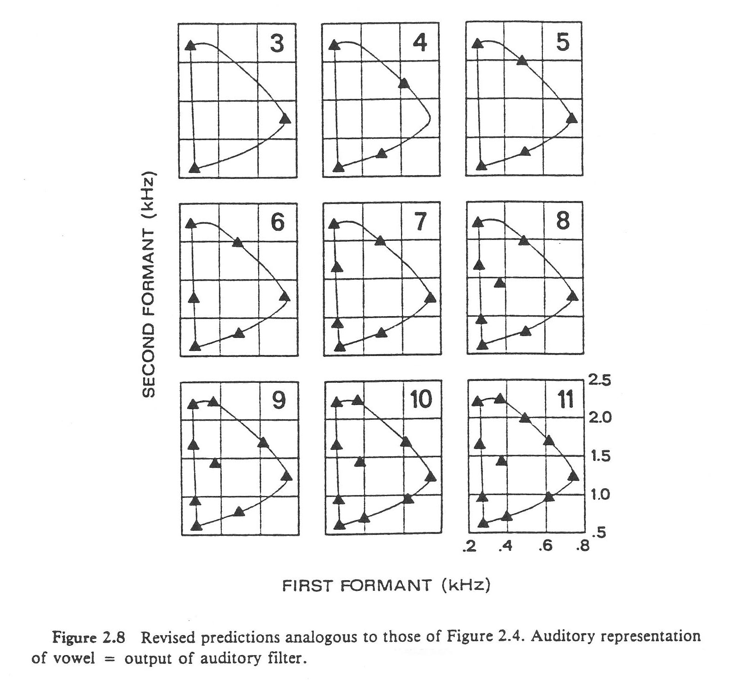
Lindblom (1986), “Phonetic universals in vowel systems” (4)

Slide 20
Lindblom (1986), “Phonetic universals in vowel systems” (5)
Maximum vs. sufficient contrast: it may explain a variety of vowel systems, especially large ones
That is, Lindblom’s formula still didn’t predict the composition of large vowel systems perfectly, so maybe sufficient distances between vowels, not optimal distances, are good enough
Note that phonetic pressures can outweigh social factors (pp. 37-38) in shaping vowel systems

Slide 21
Lindblom (1986), “Phonetic universals in vowel systems” (6)
Lindblom mentions Ohala with regard to features—child language learners learn to focus on particular cues (Ohala wondered whether that worked for consonants but not for vowels; Lindblom suggests that it does work for vowels)
Also note that he says at the end that articulation plays a role, too—difficult articulations are rare
Overall, Martinet seemed to emphasize production while Lindblom emphasized perception
Lindblom doesn’t take historical accident into account; it can explain peculiarities of vowel systems, such as why one language as a high back unrounded vowel while another has a high front rounded vowel (both of which fill the space between [i] and [u]) and why some 7-vowel systems have a vowel between [i] and [u] and others don’t

Slide 22
Problems with Maximal Dispersion
Mergers occur
Some contrasts represent much less than maximal dispersion—and such minimal contrasts are actually pretty common across languages, e.g., English // & /f/, German // & [ç], Turkish // & [▪], Mandarin [t☑] & [▪]
Languages don’t maximize contrasts to the fullest extent, by adding secondary articulations—here we come back to economy of gestures and to sufficient, not maximal, dispersion

Slide 23
Problem with Ease vs. Clarity
No predictive power
Linguists can always attribute changes to them hindsight, but they can’t predict when a change will happen based on them
On the other hand, is that really a problem if sound change is probabilistic, as Ohala says?

Slide 24
Ohala’s Misperception Model
He’s careful to note that certain changes are production-based, such as tonogenesis or spontaneous nasalization
However, many others are perception-based, such as [kw]>[p], and [kj] or [pj]>[t], and lowering of nasal vowels
One example he likes to cite is fronting of [u] next to coronals, as in Tibetan (e.g., Ohala 1981)

Slide 25
John J. Ohala (1993), “The phonetics of sound change” (1)
On p. 238, he notes that sound change can result from various factors, including social ones, but he says that he’s interested in changes that are widely attested because they’re more likely to have linguistic causes
He says that he won’t try to answer the question “Why did sound change X happen where and when it did?” —He sees sound change as probabilistic, not absolutely predictable

Slide 26
John J. Ohala (1993), “The phonetics of sound change” (2)
Although he recognizes both production-based and perception-based kinds of change, he considers the listener the key player in both kinds
On pp. 246-47, he explains how it has to be language learners (either children or adult L2 learners) who misinterpret what they hear
That view is open to question, as we’ll see later. That is, language learners undoubtedly produce some innovations, but do they produce all of them?

Slide 27
John J. Ohala (1993), “The phonetics of sound change” (3)
Ohala emphasizes the difference between the phonetic target (=competence) and the actual production (≡performance)
He says that listeners can do one of three or four things:
Correction: Listeners correctly recover the intended target (“perceptual normalization”)
Hypo-Correction: The listener is unable to perceptually adjust. This leads to assimilation, as well as to misperceptions like k^{w}>p
Hyper-Correction: The listener adjusts perceptually when they’re not supposed to. This leads to dissimilation. a) Ohala used the example of Grassmann’s Law, e.g. PIE *b^{h}and^{h}>band^{h} in Sanskrit and Greek; b) he also mentions Latin familialis>familiaris, populalis>popularis (cf. liberalis, mortalis)—[l] and [r] are especially prone to this. We have some words in English such as caterpillar, surprise, governor, temperature, reservoir, and veterinarian in which the first /r/ is commonly lost even in r-ful dialects

Slide 28
John J. Ohala (1993), “The phonetics of sound change” (4)
Ohala thinks that vowel dispersion can account for misperception; psychological tests have shown that people think that similar but different objects are more different than they really are, and he thinks that this notion could be applied to the fact that vowels seem to repel each other in vowel space. This would be a case of hyper-correction

Slide 29
John J. Ohala (1993), “The phonetics of sound change” (5)
On p. 268, about sociolinguistic factors, he says: “At their best, they are accounts of why these changes spread—because at any given time all languages are flooded by all applicable mini-sound changes.”
This sounds appealing; don’t social groups pick what sound changes they want to identify with?
It would also explain why it’s phonetically favored changes that take hold
But doesn’t that go against most sociolinguistic findings, that certain people deliberately innovate?
Anthony Kroch (1978) tried to find a way of justifying these conflicting factors (sociolinguistic findings vs. the fact that only phonetically favored changes occur). He theorized that phonetic factors are always at work producing new sound changes, but that the high socioeconomic groups actively repress these changes

Slide 30

Boersma’s response to Ohala
Boersma’s name ought to ring a bell
He said that [] is expected to be perceptually most similar to [k], but [] is more likely to shift to [d] or []
Hence languages tend to preserve distinctions, which is teleological

Slide 31
Lindblom, Guion, Hura, Moon, and Willerman (1995), “Is sound change adaptive?” (1)
Background: H&H Theory
Continuum from clearly enunciated to poorly enunciated speech
Hyper-speech: clearly enunciated
Hypo-speech: poorly enunciated
(These terms are not to be confused with Ohala’s hypercorrection and hypocorrection)
e.g. “The next word is _____.” Here, you’d have to enunciate carefully
“A stitch in time saves ______.” Here, you don’t have to enunciate carefully because the listener knows what to expect
You enunciate only as carefully as you need to in order to get your message across; otherwise you default to low-cost behavior
The hyperspeech/hypospeech continuum means that there’s always going to be lots of variation present (note that this is all production-based variation). Note that they have a very monolithic approach—all variation is treated as hyper/hypo (only once do they acknowledge other variation)

Slide 32
Lindblom, Guion, Hura, Moon, and Willerman (1995), “Is sound change adaptive?” (2)
Lindblom et al. go over one of Ohala’s favorite examples, the potential confustion
between /ut/-[yt] and [yt]-/yt/
They say that there’s a paradox in Ohala’s reasoning: How can a speaker misperceive a pronunciation and still know what word it is?
This could be circumvented by noting that Ohala cites language learners, who don’t have a preconceived picture of what sounds a word consists of
Lindblom et al. do mention language learners on p. 19, but only to say that sociolinguists think sound change happens with older kids (“competent adults”)

Slide 33
Lindblom, Guion, Hura, Moon, and Willerman (1995), “Is sound change adaptive?” (3)
They say that there’s only one way to resolve the paradox—to propose that listeners have two modes:
WHAT mode: focus on what’s being said
HOW mode: focus on how it’s being said
Then they said that the HOW mode is where sound change happens (here they agree with Ohala)
Finally, they say that speakers can go into HOW mode, notice unusual pronunciations, and manipulate them (unlike Ohala, who focuses on misperception)

Slide 34
Lindblom, Guion, Hura, Moon, and Willerman (1995), “Is sound change adaptive?” (4)
Some of their arguments are assailable. The German example (p. 21) could also be explained by fricatives’ being more perceptually salient. The Guion (1994) experiment on greater length of unfamiliar words could also be explained as a product of familiarity—it takes longer to recall an infrequently used word
After going through a bunch of examples, they get to sociolinguistics (p. 28). Here, they tie their idea of selective adoption of pre-existing variants in with the sociolinguistic notion of solidarity
This would explain why it’s phonetically favored variants that spread: listeners who are using variants for peer identification can choose only from variants that already exist, and those variants are formed by phonetic factors (we said the same thing regarding Ohala)

Slide 35
Ohala vs. Lindblom et al.
issue | stance of Ohala (1993) | stance of Lindblom et al. (1995)
Why does variation occur in the first place? | Variations are always present because of coarticulation and numerous other phonetic factors. | Variations are always present because speakers adjust their own articulation according to the communicative needs of listeners, enunciating more carefully (hyperspeech) or less carefully (hypospeech).
How do sound changes originate? | Many (not all) sound changes originate by misperceptions: listeners (usually language learners) make mistakes in reconstructing the target pronunciation of a sound. | Variations originate teleologically—for a purpose. (They maintain, though, that hypospeech is not teleological.)

Slide 36
Ohala vs. Lindblom et al.
issue | stance of Ohala (1993) | stance of Lindblom et al. (1995)
What’s the purpose of sound change? | The origin of sound changes is non-teleological—i.e., it’s not purpose-driven. Speakers don’t intend (even subconsciously) to make speech easier to pronounce or easier to understand, or to make the grammar simpler. | Speaker/listeners test natural variations for their communicative value.
How are sound changes propagated? | Sound changes may spread teleologically because social factors such as prestige provide a motivation. | Speaker/listeners deliberately take advantage of variations and select certain variants to use as social symbols.

Slide 37
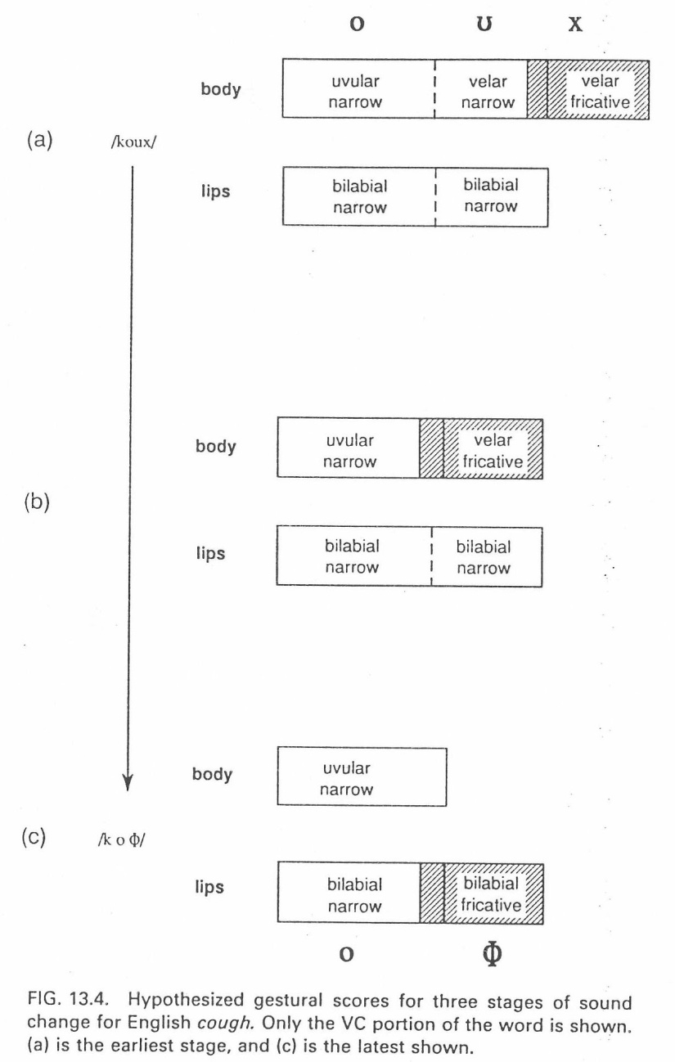
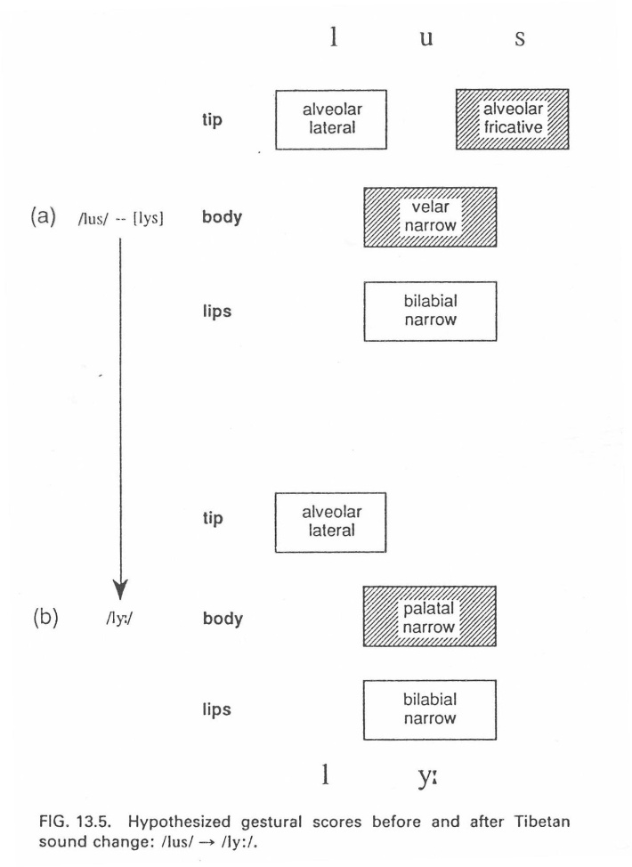
Browman and Goldstein (1991)
they agree with Lindblom et al that production, not perception, is primary
they agree with Ohala that change is accidental, not deliberate

Slide 38
Blevins (2004), Evolutionary Phonology: The Emergence of Sound Patterns
She started out life as a generative phonologist
CCC model:
change = misperception, a la Ohala
chance = reinterpretation of an ambiguous signal; some metatheses might qualify (e.g., brid>bird, drit>dirt)
choice = processes such as undershoot result in multiple realizations, and listener chooses a different one from what the speaker’s underlying form was (e.g., off>of)

Slide 39
Origin and Actuation
In contrast to the authors we’ve been looking at so far, Labov said that origin and spread can’t be separated
His reasoning was that a change isn’t a change until the population using it begins to increase
My objection to Labov: why can’t an innovation by one person be a change?
Romaine’s objection to Labov: it obscures the actual origin; i.e., actuation wouldn’t be such a “riddle” if you didn’t exclude individual innovations
My reasoning for why origin and spread can’t be separated: linguistic factors make any potential change occur part of the time in various people’s speech, so by the time the number of people using the change starts to increase, there will already be lots of people who do it at least sometimes

Slide 40
How compatible are the theories with sociolinguistic findings?
Sociolinguistic findings offer clear evidence that children adopt features from their peers and may even exaggerate them
The evidence suggests that children do that deliberately for identity reasons (however, cognitive experiments are needed to prove that it’s deliberate)
That, in turn, suggests that Lindblom et al. and Blevins’s choice explain sound changes better
However, misperception could still be plausible and might explain how the exaggeration pushes sound changes to new levels

Slide 41
Questions for Discussion
1. How would you go about tracking potential sound changes before they take on social identity functions?
2. What are some experimental ways you could test whether speakers deliberately innovate or innovate by misperception? Does your choice of method depend on the kind of variable you’re examining?

Slide 42
Labov’s Theories about Sound Change
A central assumption in Labov’s theorizing is that the vowel space is divided into peripheral and non-peripheral tracks
He even proposed [±peripheral] as a phonological feature

Slide 43
Labov’s Background Evidence
In Labov, Yaeger, & Steiner (1972), a systematic survey of known vowel shifts around the world’s languages (actually, mostly in European languages) was conducted
LYS then synthesized the recurrent patterns they found into a series of principles
Labov has reformulated these principles in various ways in subsequent publications (Labov 1991, 1994, 2001; Labov, Ash, & Boberg 2006)

Slide 44
Labov’s Principles of Vowel Shifting (1)
The first three principles are the basic ones:
Principle I. In chain shifts, tense nuclei rise along a peripheral track (Labov 1994:176); reformulated from “In chain shifts, long vowels rise” (1994:116).
Principle II. In chain shifts, lax nuclei fall along a non-peripheral track (Labov 1994:176); reformulated from “In chain shifts, short vowels fall” (1994:116).
Principle IIa. In chain shifts, the nuclei of upgliding diphthongs fall (1994:116). This principle accounts, e.g., for the lowering of Middle English and Middle High German /u/, after diphthongization to [u], through the stages [ou>u>❶u>au].

Slide 45
Labov’s Principles of Vowel Shifting (2)
Principle III. In chain shifts, tense vowels move to the front along peripheral paths, and lax vowels move to the back along non-peripheral paths (1994:200).
Principle IV. In chain shifting, low non-peripheral vowels become peripheral (the “lower exit principle;” 1994:280). That is, a vowel that falls will eventually hit bottom and enter the peripheral space when it reaches an [a] value.
Principle V. In chain shifting, one of two high peripheral morae becomes non-peripheral (1994:281). This principle accounts for the diphthongization of long high vowels—e.g., /u/ shifting to [u].

Slide 46
Labov’s Principles of Vowel Shifting (3)
Principle VI. In chain shifts, peripheral vowels rising from mid to high position develop inglides (1994:284). This accounts for shifts such as /o/ becoming [u].
Principle VII. Peripherality is defined relative to the vowel system as a whole (1994:285).
Principle VIII. In chain shifts, elements of the marked system are unmarked (1994:288). This principle is designed for languages that have a series of creaky or nasal vowels, which count as the “marked” system. By Principle VIII, such vowels would tend to lose the secondary articulation.

Slide 47
Objections to Labov’s Principles
Can be applied only to languages with a tense/lax or long/short distinction—Labov’s answer is that “marked” series of vowels can function like tense vowels
Exceptions to the principles (Cox 1999): Labov says that his principles weren’t meant to be exceptionless, and Cox’s example is problematic anyhow
Is peripherality the motivating factor (never actually stated by Labov, but certainly implied) or just an incidental by-product of shifting? See diagrams on next slide

Slide 48
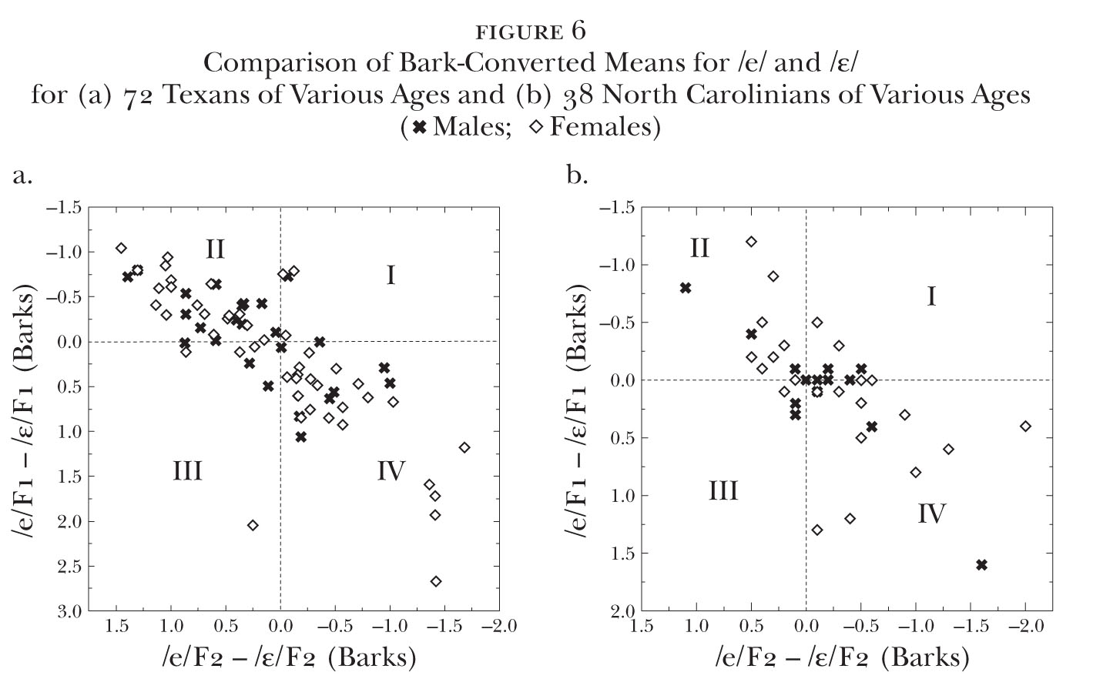
Peripherality: Motivator or By-Product of Vowel Shifting?

Slide 49
Motivations for the Principles
Theoretically speaking, this may be a bigger problem for the principles than any of the objections listed earlier
You’ve got to have a motivation—in science, there’s got to be a reason for everything!
Labov has provided a possible explanation for Principle III (asymmetry of articulatory space)
Principles IV and VII don’t require much explanation
The other principles are more problematic
Gussenhoven (2007) offered an explanation for Principles I and II, and I offered one (2003) for Principle V, but nothing’s been tested

Slide 50
Chain Shifting Patterns across Languages
Pattern 1: Principles I & IIA, with help from V; a long high vowel diphthongizes and lowers, another one rises to fill its place
Pattern 2: Principles I, II, & III; fronting & raising of long vowels, falling of short vowels
Pattern 3: Principles I & III; fronting of back vowel(s) (usually just /u/), raising of other back vowels to fill in behind
Pattern 4: Peripheral and non-peripheral vowels switch places

Slide 51
Shifting Patterns (also in Labov 1991, “The three dialects of English”)
Northern Cities Shift: Great Lakes area of U.S.; he says also in Scotland, but it’s not very convincing

Slide 52
Shifting Patterns (also in Labov 1991, “The three dialects of English”)
Southern Shift: Southern U.S.; also, in different forms, in southern England and Southern Hemisphere

Slide 53
The “Third Dialect”
Characterized by the low back merger
Labov says in a footnote (added late to the article) that back vowel fronting occurs
Subsequently, Clarke et al. (1995) proposed the “Canadian Shift” for Canada, and it’s been found in parts of the U.S. with the low back merger since then

Slide 54
Mergers
Proving that somebody really has a merger can be a problem
The flip side, which some sociolinguists forget, is that it can be equally hard to prove that somebody makes a distinction
In speech production data, you have to make sure that tokens from the two classes occur in comparable phonetic contexts
In a near merger, a speaker says they don’t make a distinction when in fact they do
However, speakers will sometimes erroneously report that they make a distinction when they don’t
Various cognitive experiments have been devised to test for mergers in speech perception; we covered them in chapter 3

Slide 55
Principles of Mergers (after Labov 1994)
Mergers are irreversible by linguistic means (1994:311—“Garde’s Principle”)
Mergers expand at the expense of distinctions (1994:313—“Herzog’s Principle”). Apparently for cognitive reasons—the simpler configuration is cognitively easier for language learners.
Both can be violated by social factors, but only by social factors
demographic swamping
pressure from prestige forms

Slide 56
Mechanisms of Merger (1):
Merger-by-Approximation
Two classes get closer together until the distance between them disappears
It’s not necessary for both classes to move—only one of the classes has to move

Slide 57
Mechanisms of Merger (2):
Merger-by-Transfer
Words are transferred from one class to another until the losing class gets bled to death

Slide 58
Mechanisms of Merger (3):
Merger-by-Expansion
The phonetic space of both classes expands until they overlap completely

Slide 59
Thomas (2001): Southern White Vowels
Chapter 4 (Whites from the Southeastern States)
Note the following general developments:
Division between plantation (/ai/ split, r-lessness) and non-plantation (monophthongal /ai/ in all contexts, r-fulness) regions.
Southern drawl. Much remarked on, but little studied.
Southern Shift. We’ve been over it already.
Front-gliding /o/ and /u/: This recent pattern has spread widely in the Southeast but seems to have started around the Pamlico Sound.

Slide 60
Thomas (2001): Local Southern Patterns
The South has a lot of local dialects, most of which are giving way to a general pan-Southern pattern. Most noteworthy are:
1. Tidewater & Piedmont of Virginia. Canadian raising, r-lessness except stressed, syllabic position, and various other features

Slide 61
Thomas (2001): Local Southern Patterns
2. Low Country (SC & GA). Ingliding /e/ and /o/, merger of /ir/ and /er/, /æ/ in words like pa and ma, Canadian raising, etc.

Slide 62
Thomas (2001): Local Southern Patterns
3. Louisiana. Various kinds of French influence, including monophthongal tense vowels
Vowels of a white male, born 1926, from Lafourche Parish, Louisiana

Slide 63
Thomas (2001): Local Southern Patterns
4. Pamlico Sound and the eastern shore of Chesapeake Bay. /ai/>[i~i], front-gliding /au/, r-fulness, no sign of /æ/ split. They’re relic areas

Slide 64
Thomas (2001): Local Southern Patterns
5. The Mountains: innovative in having the most extreme forms of the Southern Shift and /ai/ monophthongization in all contexts, but a relic area in, e.g., preserving [æ] in bath words

Slide 65
Thomas (2001): AAE Vowels
Chapter 6 (African Americans)
This dialect is typically r-less, though most African Americans today seem to be r-ful in stressed, syllabic contexts, e.g. in first. R-fulness is probably increasing, however
There’s some resistance to shifts affecting white speech, but slow assimilation has taken place
Other features:
Split of /ai/
Raising of /æ/ and maybe of /ε/ and //
Back vowel fronting has usually progressed far more slowly than in white speech (this is what makes Hyde County unusual, even for younger speakers)

Slide 66
Thomas (2001): AAE Vowels
Note the raised lax front vowels, the /ai/ allophones, and the lack of /au/, /o/, and /u/ fronting

Slide 67
The Neogrammarian Controversy (1)
The Neogrammarian Controversy started in the 1870s when Hermann Osthoff and Karl Brugmann proposed that:
Sound changes are exceptionless
When exceptions occur, they have to be conditioned by phonetic factors
It immediately stirred up a firestorm in linguistics; are sound changes really exceptionless?
Since then, however, there have been two challenges to it:
Whether morphological or syntactic factors can condition sound changes
Lexical diffusion: the notion that sound changes can spread word-by-word through a language. Main proponent has been William S.-Y. Wang

Slide 68
The Neogrammarian Controversy (2)
Labov spent a lot of time sorting it out
He concluded that most sound changes followed the Neogrammarian Hypothesis
He allowed for several kinds of changes to be lexically conditioned, however (e.g., shortening/lengthening, deletions of obstruents)

Slide 69
Propagation of Changes
I won’t say much about it here, but there’s a bunch of terminology
Note internal and external motivations for changes
We’ve already discussed language contact
Keep in mind what the Wellentheorie (wave model) and Stammbaum (genetic model) are; we’ll come back to Stammbaum in chapter 12
Spatial diffusion can be hierarchical, contrahierarchical, or contagious (though both dialect geographers and sociolinguists have assumed hierarchical to be the norm)
Recall what change-from-above and change-from-below are

Slide 70
Questions for Discussion
How does the opposition of least effort vs. clarity relate to the controversy over the Neogrammarian Hypothesis vs. lexical diffusion?
What methods could be used to test Labov’s principles of vowel shifting?

Slide 71
Fun with Vowel Formant Plots

Slide 72
References
The diagram on slide 48 is taken from:
Thomas, Erik R. 2003. Secrets revealed by Southern vowel shifting. American Speech 78:150-70.
Other sources:
Blevins, Juliette. 2004. Evolutionary Phonology: The Emergence of Sound Patterns. Cambridge, UK/New York: Cambridge University Press.
Boersma, Paul. 1998. Functional phonology: Formalizing the interactions between articulatory and perceptual drives. Ph.D. dissertation, University of Amsterdam.
Browman, Catherine P., and Louis Goldstein. 1991. Gestural structures: Distinctiveness, phonological processes, and historical change. In Ignatius G. Mattingly and Michael Studdert-Kennedy (eds.), Modularity and the Motor Theory of Speech Perception, 313-38. Hillsdale, NJ: Lawrence Erlbaum.
Clarke, Sandra, Ford Elms, and Amani Youssef. 1995. The third dialect of English: Some Canadian evidence. Language Variation and Change 7:209-28.
Cox, Felicity. 1999. Vowel change in Australian English. Phonetica 56:1-27.
Guion, Susan Guignard. 1994. Word frequency effects among homonymns. Unpublished typescript.

Slide 73
References (continued)
Gussenhoven, Carlos. 2007. A vowel height split explained: Compensatory listening and speaker control. In Jennifer Cole and José Ignacio Hualde, Laboratory Phonology 9, 145-72. Berlin/New York: Mouton de Gruyter.
Kroch, Anthony S. 1978. Toward a theory of social dialect variation. Language in Society 7:17-36.
Labov, William. 1991. The three dialects of English. In Penelope Eckert (ed.), NewWays of Analyzing Sound Change, 1-44. New York: Academic.
Labov, William. 1994. Principles of Linguistic Change. Volume 1: Internal Factors. Language in Society 20. Oxford, U.K./ Malden, MA: Blackwell.
Labov, William. 2001. Principles of Linguistic Change. Volume 2: Social Factors. Language in Society 29. Oxford, UK/ Malden, MA: Blackwell.
Labov, William, Sharon Ash, and Charles Boberg. 2006. The Atlas of North American English: Phonetics, Phonology and Sound Change. A Multimedia Reference Tool. Berlin: Mouton de Gruyter.
Labov, William, Malcah Yaeger, and Richard Steiner. 1972. A Quantitative Study of Sound Change in Progress. Philadelphia: U.S. Regional Survey.
Liljencrants, Johan, and Björn Lindblom. 1972. Numerical simulation of vowel quality systems: The role of perceptual contrast. Language 48:839-62.

Slide 74
References (continued)
Lindblom, Björn. 1986. Phonetic universals in vowel systems. In John J. Ohala and Jeri J. Jaeger (eds.), Experimental Phonology, 13-44. Orlando: Academic Press.
Lindblom, Björn, Susan Guion, Susan Hura, Seung-Jae Moon, and Raquel Willerman. 1995. Is sound change adaptive? Rivista di Linguistica 7:5-37.
Martinet, André. 1952. Function, structure, and sound change. Word 8:1-32.
Moulton, William G. 1962. Dialect geography and the concept of phonological space. Word 18:23-32.
Ohala, John J. 1981. The listener as a source of sound change. In Carrie S. Masek, Roberta A. Hendrick, and Mary Frances Miller (eds.), Papers from the Parasession on Language and Behavior. Chicago Linguistic Society, May 1-2, 1981, 178-203. Chicago: Chicago Linguistic Society.
Ohala, John J. 1993. The phonetics of sound change. In Charles Jones (ed.), Historical Linguistics: Problems and Perspectives, 237-78. London: Longman.
Thomas, Erik R. 2001. An Acoustic Analysis of Vowel Variation in New World English. Publication of the American Dialect Society 85. Durham, NC: Duke University Press.
Weinreich, Uriel, William Labov, and Marvin Herzog. 1968. Empirical Foundations for a Theory of Language Change. In Winfred P. Lehmann and Yakov Malkiel (eds.), Directions for Historical Linguistics: A Symposium, 95-188. Austin: University of Texas Press.

