Slide 1
ENG 528: Language Change Research Seminar
Sociophonetics: An Introduction
Chapter 9: Variation and the Cognitive Processing of Sounds
And Related Articles

Slide 2
Background: Phonology and Phonetics
The traditional understanding of the difference between phonetics and phonology (from Bloomfield 1933 and earlier scholars, followed by Chomsky & Halle 1968):
Phonology=discrete phenomena (phonemes, features, rules, syllables) that are cognitively represented
Phonetics=gradient phenomena (consequences of the construction of the articulatory and auditory apparatuses) that are not cognitively represented

Slide 3
Background: Generative Phonology
Chomsky and Halle (1968), The Sound Pattern of English (SPE), was the Bible of phonology for a long time
It provided a list of phonological features for English sounds: e.g., [t] is [-syl, +cons, -son, -voiced, -cont, +cor, -lab, +ant, -constr]; the features were developed from earlier feature systems
It adopted the standard way of writing phonological rules, e.g., [+cont,+ant]→[+voice]/[+voice]_[+voice] for voicing of certain Old English fricatives
It also included detailed derivations for such pairs as divine/divinity, serene/serenity, sane/sanity, code/codify

Slide 4
John J. Ohala (1992), “The Costs and Benefits of Phonological Analysis”
follows up on Ohala (1974), “Experimental Historical Phonology,” in which experiments showed that speakers don’t consistently employ the SPE rules when asked to make new words using existing words and suffixes (for either vowels or consonants)—e.g., they said obtanitory with /e/ and domesticism with /k/
See also his 1986 paper, “Consumer’s Guide to Evidence in Phonology”
For instance, SPE treats the “short o” and “long o” sounds as underlyingly /o/ and /o/ because of the relationship between words like cone/conical, depose/deposit, code/codify, verbose/verbosity, etc.
However, Ohala says that the sound alternations are
a) more opaque than phonologists have acknowledged (e.g., suppose and suppository) and
b) less productive than phonologists have claimed (as with the experiments mentioned above)

Slide 5
John J. Ohala (1992), “The Costs and Benefits of Phonological Analysis”
“…there will come a point…where one can set up alternative systems to explain quite a wide range of phenomena. One can think that this or that system is more elegant or more deep than some other, but is it right?” —Noam Chomsky, 1967
just because a theory is elegant or “deep,” that doesn’t make it correct
Phonologists like to create notations and formalisms, but do they really reflect what’s going on in a speaker’s brain? I.e., IT LOOKS NICE, BUT IS IT REAL?

Slide 6
John J. Ohala (1992), “The Costs and Benefits of Phonological Analysis”
§2: the “cost-benefit” issue
Simplicity is not always the only consideration
memory may be cheaper than computational ability (or ability to process complex grammatical rules)
However, phonologists have traditionally used simplicity as the only criterion for evaluating proposed rules.
Evidence now shows that storage space in the brain is not a limitation (see Jaeger 1986)

Slide 7
John J. Ohala (1992), “The Costs and Benefits of Phonological Analysis”
§3: several issues that are problems for the SPE approach
1. It’s often difficult to figure out what the constituent morphemes of words are
phonologists came up with generative rules because they are more educated (about language history) and more aware of linguistic relationships than ordinary people
Many historically related words have drifted apart from each other in meaning (e.g., author/authority). We also have lots of polysemes (e.g., raise/raze) and cranberry morphemes. Thus the connections between morphemes are hard to figure out

Slide 8
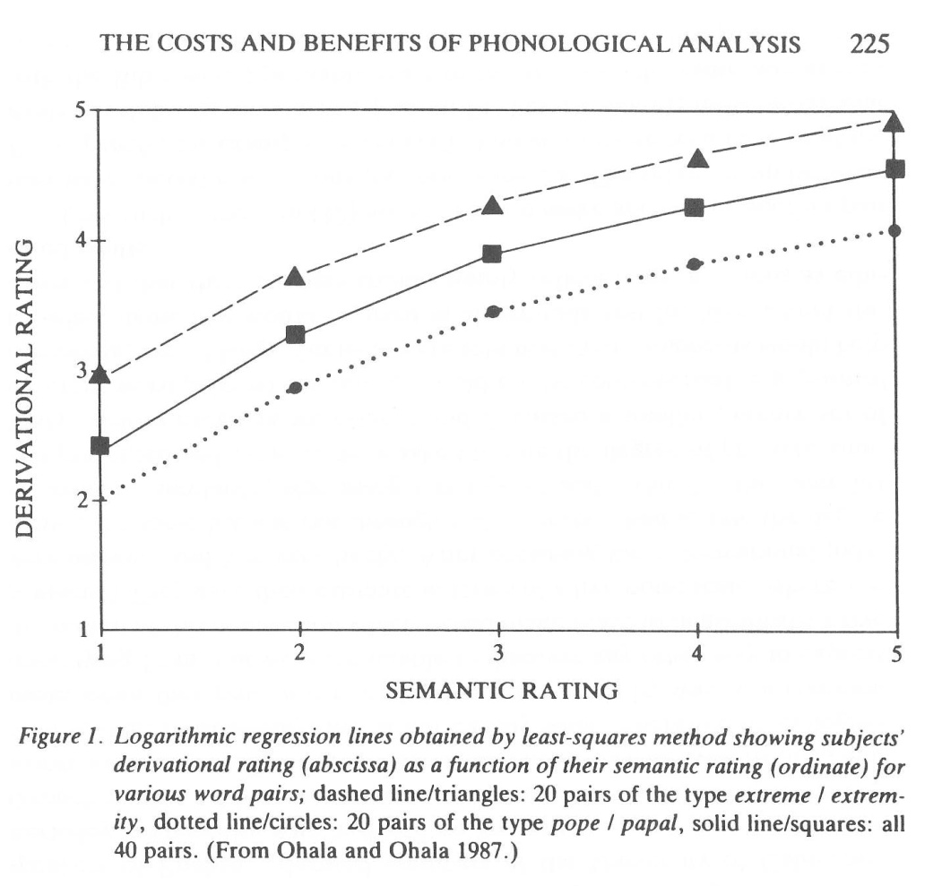
John J. Ohala (1992), “The Costs and Benefits of Phonological Analysis”
2. Exceptions make general phonological patterns hard to discern
Sure, there are repeated patterns like extreme/extremity, serene/serenity, obscene/obscenity, etc. But there are also patterns like bean/beanery, obese/obesity, peace/pacify, etc.
The experiment that Ohala and his class conducted (see graph to right) showed that the same regression line appeared for common and isolated patterns, indicating that speakers don’t treat them differently

Slide 9
John J. Ohala (1992), “The Costs and Benefits of Phonological Analysis”
§3 (continued)
3. Exposure to patterns doesn’t mean that speakers will recognize ‘em
Note the spelling mistakes that he lists. The point is that people just don’t recognize connections between words
The suppose/suppository case is another example
4. The payoff for an SPE-type grammar isn’t worth the effort
People get along fine without recognizing relationships between words. Hence you get musicisms with /k/. Even if they do figure out that two words are related, why do they need to work out an underlying form?
A better answer to how speakers make connections is that they use what Ohala calls “cut-and-paste rules”—most other people call this analogy. In the 1974 experiment, speakers could be primed to give a certain response by an immediately preceding pair of words. The speakers just copied the pattern. Q.v. witticism, Congolese, egotist, tobacconist

Slide 10
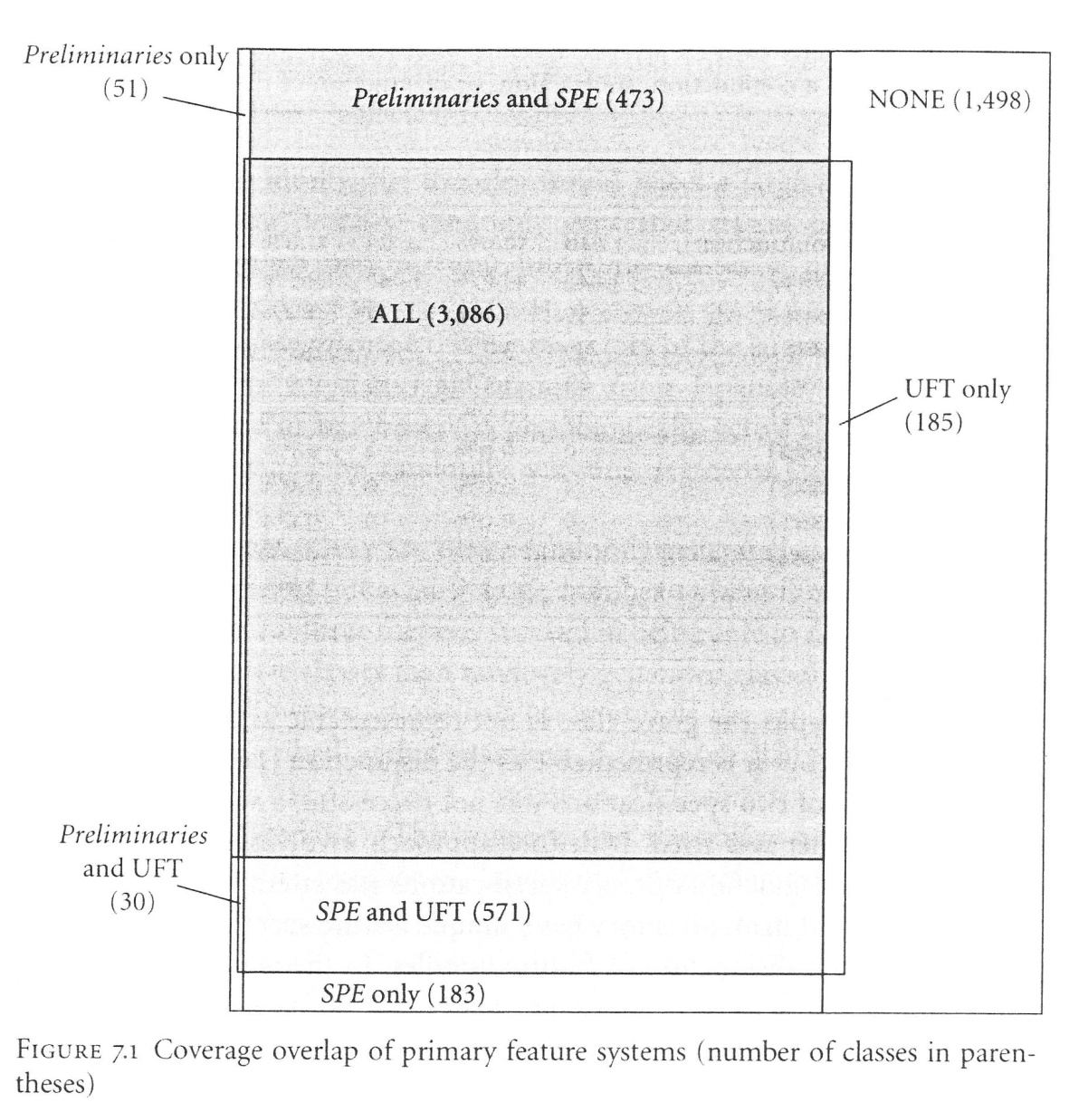
A Different Problem with Distinctive Feature Theory
Mielke (2008) found that the three main feature theories together could account for only 70% of known phonological rules in a survey of 628 language varieties
He used this finding to argue that features were acquired, not innate

Slide 11
Blurring the Phonology/Phonetics Boundary
Various studies have found processes that are clearly specified cognitively, but are not discrete or contrastive
We’ll cover three here: variability in cues, phasing of gestures, and variability in undershoot
This opens up the possibility for a probabilistic approach to phonological categories
Note the evidence that phonemes can be fuzzy and ambiguous around the edges: this challenges the notion of invariance

Slide 12
Variability in Cues Used for Contrasts
This issue is basically about trading relations
Various studies (particularly Kingston & Diehl 1994) have found variation in the cues used for the [voice] feature
Note how Purnell, Salmons, and colleagues found variation for [voice] in Wisconsin English (shown on next slide)
Other examples are the [tense] feature for vowels and the height distinction for vowels

Slide 13
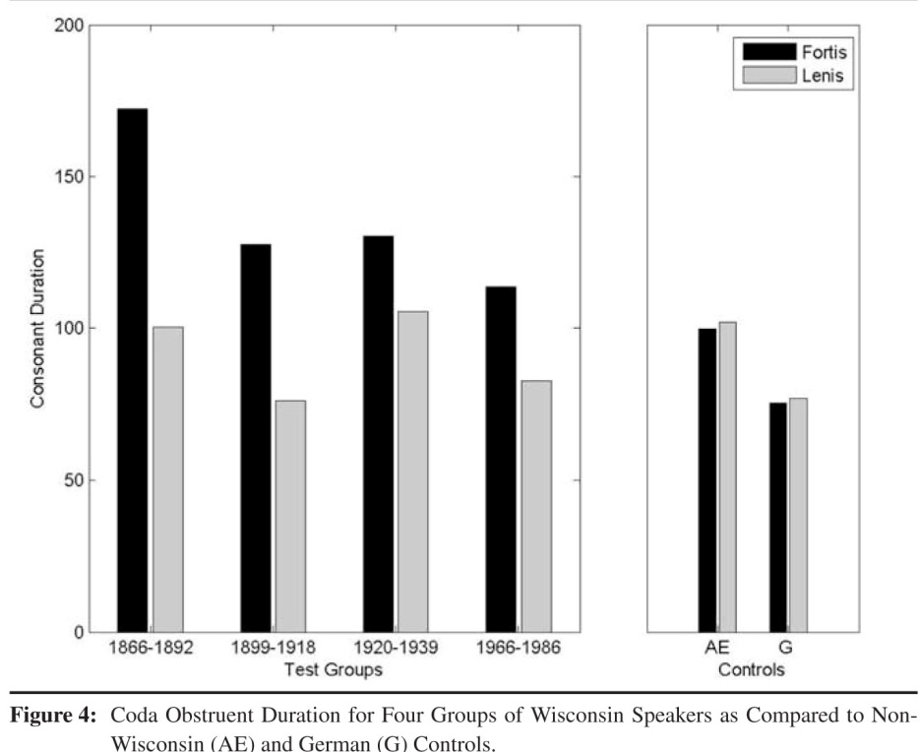
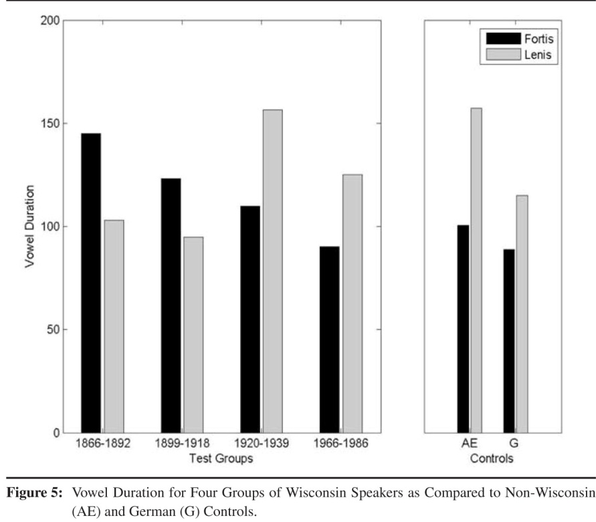
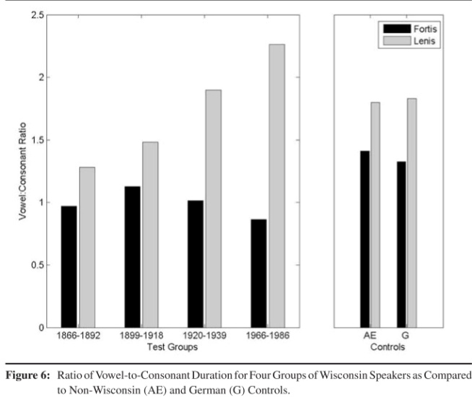
Variability in Cues Used for Contrasts: Results from Purnell et al. (2005)

Slide 14
Phasing of Gestures
We’ve already talked about Fourakis & Port (1986); they proposed that languages vary in the phase rules they used to implement articulatory gestures

Slide 15
Variations in Undershoot
Note that this can apply to vowels, consonants, lexical tone contours, or intonational contours
You’ve already seen the cross-linguistic comparisons of /a/ in Turkish, K’iche’, and English
Here’s a similar difference for a diphthong, as uttered by two speakers who were the same age, were from the same community, and knew each other well

Slide 16
How do you define a phonological category?
After Medin & Barsalou (1987):
By rules: problematic for phonology
By prototypes: but is a prototype an average or an ideal (extreme) form?
By boundaries
By exemplars: a category is a cloud of remembered examples

Slide 17
Prototypes vs. Boundaries (1)
Depends on a prototype being an average form, not an extreme

Slide 18
Prototypes vs. Boundaries (2): The Perceptual Magnet Effect
Perceptual Magnet Effect was first described by Patricia Kuhl (e.g., Kuhl 1991)
If it’s present, discriminability and goodness ratings will differ for prototype and boundary effects

Slide 19
Exemplar Theory
This is what’s called an “episodic” approach
Radically different approach to phonology from traditional views, which are called “abstract” approaches
The discovery that the brain has plenty of storage space, obviating the need for minimalism in phonology, is one factor behind it
It holds that people store detailed knowledge of exemplars, including where, when, and from whom they heard an exemplar

Slide 20
Keith Johnson (1997) “Speech Perception without Speaker Normalization: An Exemplar Model” (1)
The main pretense of the article is human auditory normalization: note that this is the cognitive issue, not the one sociolinguists usually deal with (reduction of interspeaker differences)
All normalization techniques (as well as gesture recovery theories, e.g., Liberman & Mattingly 1985, Fowler 1986) assume that listeners have to normalize. That is, there’s an intermediate step between audition and linguistic processing
p. 146: Exemplar Model: “no abstract category prototypes are posited:” “a perceptual category is defined as the set of all experienced instances of the category”

Slide 21
Keith Johnson (1997) “Speech Perception without Speaker Normalization: An Exemplar Model” (2)
P. 148: speakers “retain speaker-specific information in the long-term category representation (the set of exemplars)”
Word frequency has an effect (see reference to Ganong 1980) because common words have more exemplars that are recent, i.e., fresh in the listeners’ mind
d_{ij} = √(Σw_{m}(x_{im}-x_{jm})²), where
  d_{ij} = Euclidian distance between exemplars i and j
w_{m}= attention weight for m
x_{im} = auditory property m of exemplar i
x_{jm} = auditory property m of exemplar j
s_{ij} = exp(-cd_{ij})
  c = sensitivity constant
s_{ij} = auditory similarity between exemplars i and j

Slide 22
Keith Johnson (1997) “Speech Perception without Speaker Normalization: An Exemplar Model” (3)
Solutions to the “head-filling-up problem:”
There’s more memory space in the brain than generativists assumed
a connectionist model involving mapping of exemplars into auditory space would help solve it
Attention weights and association weights are learned by a neural network method (“feedback on correct categorization”)
The JND (just noticeable difference) effect makes this plausible

Slide 23
Keith Johnson (1997) “Speech Perception without Speaker Normalization: An Exemplar Model” (4)
He suggests that the production/perception link comes from one’s own speech by means of gestural mirages (similar to Liberman’s Motor Theory and Fowler’s Direct Realism*)
In the conclusion, he briefly mentions that his account would explain not only interspeaker recognition, but also
a) recognition of speech at different rates and
b) the fact that increased exposure to a dialect increases your ability to understand it
*Fowler argued that listeners perceive gestures not by means of a specialized decoder, as in the Motor Theory, but because information in the acoustic signal specifies the gestures that form it

Slide 24
John Coleman (2002), “Phonetic Representations in the Mental Lexicon” (1)
Coleman argues that:
1. mental representations of sounds are phonetic, not phonological
2. phonological competence utilizes statistical properties
3. phonetic, statistical, and semantic knowledge account for many “phonological” realms
Basically, he’s against the levels of abstraction proposed by phonologists.
He says that you have to test phonological theories empirically, not philosophically (e.g., judging them by how parsimonious they are)—exactly what John Ohala has said

Slide 25
John Coleman (2002), “Phonetic Representations in the Mental Lexicon” (2)
Various units seem to support an abstract level (but…):
syllable—note, though, that studies of both infants and adults show a link between syllables and statistical probabilities
foot—here, again, statistical probability offers an alternative explanation
mora, onset, rhyme—he basically says only that psychological evidence is shaky for morae but strong for onsets and rhymes
phonemes—beware of evidence from subjects who are alphabetic literates
brain activation studies don’t seem to support phonemes well
Kuhl’s “perceptual magnet effect” construct makes phonemes look like statistical constructs
features—they work insofar as they represent phonetic properties
between a phonetic (with gradual tapering off) and phonological (with abrupt shift) model of phonic boundaries, though, all the evidence favors a phonetic one
phonological categories consist of two dimensions:
continuous physical scale (mostly for production)
continuous probability scale (mostly for perception)

Slide 26
John Coleman (2002), “Phonetic Representations in the Mental Lexicon” (3)
Then he names various other pieces of evidence, among them:
Incomplete neutralization (e.g., German final stops)
Variable rules—but he says that sociolinguists didn’t get them right (the rules were binary except for their output, and you can’t write them without either overgenerating or missing the generalization)
Previous familiarity with a voice increases accuracy of word identification—
therefore, redundant features are stored alongside distinctive ones (recall all the phonetic features used to mark a single contrast)

Slide 27
John Coleman (2002), “Phonetic Representations in the Mental Lexicon” (4)
P. 125: knowledge of word forms includes knowledge of:
1. fine phonetic details, well beyond “phonological features”
2. word frequencies
3. statistical patterns of phonetic variation, as well as correlation with pragmatic context and sociolinguistic factors
He concludes by giving a time/frequency model of linguistic representation

Slide 28
John Coleman (2002), “Phonetic Representations in the Mental Lexicon” (5)
P. 126: new conception of lexical representation
1. word forms are stored as memories of auditory/articulatory experience, not as phonological abstractions
2. phonological constituents are statistical regularities from that experience
3. phonological abilities can arise either from storage (minimal pair discrimination) or on-line (phoneme monitoring)

Slide 29
Exemplar Theory vs. Prototypes
The two give very similar results: in both cases, a target value emerges
The difference is that the target is immobile for a prototype effect but malleable (with exposure to new exemplars) for an exemplar effect
To test them against each other, you’d need an experiment in which you exposed subjects to lots of unusual exemplars and then examined their behavior

Slide 30
Maye, Aslin, & Tannenhaus (2008): “The weckud wetch of the wast: Lexical adaptation to a novel accent”
Listeners heard 20 minutes of The Wizard of Oz with all the front vowels lowered
Then they had to judge whether stimuli were real words or not
Their judgments reflected the vowel lowering they’d heard: they rated lowered vowels as good exemplars
To test whether their judgment norms were lowered or just relaxed (i.e., expanded), they ran a second experiment in which the stimuli included raised vowels
Subjects did not rate the raised vowels as good exemplars

Slide 31
Applications of Exemplar Theory
Child language acquisition
Speech perception, especially as an alternative to normalization
Speech production
Accounting for how language users connect linguistic variants with social identity/ indexicality

Slide 32
How Exemplar Theory Affects Sociolinguistics
It makes sociolinguists look good, since we’ve been saying for years that social factors are part of Grammar
There are lots of fine phonetic variants to use as variables
It puts us on the track to look at mental representation of language
For sound change, the fine phonetic factors are now key (as well as being cognitively encoded)
Also for sound change, the probabilistic component facilitates sound change

Slide 33
Foulkes and Docherty (2006), “The Social Life of Phonetics and Phonology”
They start out talking about the consonantal variation that we saw in another paper by them earlier
On pp. 425-432, they get into Exemplar Theory and how it impacts sociolinguistics

Slide 34
Foulkes and Docherty (2006), “The Social Life of Phonetics and Phonology”
Phonology theories have a lot of trouble with variation; often they ignore it (e.g., SPE); when they do address it, they do it clumsily
optional rules and variable rule orderings (response to generative phonology)
alternative constraint rankings or unordered clusterings of constraints (Optimality Theory)

Slide 35
Foulkes and Docherty (2006), “The Social Life of Phonetics and Phonology”
Exemplar Theory has variation built into it:
lexical representations aren’t stored in abstract or invariant form
language users have detailed memories of exemplars, including both the phonetic realization, the context, and the speaker
that provides a mechanism for sociolinguistic findings that speakers index social meanings with particular variants
the probabilistic aspect of Exemplar Theory accounts for how speakers can change their usage as they mature; building socio-indexical knowledge is part of language acquisition
this also allows for fluidity in socio-indexical meanings

Slide 36
Problems with Exemplar Theory (1): Memory Saturation
Memory saturation is the “head-filling-up problem”
People can’t possibly remember every token they’ve ever heard
To review, Johnson (1997) said that:
There’s more memory space in the brain than generativists assumed
a connectionist model involving mapping of exemplars into auditory space would help solve it
Attention weights and association weights are learned by a neural network method (“feedback on correct categorization”)
Pierrehumbert (2006) added that certain events are more salient, more memorable, to listeners than others. (She cites an analogy of going by a store every day, which loses its saliency.)

Slide 37
Problems with Exemplar Theory (2): Lack of Abstractions
People can learn new words they hear rapidly
A very literal interpretation of Exemplar Theory would hold that only previously heard words can be interpreted
Also, there’s quite a bit of evidence for certain abstractions, e.g., the vowel/consonant distinction or syllables and their constituent parts
This points out the need for some level of abstraction
In actuality, Exemplar Theorists hold that people develop phonological categories through hearing lots of exemplars, and new words are matched to these categories
We’ll come back to this issue when we get to Pierrehumbert (2006) and two other articles I didn’t assign

Slide 38
Problems with Exemplar Theory (3): Lack of Lexical Diffusion in Sound Change
I see this as the weakest of the criticisms
Labov (2006) said that ANAE didn’t find lexical effects
However, he looked only at average values of lots of people; to find lexical effects, you have to treat people as individuals
I suspect he was too fixated on William S-Y. Wang’s (1977) Lexical Diffusion theory, which he mostly opposes

Slide 39
Hybrid Models
Pierrehumbert (2006:524) says that “the future lies with hybrid models, which have multiple levels of representation (like neo-generative models) while also having explicit mechanisms for statistical learning and situational indexing (like exemplar models)

Slide 40
Janet Pierrehumbert (2006), “The Next Toolkit”
There are certain abstract phonological concepts that you simply can’t get around
A strong version of Exemplar Theory doesn’t have a means of accounting for them
There’s also some other evidence: experiments show that likely phonotactics make recognition easier, but lexical neighbors make recognition harder, which suggests that the two processes occur at different levels (stages) in speech perception
The very low correlation between sound and meaning implies that there’s a phonological stage in speech perception
People are also better at learning new words than learning new voices
Ambiguous signals are heard immediately as one word or another (Fast Mapping), not as something amorphous

Slide 41
Janet Pierrehumbert (2006), “The Next Toolkit”
However, Pierrehumbert staunchly defends the statistical properties of language learning, the same ones that make Exemplar Theory attractive to sociolinguists
Pierrehumbert recommends a “combined theory” that retains the store of exemplars and the statistically-based learning of language but allows for some phonological categories
In a hybrid model, there’s a phonological coding level between the phonetic level and the lexical (word recognition) level
However, the phonological categories are learned from statistical interpretations of heard exemplars, not necessarily from a store of innate features (or constraints, or…)
P. 527: “hybrid exemplar models by their nature have frequency effects everywhere. However, more frequent does not necessarily mean more.”

Slide 42
Janet Pierrehumbert (2006), “The Next Toolkit”
Pierrehumbert implies that positional allophones, not phonemes, are what are learned. (This would suggest that phonemes in the traditional sense don’t really exist, which is a valid position.)
Some of Pierrehumbert’s understanding of sociolinguistics (p. 528) is faulty:
Although Clopper and Pisoni (2004) did find a poor ability of listeners to identify dialects, they were comparing very similar dialects, and other comparisons (e.g. Afr. Am./Eur. Am.) have yielded much higher identification levels
Her comments about the Northern Cities Shift jumping from city to city are based on early findings; more recent studies have revealed a much more complex picture

Slide 43
Cynthia Connine & Eleni Pinnow (2006), “Phonological variation in spoken word recognition: Episodes and abstractions”
Review of various experiments those two had been involved in
Experiments had examined tapping and schwa deletion in American English
Tapped variants are cognitively encoded because they’re so common
Schwa-deletion is cognitively encoded for words in which it occurs frequently
In experiments, exposure to an infrequent variant improved word recognition
However, using a different speaker or a different word in the priming and in the test also improved word recognition, suggesting that some abstraction was going on

Slide 44
Cynthia Connine & Eleni Pinnow (2006), “Phonological variation in spoken word recognition: Episodes and abstractions”
Connine & Pinnow assert that these results suggest that there are both episodic and abstract kinds of processing
That means you need a hybrid model

Slide 45
Lynne Clark & Graeme Trousdale (2010), “A cognitive approach to quantitative sociolinguistic variation: Evidence from th-fronting in central Scotland”
They examined fronting of // to [f] in West Fife, Scotland (across the Firth of Forth from Edinburgh) in a 2-year ethnographic study
Lexical frequency was a significant predictor, but social clique, presence of /f/ elsewhere in the word, onset vs. coda position, and type of word (name, ordinal, or other) had stronger effects (all based on Varbrul analysis)
They assert that people choose the variants they use to signal their affiliation with groups. “The repeated co-activation and entrenchment of particular (social and linguistic) nodes and links in the cognitive network enables each speaker to associate social knowledge with particular linguistic variants” (p. 312).
They favor a Hybrid Model involving not only episodic memory but also abstractions away from exemplars—context isn’t just the particular event, but also the wider social context in which a variant is used
We’ll get into choice and social context more in the next two chapters

Slide 46
Small-Group Discussion Questions
Compare and contrast the main tenets of Prototype Theory and Exemplar Theory. Design experiments to test these issues:
Are the two completely incompatible or are there ways that both could operate simultaneously?
Is it plausible that each could predominate at different stages of a person’s life, and if so, how could you test that?
Might they have different degrees of influence on production vs. perception—e.g., when somebody gets used to hearing a dialect different from their own?
2. What advantages and disadvantages does Exemplar Theory have in terms of a) its compatibility with sociolinguistic and phonetic theory and b) testing it empirically?

Slide 47
References
Bloomfield, Leonard. 1933. Language. New York: Holt, Rinehart, and Winston.
Chomsky, Noam. 1967. Discussion. In C. H. Millikan and F. L. Darley (eds.), Brain Mechanisms Underlying Speech and Language, 99-100. New York: Grune & Stratton.
Chomsky, Noam, and Morris Halle. 1968. The Sound Pattern of English. New York: Harper and Row.
Clark, Lynne, and Graeme Trousdale. 2010. A cognitive approach to quantitative sociolinguistic variation: Evidence from th-fronting in central Scotland. In Dirk Geeraerts, Gitte Kristiansen, and Yves Peirsman (eds.), Advances in Cognitive Sociolinguistics, 291-321. Cognitive Linguistics Research, vol. 45. Berlin/New York: De Gruyter Mouton.
Clopper, Cynthia G., and David B. Pisoni. 2004. Some acoustic cues for the perceptual categorization of American English regional dialects. Journal of Phonetics 32:111-40.
Coleman, John. 2002. Phonetic representations in the mental lexicon. In Jacques Durand and Bernard Laks (eds.), Phonetics, Phonology, and Cognition, 96-130. Oxford, UK/ New York: Oxford University Press.
Connine, Cynthia M., and Eleni Pinnow. 2006. Phonological variation in spoken word recognition: Episodes and abstractions. The Linguistic Review 23:235-45.
Foulkes, Paul, and Gerard J. Docherty. 2006. The social life of phonetics and phonology. Journal of Phonetics 34:409-38.
Fourakis, Marios, and Robert Port. 1986. Stop epenthesis in English. Journal of Phonetics 14:197-221.

Slide 48
References (continued)
Fowler, Carol A. 1986. An event approach to the study of speech perception from a direct-realist perspective. Journal of Phonetics 14:3-28.
Ganong, William F., III. 1980. Phonetic categorization in auditory word perception. Journal of Experimental Psychology: Human Perception and Performance 6:110-25.
Jaeger, Jeri J. 1986. On the acquisition of abstract representations for English vowels. Phonology Yearbook 3:71-97.
Johnson, Keith. 1997. Speech perception without speaker normalization: An exemplar model. In Keith Johnson and John W. Mullennix (eds.), Talker Variability in Speech Processing, 145-65. San Diego: Academic.
Kingston, John, and Randy L. Diehl. 1994. Phonetic knowledge. Language 70:419-54.
Kuhl, Patricia K. 1991. Human adults and human infants show a “perceptual magnet effect” for the prototypes of speech categories, monkeys do not. Perception & Psychophysics 50:93-107.
Labov, William. 2006. A sociolinguistic perspective on sociophonetic research. Journal of Phonetics 34:500-15.
Liberman, Alvin M., and Ignatius G. Mattingly. 1985. The motor theory of speech perception revised. Cognition 21:1-36.

Slide 49
References (continued)
Maye, Jessica, Richard N. Aslin, and Michael K. Tanenhaus. 2008. The weckud wetch of the wast: Lexical adaptation to a novel accent. Cognitive Science 32:543-62.
Medin, Douglas L., and Lawrence W. Barsalou. 1987. Categorization processes and categorical perception. In Stevan Harnad (ed.), Categorical Perception: The Groundwork of Cognition, 455-90. Cambridge, UK: Cambridge University Press.
Mielke, Jeff. 2008. The Emergence of Distinctive Features. Oxford, U.K./New York: Oxford University Press.
Ohala, John J. 1986. Consumer‘s guide to evidence in phonology. Phonology Yearbook 3:3-26.
Ohala, John J. 1992. The costs and benefits of phonological analysis. In Pamela Downing, Susan D. Lima, and Michael Noonan (eds.), The Linguistics of Literacy, 211-37. Amsterdam/Philadelphia: John Benjamins.
Pierrehumbert, Janet B. 2006. The next toolkit. Journal of Phonetics 34:516-30.
Purnell, Thomas, Joseph Salmons, Dilara Tepeli, and Jennifer Mercer. 2005. Structured heterogeneity and change in laryngeal phonetics: Upper Midwestern final obstruents. Journal of English Linguistics 33:307-38.
Wang, William S.-Y., ed. 1977. The Lexicon in Phonological Change. Monographs on linguistic analysis, no. 5. The Hague/Paris: Mouton de Gruyter.

