Slide 1
ENG 528: Language Change Research Seminar
Sociophonetics: An Introduction
Chapter 6: Prosody
Sections 6.4-6.5

Slide 2
Preliminaries of Intonation
Boundaries or Juncture: delimit different kinds of phrases or individual words
Edge Tones: mark higher-level boundaries
Pitch Accents: tones that listeners are expected to notice and interpret; not at boundaries

Slide 3
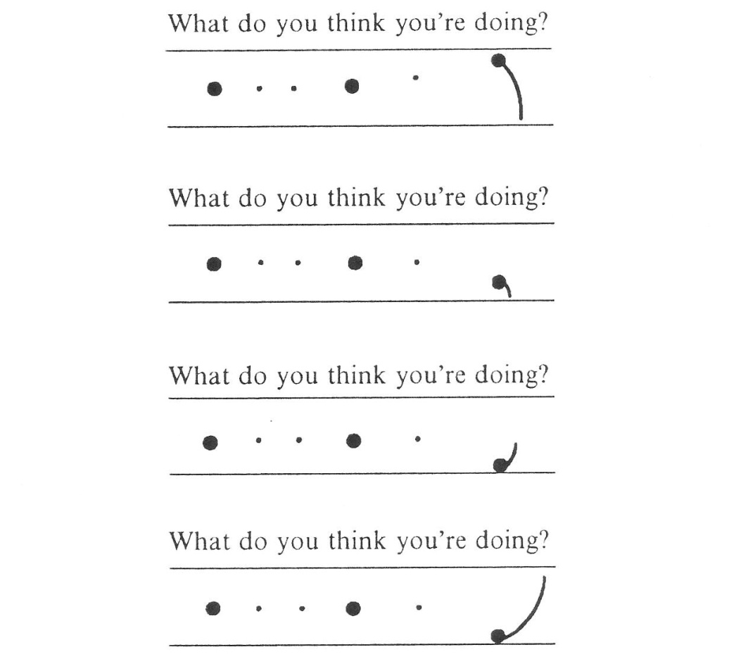
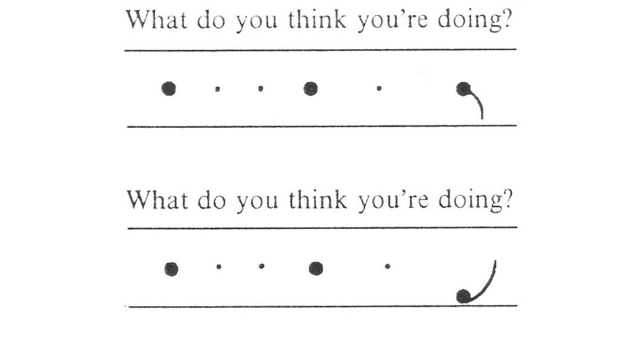
Intonational Transcription (1)
British system: based on contours—see the diagrams with dots and tails in Cruttenden

Slide 4
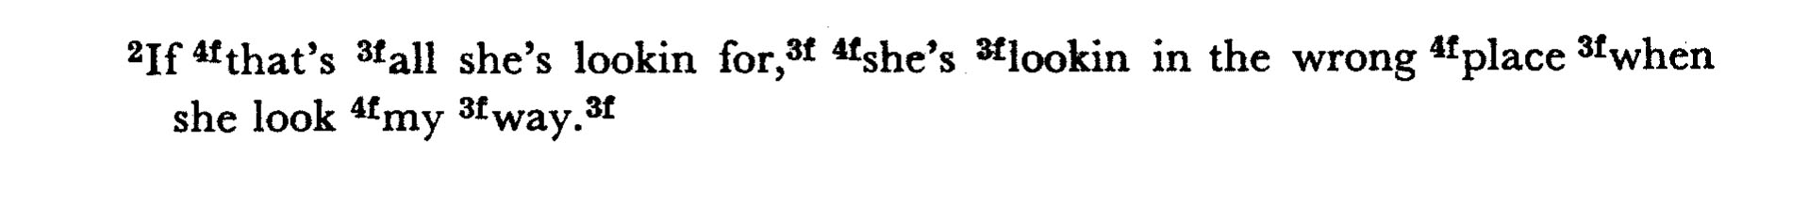
Intonational Transcription (2)
The old Trager & Smith (1951) system: based on four levels
Problem: too arbitrary
Where are the boundaries between levels?
Why four levels instead of some other number?

Slide 5
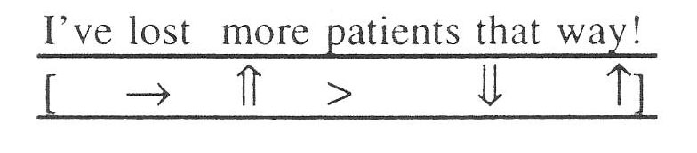
Intonational Transcription (3)
INSTINT (INternational Transcription System for INTonation): designed to be a phonetic system so that it can be used for any language
two horizontal lines indicating the upper and lower pitch limits
↑ = a higher tone
↓ = a lower one
→ = a tone at the same pitch
> = a slight downstep
< = a slight upstep
⇑ = a movement to the upper extreme
⇓ = a movement to the lower extreme
It hasn’t really caught on

Slide 6
Intonational Transcription (4)
Autosegmental approaches: designed as phonological systems
Autosegmental means there are different tiers that are linked together
The main one is the ToBI (Tone and Break Index) system
There are now ToBI systems for over a dozen languages, with more under development
Others include ToDI (Transcription of Dutch Intonation) and IViE (Intonational Variation in English)

Slide 7
Problems with Intonational Transcription
What’s the best transcription system? —For better or for worse, ToBI predominates now
Form-Function Problem: different variants don’t necessarily mean the same thing
Reliability: too much uncertainty and subjectivity in transcriptions
Transcription Speed: the process is awfully slow, especially if you do it thoroughly, with reliability testing

Slide 8
ToBI Components
Obviously, you need a sound signal and a way to see F₀ (usually a pitch track, but superimposing it on a narrowband spectrogram is highly useful)
Tonal Tier: where your transcriptions go
Orthographic Tier: the words spelled out
Break Index Tier: deals with level of juncture; originally intended for speech recognition systems, and thus expendable for intonational analysis
Miscellaneous Tier: for extra comments, such as about uncertainty

Slide 9

Example of a ToBI Transcription
tones
orthographic
break index
miscellaneous

Slide 10
Types of Phrases and Edge Tones (1)
Intonation(al) Phrase (IP): the highest-level phrase
all languages appear to have it
end (and rarely the beginning) marked by a boundary tone
boundary tone is denoted with % (in English, H% or L% at end, and if needed, %H or %L at beginning)

Slide 11
Types of Phrases and Edge Tones (2)
intermediate phrase (ip): next-highest-level phrases
present in English and some other languages, but not all
end is marked by a phrase accent
phrase accent is denoted by – (H-, L-)
Because all IP edges are also ip edges in English, boundary tones will include a phrase accent designation (H-H%, H-L%, L-H%, L-L%)

Slide 12
Types of Phrases and Edge Tones (3)
Accentual phrases (AP) are the lowest-level phrases
Only some languages, such as French, Korean, and Tongan, have them (African American English? Maybe.)
Accentual phrase tones are usually marked with a (Ha, La), though the system for French works differently (with a basic L H L H* structure)
Accentual phrases most often consist of a single content word and, optionally, function words

Slide 13
The L-L% Edge Tone
L-L% is used for ordinary statements
It’s by far the most common edge tone
Tone will be low at end (but don’t be fooled by a pitch track that shows an erroneous upward movement or is influenced by the final consonant)

Slide 14
The H-H% Edge Tone
H-H% is used for yes/no questions
It occasionally appears elsewhere, such as in conveying excitement
It involves a sharp rise in pitch

Slide 15
The L-H% Edge Tone
L-H% is often called the “continuation rise” because one of its most common uses is to indicate that the speaker isn’t done talking
It has a rise at its end that isn’t as strong as the rise for H-H%

Slide 16
The H-L% Edge Tone
In English, H-L% represents a final level tone, not a falling one
In some other languages, such as German, H-L% is used for an edge tone that really does have a falling tone
H-L% shows up from time to time; one use is in reciting lists

Slide 17
Break Index
Used to represent different kinds of juncture
Not essential for intonational transcription
For English:
4=IP boundary
3=ip boundary
2=mismatch in degree of juncture and tonal marking
1=most word boundaries
0=words that are bound together by cliticization or a phonological process (tapping of medial coronals is a common case)

Slide 18
Pitch Accents (1)
Pitch accents are denoted with * (e.g., H*, L*+H)
If a syllable has a pitch accent, it’s marked by having a noticeably different pitch than the preceding syllables
The most prominent pitch accent in an Intonational Phrase is called the nucleus; it’s considered to be the last pitch accent in the IP
Different languages have different inventories of pitch accents; some have pitch accents that English lacks, such as H*+L or H+L* (see Jun 2005)
A few languages (Korean and Cantonese are described so far) lack pitch accents altogether

Slide 19
Pitch Accents (2)
Pitch accents normally have a stressed syllable as their host syllable
However, not every stressed syllable has a pitch accent
To have a pitch accent, a syllable has to stand out tonally compared with nearby syllables

Slide 20
The H* Pitch Accent
This is one of the common ones in English
Its highest point is at or very close to the onset of the vowel in its host syllable

Slide 21
The L+H* Pitch Accent
This is the other common one in English
It’s similar to H*, but the peak is later, with a noticeable slope leading up to the peak

Slide 22
The L*+H Pitch Accent
Often called a “scooped” accent; infrequent
Similar to L+H*, but the peak is even later—on the next syllable—and there’s a sustained low tone

Slide 23

The L* Pitch Accent
Somewhat uncommon in English except in yes/no questions, where it appears right before the edge tone
The rise after it is accounted for by the edge tone

Slide 24
The H+!H* Pitch Accent
Relatively rare; usually connotes disappointment, annoyance, or disgust

Slide 25
Downstepping
Denoted by ! (as in !H*)
Occurs when you have two H tones in a row, but the second is noticeably lower than the first
Be sure there’s no phrasal break between the tones

Slide 26
Peak Delay (Peak Alignment)
Peak delay = distance in ms between onset of syllable and point of highest F₀

Slide 27
Segmental Anchoring of pitch accents
Closely connected to the peak delay
For a pitch accent, proportion =
[(vowel offset)-(pt. of maximum F₀)]/(duration of vowel)

Slide 28
Segmental Anchoring of edge tones
For an edge tone, compute the distance of the interval between the vowel onset and last F₀ reading and determine where the peak/trough occurs relative to that interval

Slide 29
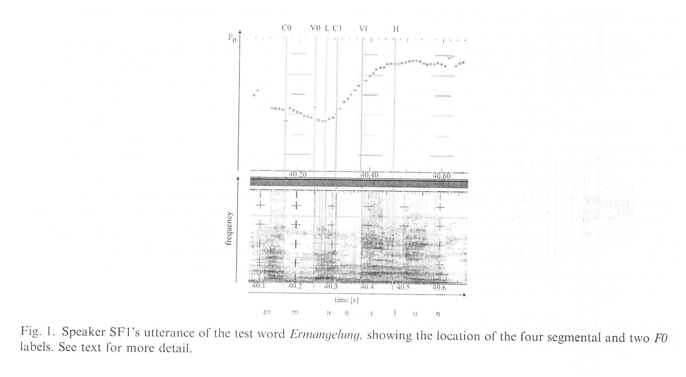
Peak Delay: Atterer & Ladd (2004)

Slide 30
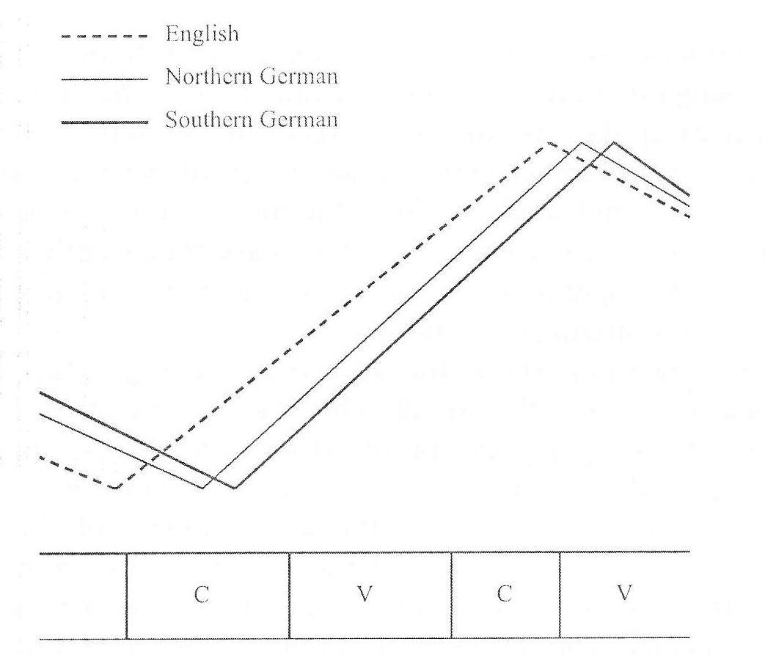
Peak Delay: Atterer & Ladd (2004)

Slide 31
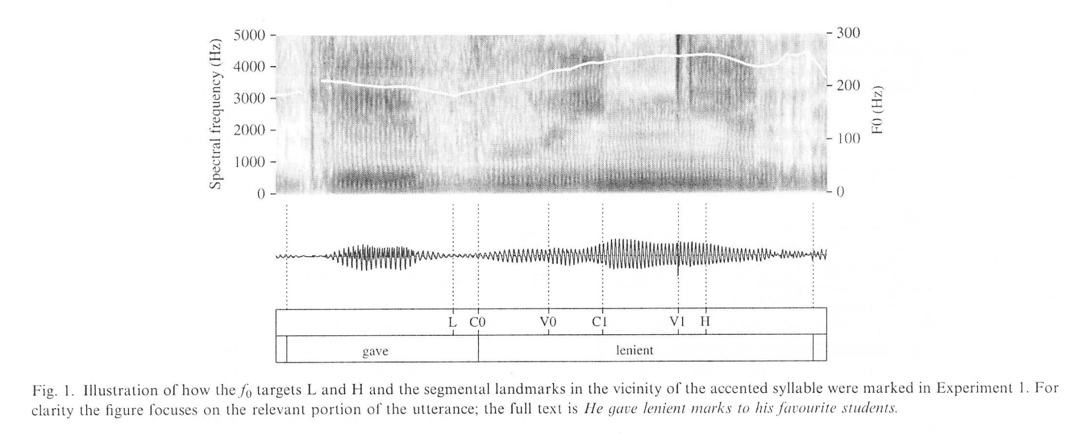
Peak Delay: Ladd et al. (2009)
Their first experiment dealt with pre-nuclear pitch accents.

Slide 32
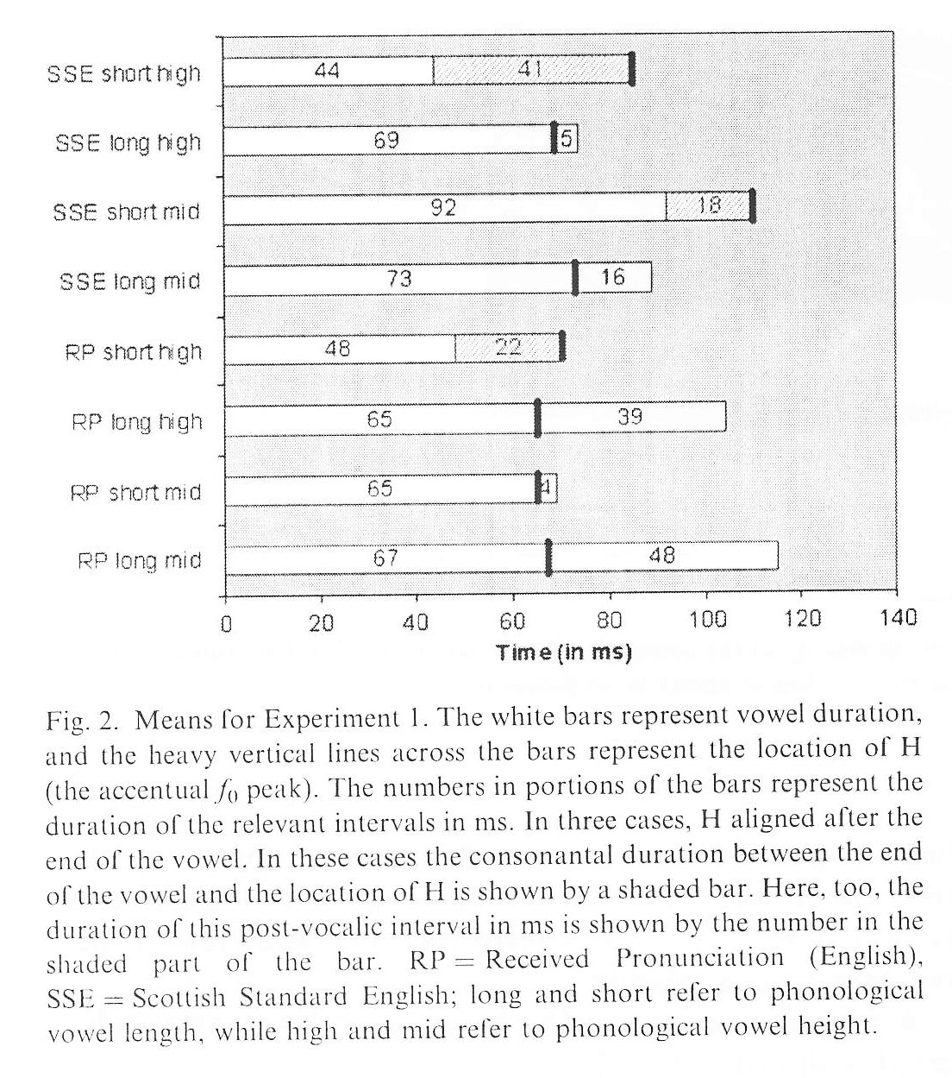
Peak Delay: Ladd et al. (2009)
Results for pre-nuclear pitch accents.
Peaks are aligned later in Standard Scottish English than in RP.
Also, peaks are aligned later for short vowels than for long vowels.

Slide 33
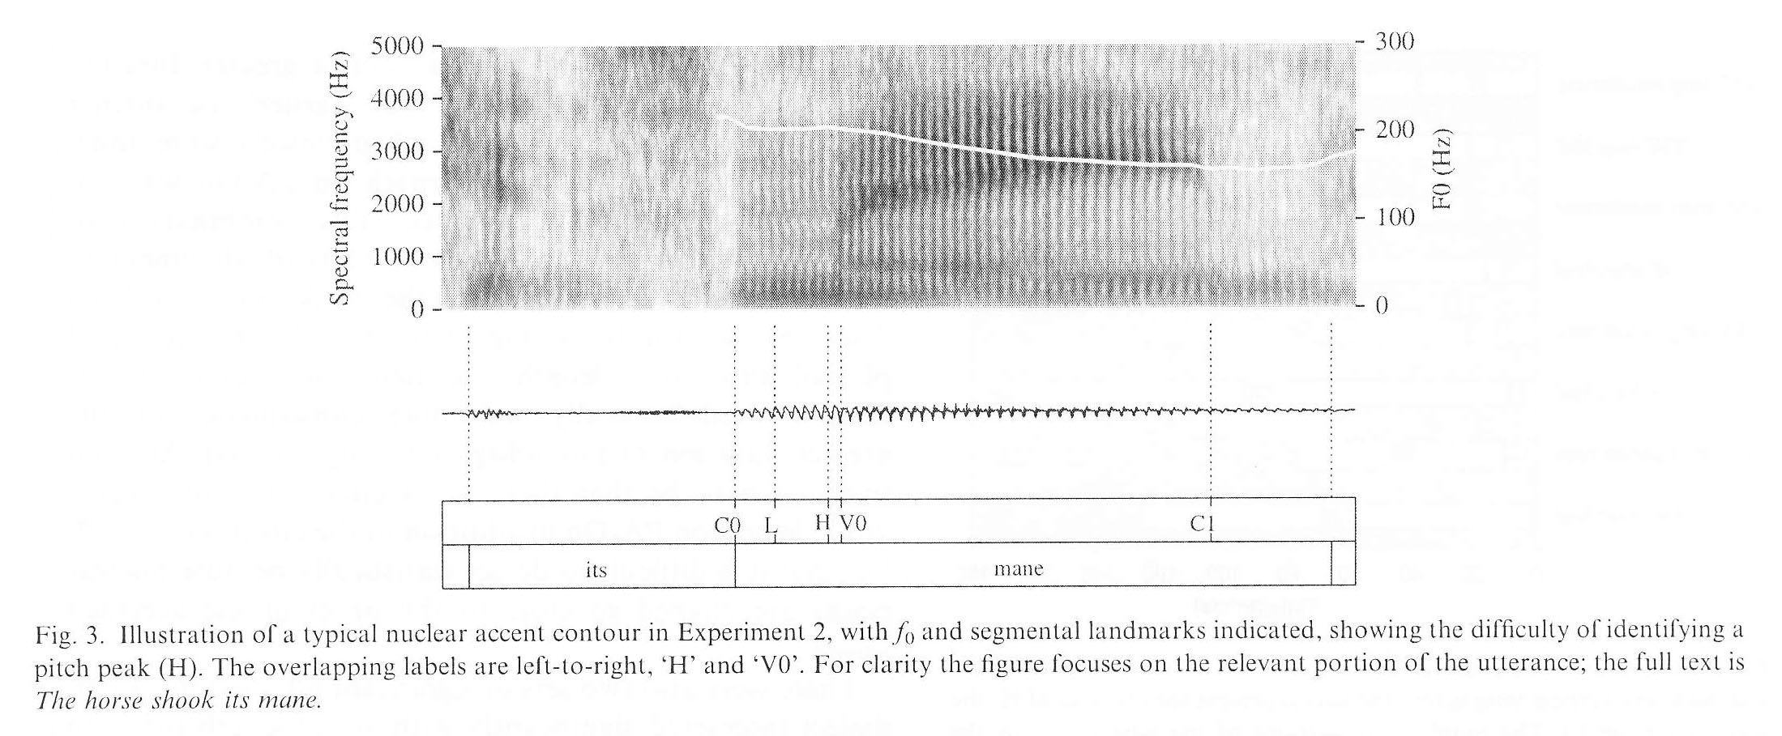
Peak Delay: Ladd et al. (2009)
Second experiment: nuclear pitch accents

Slide 34
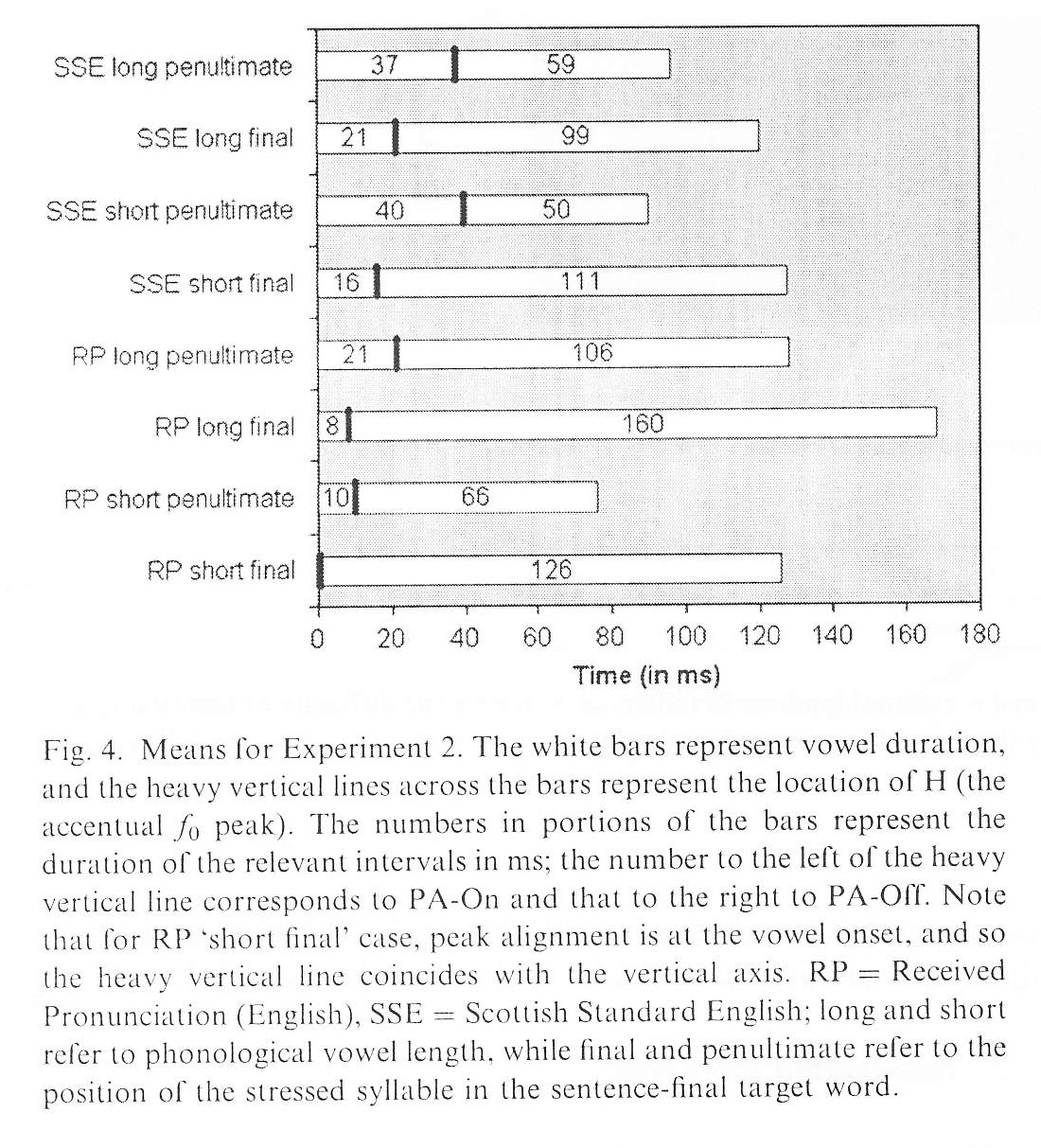
Peak Delay: Ladd et al. (2009)
Peaks were much earlier for nuclear pitch accents than for pre-nuclear ones. Presumably, this is due to tonal crowding from the edge tone.
The dialectal difference between Std. Scottish Eng. And RP reappeared, however.

Slide 35
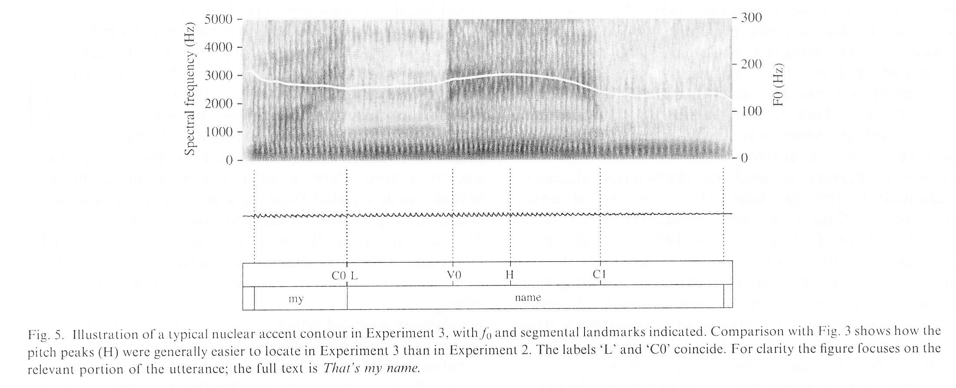
Peak Delay: Ladd et al. (2009)
Experiment 3: nuclear pitch accents in sentences without pre-nuclear pitch accents

Slide 36
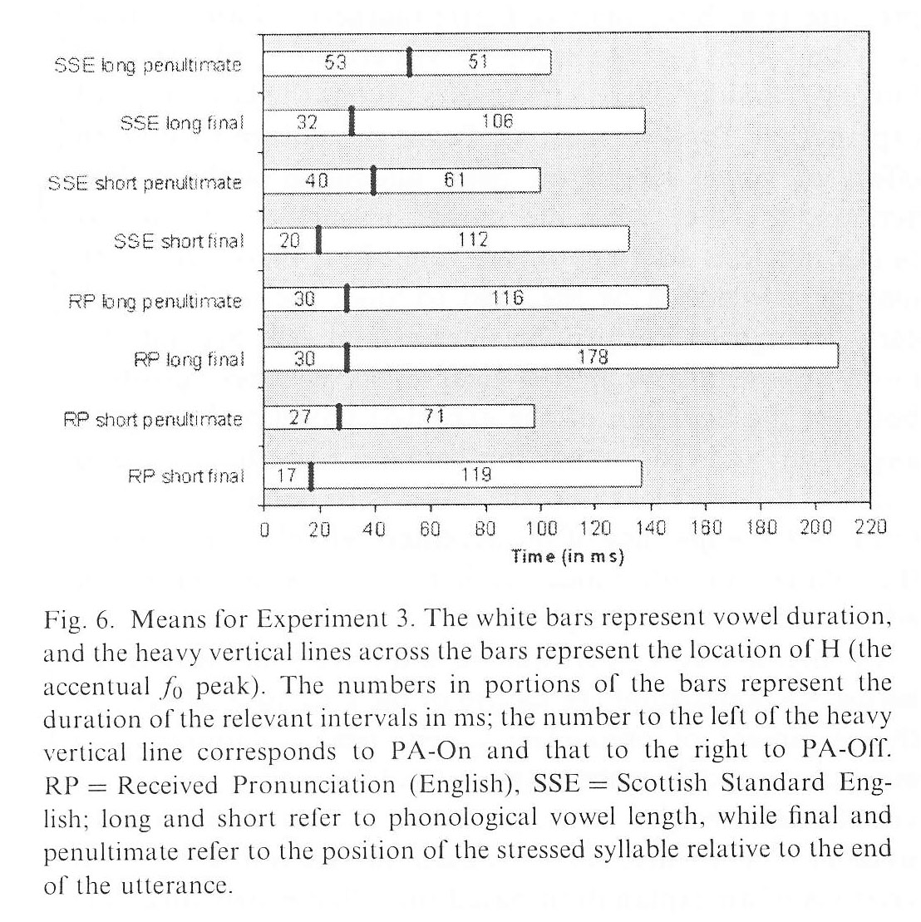
Peak Delay: Ladd et al. (2009)
All the earlier findings were confirmed.

Slide 37
Compression vs. Truncation
When the duration of a tonal contour is reduced, what happens to it?

Slide 38
Pitch Excursion and F₀ slopes
Useful measures for truncation
For pitch excursion, subtract F₀ of trough from F₀ of peak
For slope, divide excursion by the time between trough and peak

Slide 39
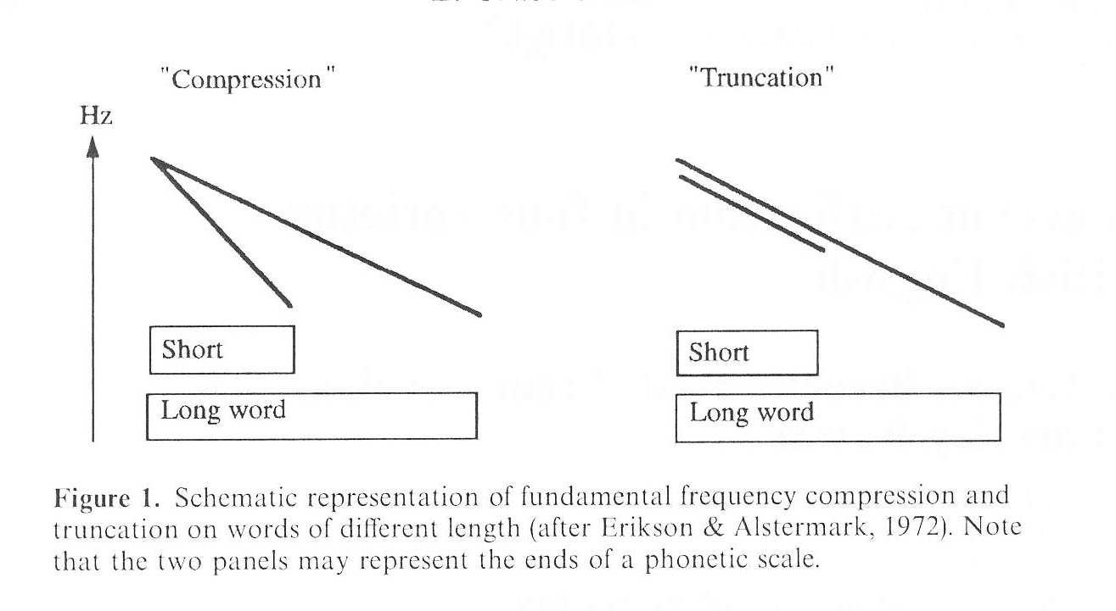
Compression & Truncation: Grabe et al. (2000)

Slide 40
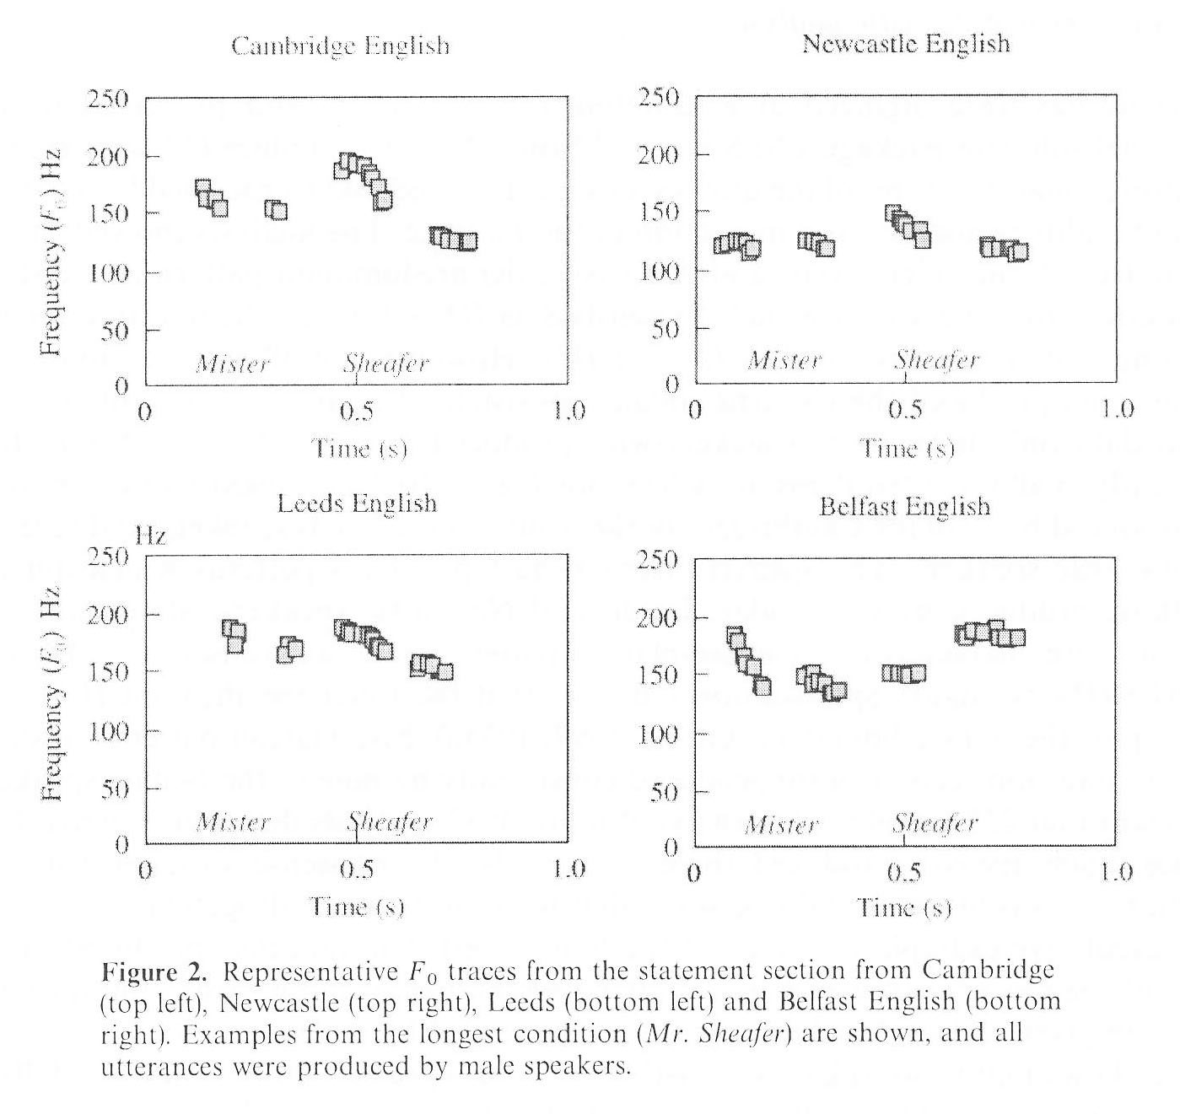
Compression & Truncation: Grabe et al. (2000)

Slide 41
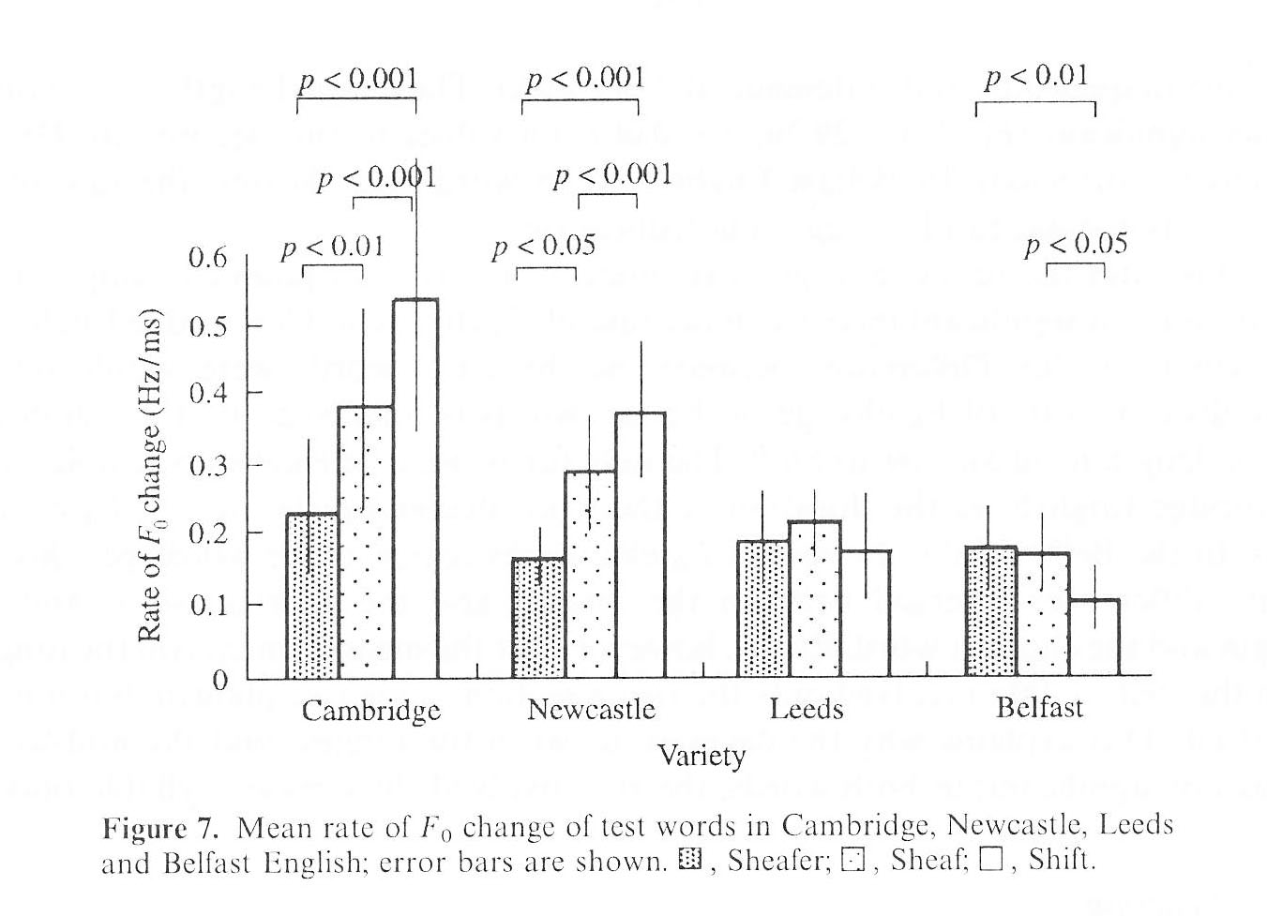
Compression & Truncation: Grabe et al. (2000)

Slide 42
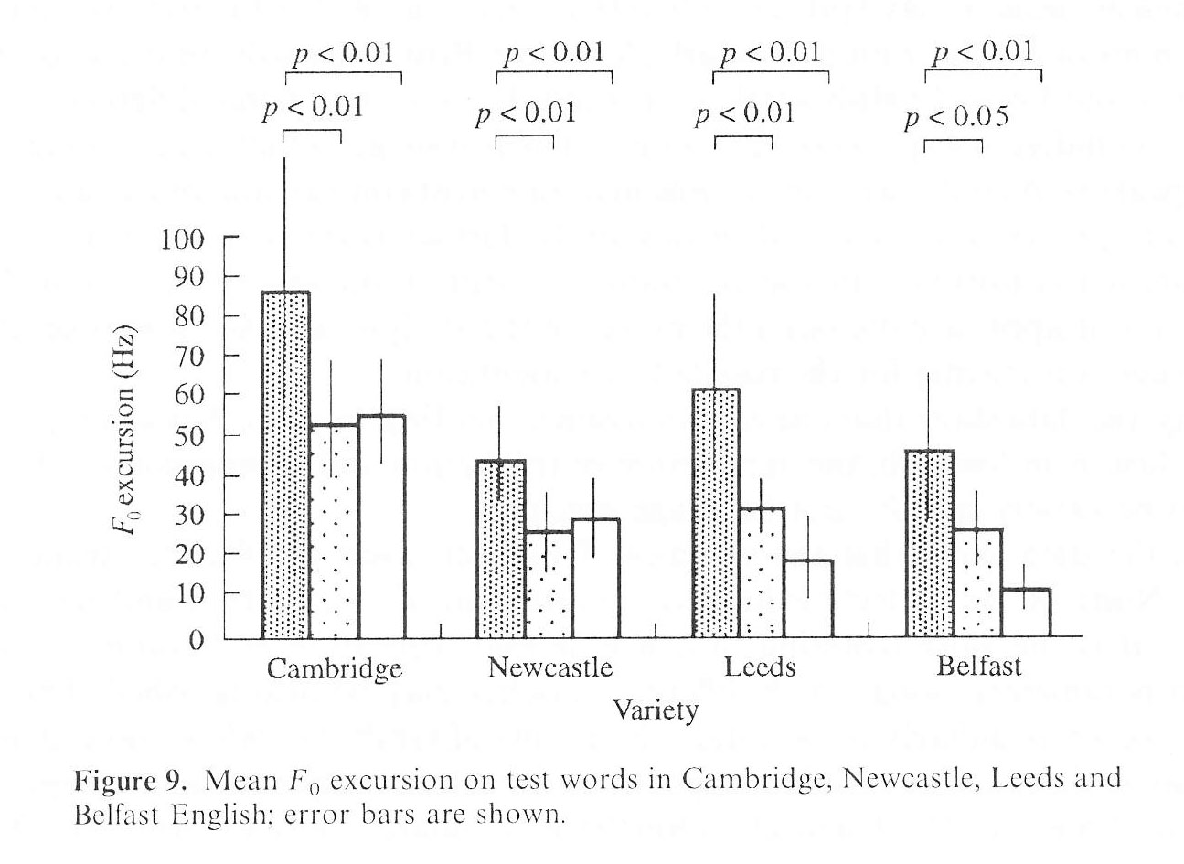
Compression & Truncation: Grabe et al. (2000)

Slide 43
Dialectal Variation in Intonation
We just saw some examples of dialectal variation
Three ways dialects can vary in intonation:
Different inventories of pitch accents, edge tones, kinds of phrases
Different use of same tone; usually accompanied by semantic difference
Different phonetic realization of same tone

Slide 44
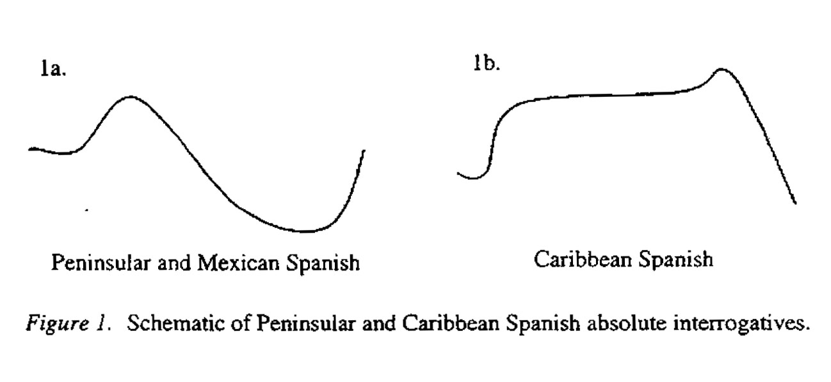
An example of differential use of tones
¿Miraba la luna? (‘Is he gawking at the moon?’)

Slide 45
Cruttenden (1997)
The excerpts were on dialectal variation
A lot has happened since he published the book these excerpts came from
He notes that there’s considerable intonational variation in the British Isles; even Americans can distinguish southern English, northern English, and Scottish intonation
He also discusses HRT, or high rising tunes, which are most prevalent in Australia and New Zealand but also occur sporadically in North America; characterized by final H-H% or L-H% tones

Slide 46
Tarone (1973)
Though early, it’s perhaps the best-known paper on what makes AAE intonation distinctive
AAE intonation has been a frustrating topic—nobody can seem to lay their finger on what makes it distinctive
Note that variation within AAE, particularly social-class-based and stylistic variation—has probably obscured the answer
You have to look at the most divergent forms, not the average form, to find the answer. Why?

Slide 47
Summary of Past Findings on AAE Intonation
 | AAE | EAE
Declaratives | More stresses More Pitch Accents (PAs) postnuclear PAs? | Fewer stresses Fewer PAs No postnucl.PAs
Yes/No questions | Falling final contours Level final contours Various PAs | Low PAs
Overall F₀ | Wider pitch range Use of falsetto | Greater F₀ falls

Slide 48
Accentual Phrases in AAE?
Suggested by Jennifer Cole when I was working with her
Jason McLarty has examined it recently
A complication is the trochaic pattern of English; most other languages described as having APs have an iambic structure

Slide 49
Declination
Tendency of F₀ to fall over the course of an utterance
Can be measured in Hz (or better, ERB) per time
You have to control for length of utterance

Slide 50
Pre-Boundary Lengthening
We’ve already seen that the final syllable or foot of an utterance is prolonged
Is there any variation in pre-boundary lengthening? Nobody knows at this point
One possible approach is described in the book; other approaches could also be tried

Slide 51
References
The diagram on slide 3 is taken from:
Cruttenden, Alan. 1997. Intonation. Cambridge, UK: Cambridge University Press.
The diagram on slide 4 is taken from:
Tarone, Elaine E. 1973. Aspects of intonation in Black English. American Speech 48:29-36.
The diagram on slide 5 is taken from:
Hirst, Daniel, and Albert Di Cristo. 1998. Intonation Systems: A Survey of Twenty Languages. Cambridge, UK: Cambridge University Press.
The diagram on slide 44 is taken from:
Willis, Eric W. 2004. Dominican Spanish absolute interrogatives in broad focus. In Timothy L. Face (ed.), Laboratory Approaches to Spanish Phonology, 62-90. Phonology and Phonetics, vol. 7. Berlin/New York: Mouton de Gruyter.

Slide 52
References (continued)
Other sources:
Atterer, Michaela, and D. Robert Ladd. 2004. On the phonetics and phonology of “segmental anchoring” of F0: Evidence from German. Journal of Phonetics 32:177-97.
Grabe, Esther, Brechtje Post, Francis Nolan, and Kimberley Farrar. 2000. Pitch accent realization in four varieties of British English. Journal of Phonetics 28:161-85.
Jun, Sun-Ah. 2005. Prosodic typology. In Sun-Ah Jun (ed.), Prosodic Typology: The Phonology of Intonation and Phrasing, 430-58. Oxford, UK: Oxford University Press.
Ladd, D. R[obert], Astrid Schepman, Laurence White, Louise May Quarmby, and Rebekah Stackhouse. 2009. Structural and dialectal effects on pitch peak alignment in two varieties of British English. Journal of Phonetics 37:145-61.
Trager, George L., and Henry Lee Smith. 1951. An Outline of English Structure. Norman, OK: Battenburg Press.

