Slide 1
ENG 528: Language Change Research Seminar
Sociophonetics: An Introduction
Chapter 6: Prosody
Sections 6.1-6.3

Slide 2
What’s Prosody?
Anything non-segmental in phonology or phonetics, including:
pauses
rate of speech
lexical tone
word stress
rhythm
intonation
These factors are mainly based on:
timing
pitch (≡F₀ frequency)
loudness (≡amplitude)

Slide 3
Pauses
Some terminology:
silent pause=literally silent
filled pause=made up of a hesitation marker, such as uh or um or you know or like in English, eh or este in Spanish, etc.

Slide 4
Measurement of Pauses
Usually, the duration of the pause is measured
Lower and upper limits of what counts as a pause is an issue
Durations of both pauses and speech can be plotted in what Kendall dubbed a “Henderson graph” (after Henderson et al. 1966)

Slide 5
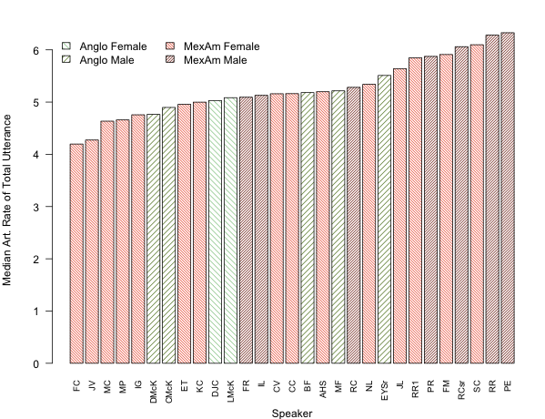
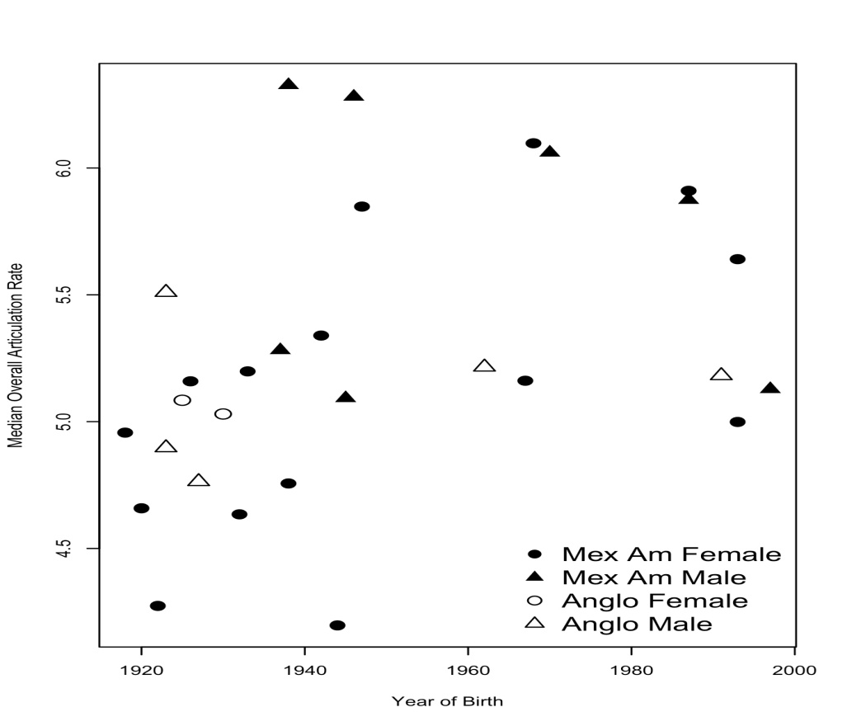
Rate of Speech
Speaking rate=number of syllables per unit of time, including silent pauses
Articulation rate=number of syllables per unit of time, with silent pauses excluded

Slide 6
Lexical Prosody
Aspects of prosody that depend on word structure
Definitions:
lexical tone=distinctive pitches are applied to each syllable in a word
lexical pitch accent=distinctive pitches are applied to some syllables, but not all
lexcial stress=some syllables are pronounced more forcefully than others; the particular cues used to signal forcefulness may vary
prosodic rhythm=the tendency of the timing of syllables to be relatively even or uneven

Slide 7
Tone: Some Definitions
Two types of tones:
level (register) tones—no intrinsic contours; only one pitch specified
contour tones—the tone is specified to change its pitch within it (controversy: are the high and low targets specified or is the contour specified?)
Host syllable=the syllable that a tone is specified for (and you can speak of a host vowel, too)

Slide 8
Properties of Tones
Implementation of a tone starts at the onset of its host syllable, but its effects usually last well into the following syllable. In fact, for a rising tone, the point of highest F₀ is quite often in the following syllable.
F₀ doesn’t start off at its target value, but it gradually gets closer and closer to the target value, and it gets closest at the syllable offset. (In terms of targets, tones show undershoot much like vowels.)
The perseveratory effect from a preceding tone is assimilatory—e.g., a preceding low tone makes a tone lower than a preceding high tone. However, the anticipatory effect to a following tone is dissimilatory—e.g., a high tone will be higher when the next syllable has a low tone than when it has another high tone.
When a tone-bearing syllable is emphasized, F₀ in later syllables is lowered overall.
(This is on p. 190 of the textbook.)

Slide 9

Example from Mandarin

Slide 10
Measuring Tone
You’ll need a way to measure F₀ continuously, whether with an autocorrelation pitch track or a narrowband spectrogram
You’ll also need a textgrid to show where the syllables and/or vowels begin and end
Measure F₀ and record the timepoint at various places: peak, trough, onset of host syllable or host vowel, offset of host syllable or host vowel
It’s a good idea to convert from Hz to ERB
Normalization is often necessary

Slide 11
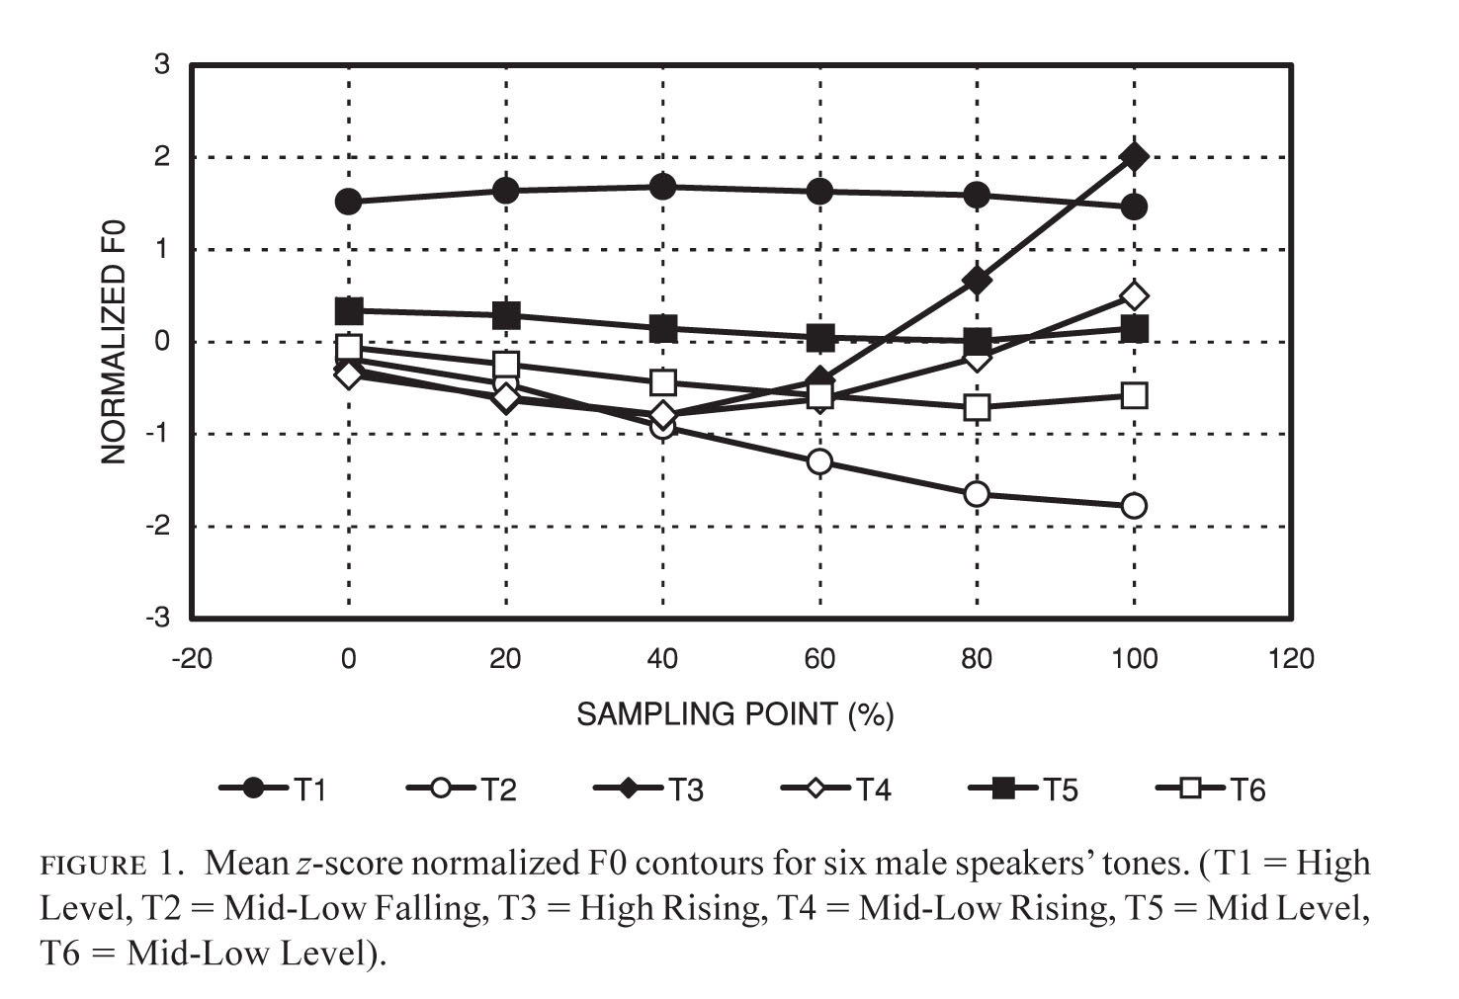
Tonal Variation: Bauer et al. (2003)
They were interested in a tonal merger in Hong Kong Cantonese
H.K.C. has nine tones—6 in open and nasal-closed syllables and three in stop-closed syllables
Used a formula to normalize tone

Slide 12
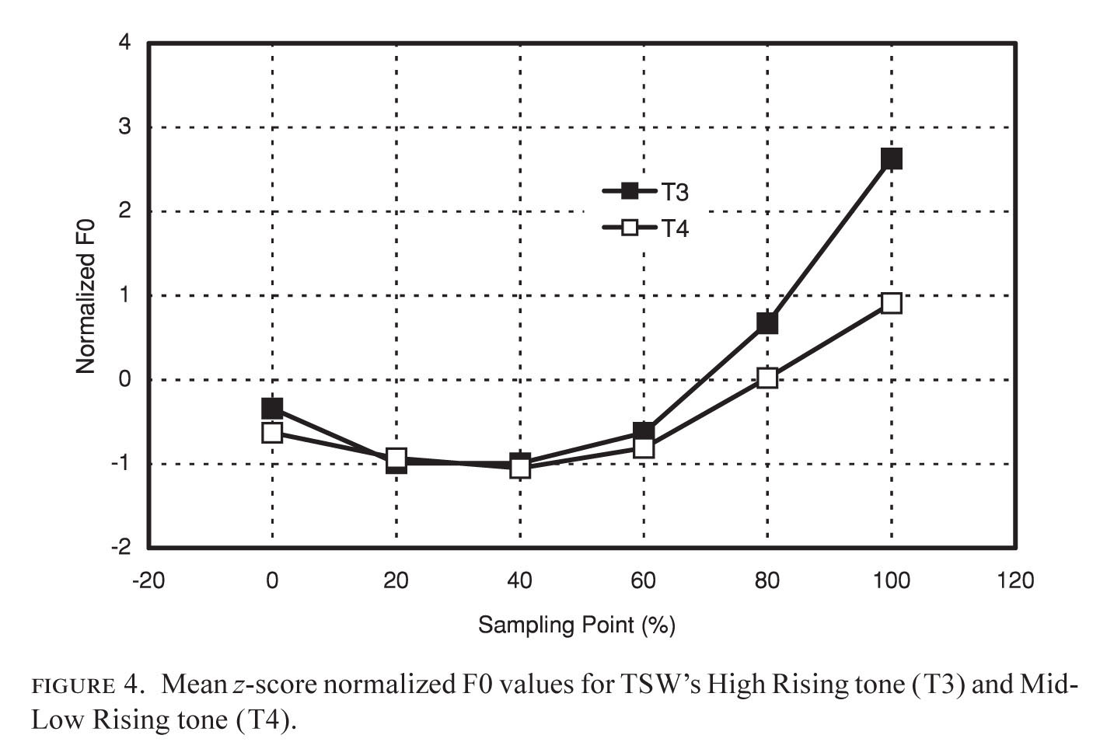
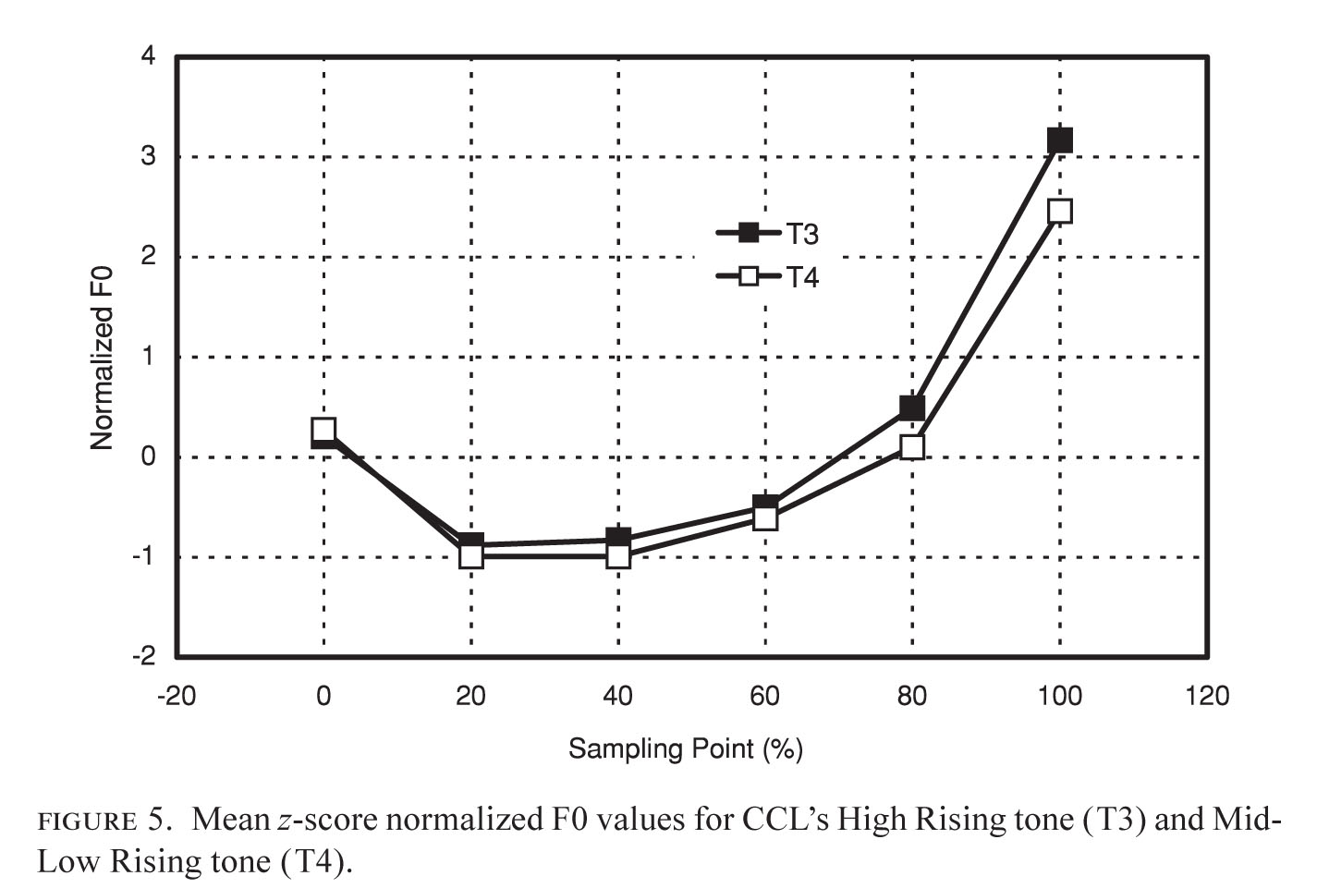
Tonal Variation: Bauer et al. (2003)
Speakers without (left) and with (right) merger

Slide 13
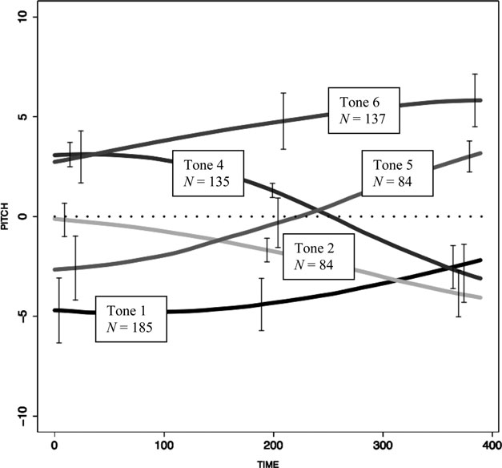
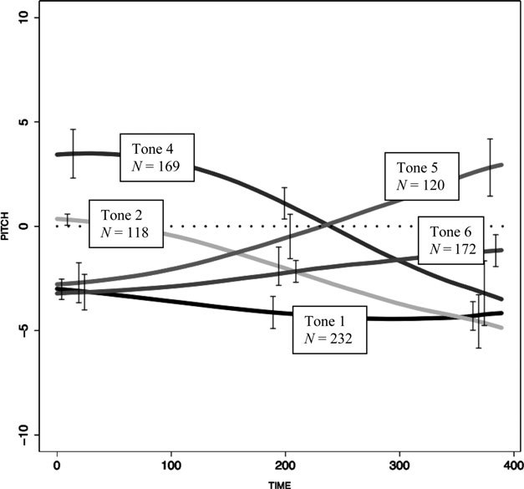
Tonal Variation: Stanford (2008)
Looked at variation in the realization of a tone in Sui (interested in what women in extra-dialectal marriages did)
Normalized based on the frequency of the mid level tone, in ERB
Note differences in Tones 1 and 6 between Southern (left) and Northern (right) Sui

Slide 14
Lexical Stress
Whereas tone is realized primarily through pitch, stress often (but apparently not always) depends more on loudness and duration
In English, we add phonological vowel reduction to the cues: e.g. noun and verb forms of record
There’s some stereotypical (e.g., cement, insurance, July) and some less noticed (e.g., noun forms of defense, permit, and address) variation in English
Analyze amplitude much as you do F₀ frequency, taking declination into consideration just as you have to for F₀ frequency
You’d also need to analyze duration

Slide 15
Prosodic Rhythm
Traditionally viewed as
syllable-timing (each syllable with same duration) vs.
stress-timing (each foot with same duration)
with mora-timing thrown in for good measure

Slide 16
Problems with the Prosodic Rhythm Concept
Supposed syllable-timed languages weren’t isochronous: syllable durations were not all the same or even close
No significant differences in timing between stresses in syllable-timed and stress-timed languages

Slide 17
The Big Breakthrough
In the 1980s, it was suggested that rhythm was a gradient feature—not an absolute feature
That opened the door to the development of formulas for computing rhythm

Slide 18
A Necessary Precursor
For any kind of rhythm measurement, it’s necessary to demarcate the boundaries of segments and/or syllables
Durations are then measured

Slide 19
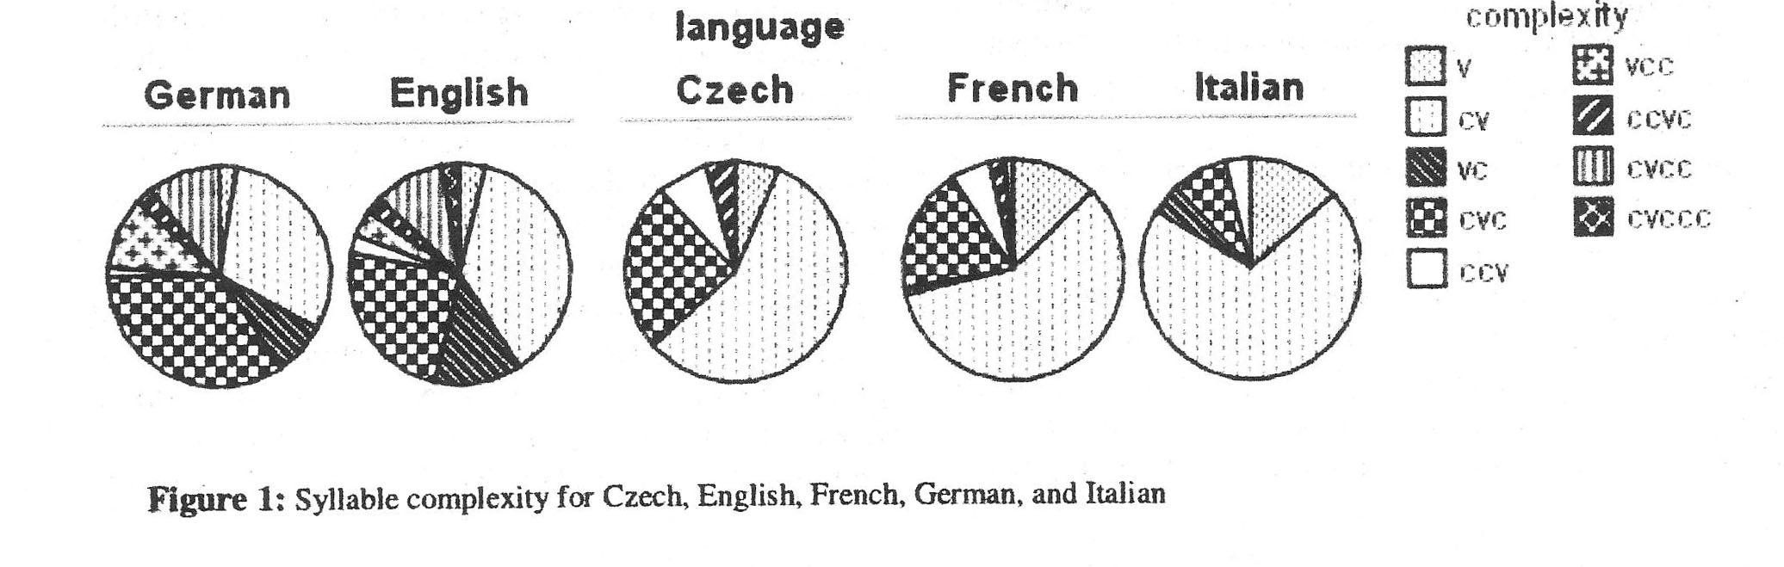
Interval Measures (1)
One approach was to base formulas on phonotactic properties of languages
This approach assumes that rhythm is entirely a function of phonotactics

Slide 20
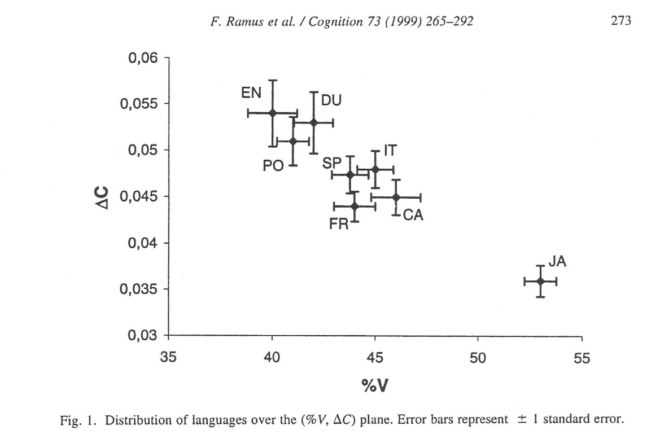
Ramus, Nespor, & Mehler (1999)
ΔV = standard deviation of the durations of the vocalic intervals
ΔC = standard deviation of the durations of the consonantal intervals
%V = percentage of the duration of utterance made up of vocalic intervals

Slide 21
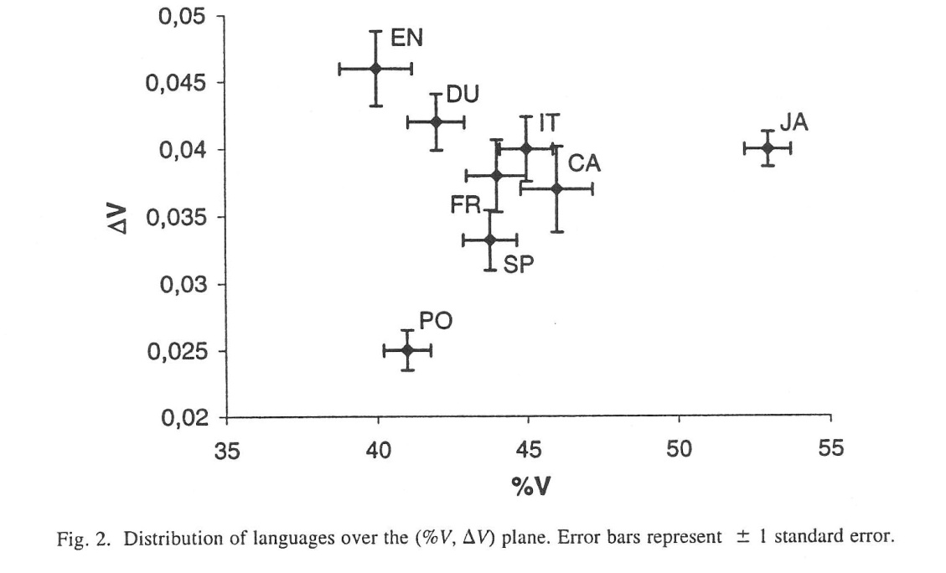
Ramus, Nespor, & Mehler (1999)
ΔV = standard deviation of the durations of the vocalic intervals
ΔC = standard deviation of the durations of the consonantal intervals
%V = percentage of the duration of utterance made up of vocalic intervals

Slide 22
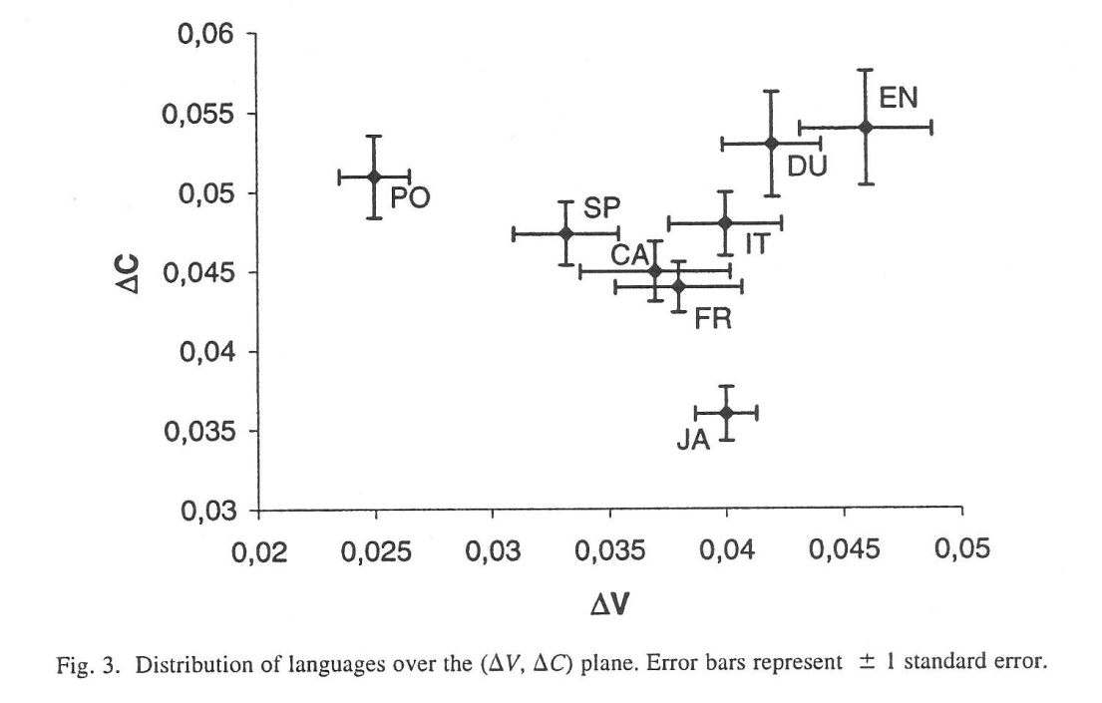
Ramus, Nespor, & Mehler (1999)
ΔV = standard deviation of the durations of the vocalic intervals
ΔC = standard deviation of the durations of the consonantal intervals
%V = percentage of the duration of utterance made up of vocalic intervals

Slide 23
Ramus, Nespor, & Mehler (1999)
higher ΔC values and
lower %V values
are associated with stress-timing,
but ΔV seems to describe something else

Slide 24
Dellwo (2006)
VarcoΔC = 100(ΔC)/C, or
VarcoΔC = 100 x (standard deviation of consonantal interval durations) / (mean consonantal interval duration)
Higher VarcoΔC values are associated with stress-timing
Added by White and Mattys (2007b):
VarcoΔV = 100(ΔV)/V, or
VarcoΔV = 100 x (standard deviation of vocalic interval durations) / (mean vocalic interval duration)
Higher VarcoΔV values are associated with stress-timing

Slide 25
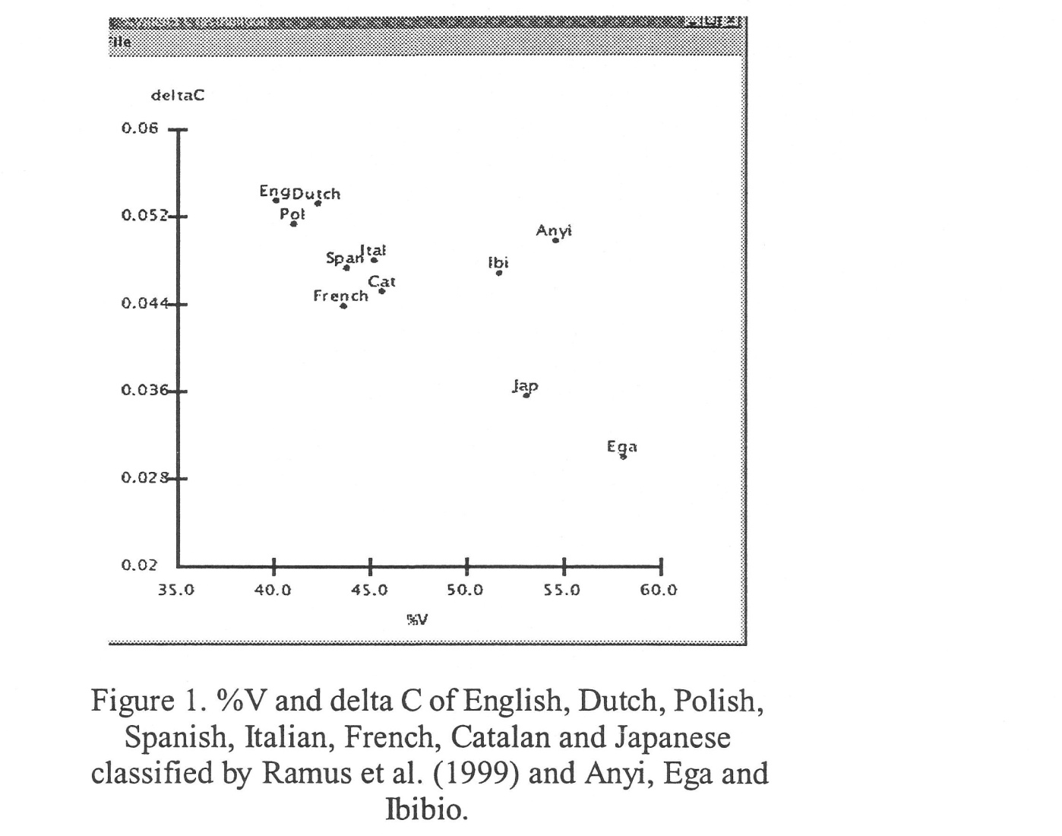
Counterevidence
Some studies have disputed that rhythm is purely a function of phonotactics: here’s Gut et al. (2002)
Anyi has consonant clusters but no consonantal codas
Ega has consonant clusters and a few consonantal codas
Ibibio has many consonantal codas but the few consonant clusters have to have a semivowel as the 2nd element
All three appear as syllable-timed using the %V x ΔC scheme

Slide 26
Pairwise Variability Measures
The most commonly used is Low, Grabe, and Nolan’s (2000) nPVI formula:
m-1 d_{k} – d_{k+1}
nPVI = 100×[ Σ | —————— | / (m-1) ]
k=1 (d_{k} + d_{k+1})/2
Put another way, it divides the difference between vowels in adjacent syllables by the mean of the same two vowels
This is easily done in Excel

Slide 27
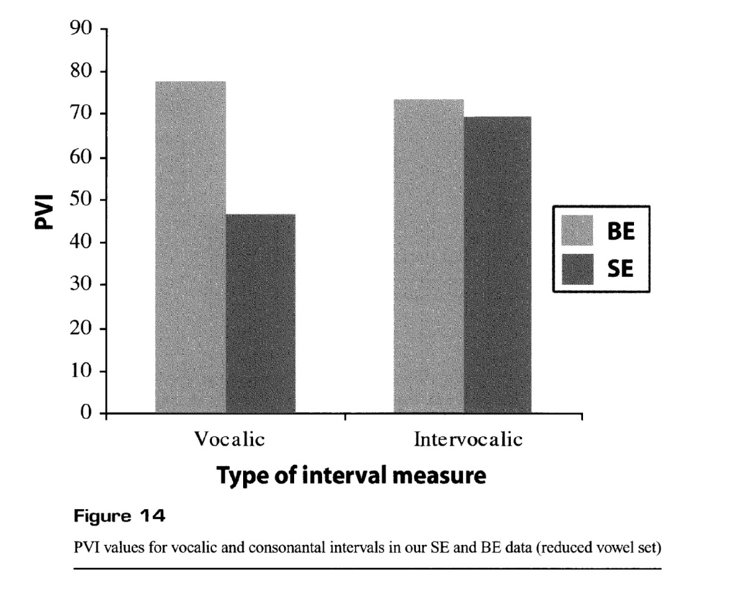
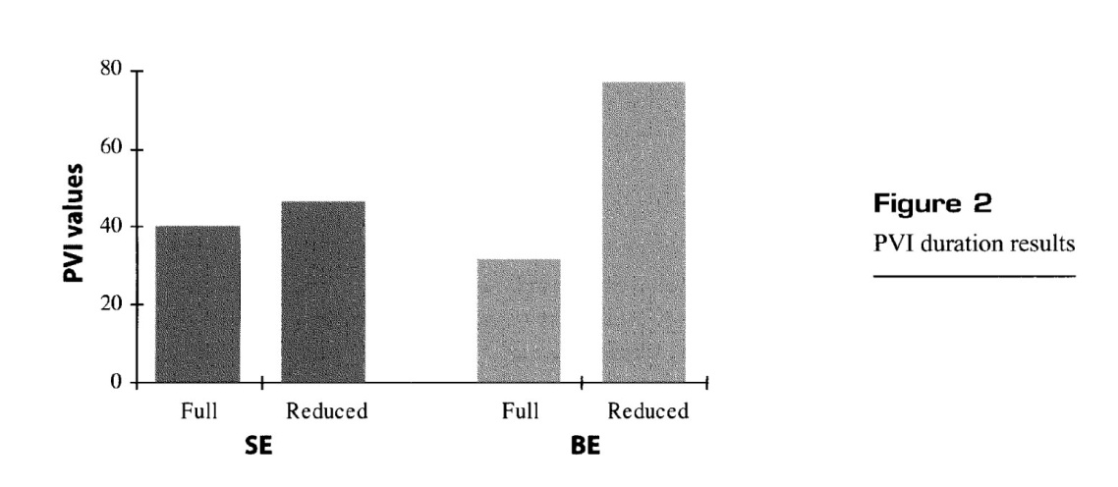
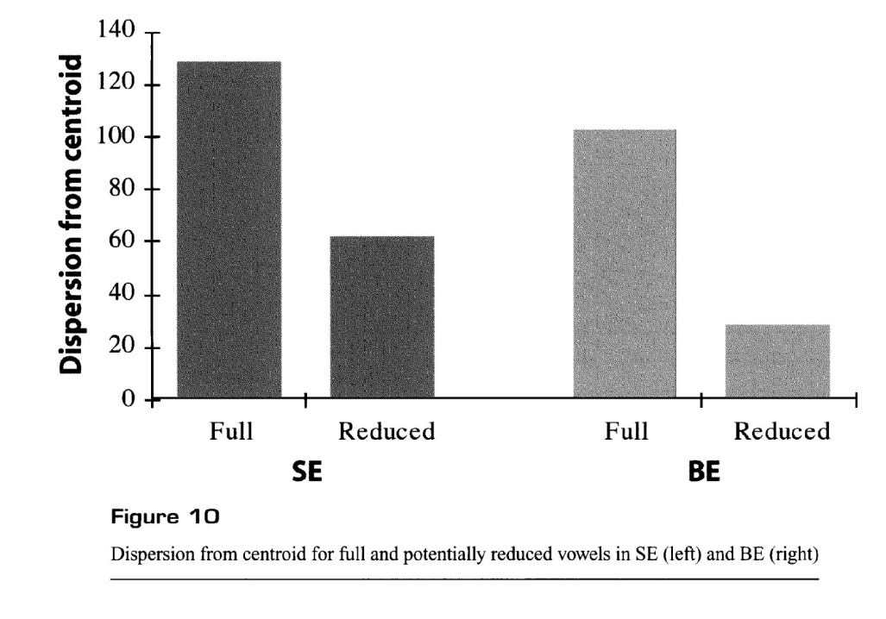
Results from Low, Grabe, & Nolan
Comparisons of British English (BE) and Singapore English (SE): BE is more stress-timed and shows more vowel reduction

Slide 28
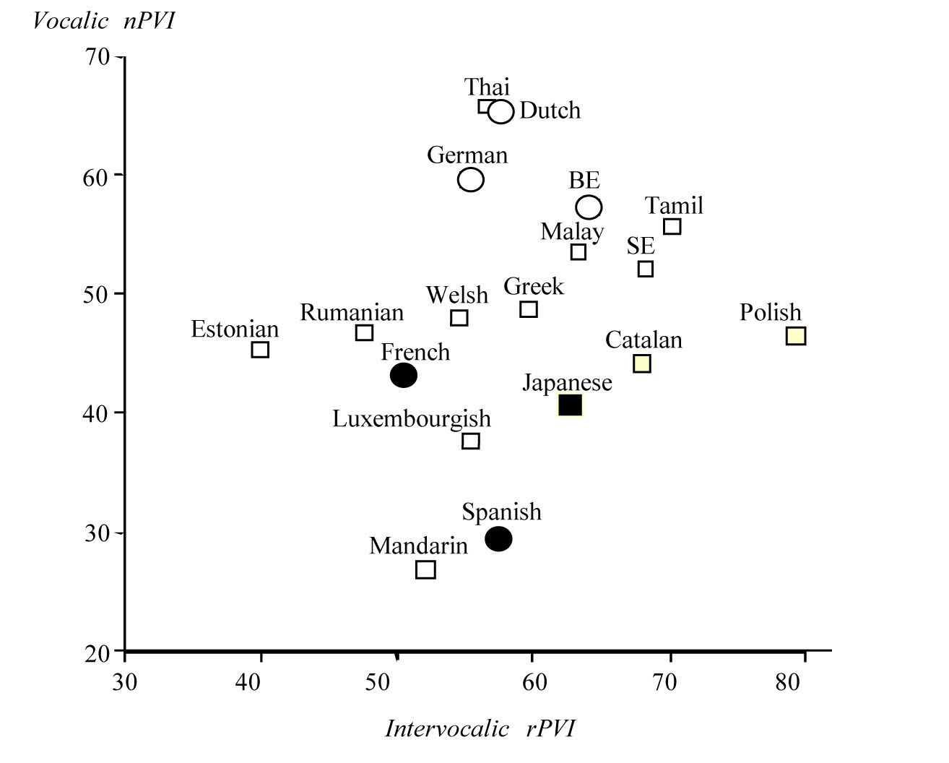
PVI across a bunch of languages
(from Low et al. 2000)

Slide 29
Other Pairwise Variability Measures
Deterding (2001) wanted to analyze spontaneous speech. He developed the Variability Index (VI):
1 n-2
VI = ——— [ Σ | d_{k+1} – d_{k} | ]
n-2 k=1
Note that he also omitted final syllables to factor out phrase-final lengthening

Slide 30
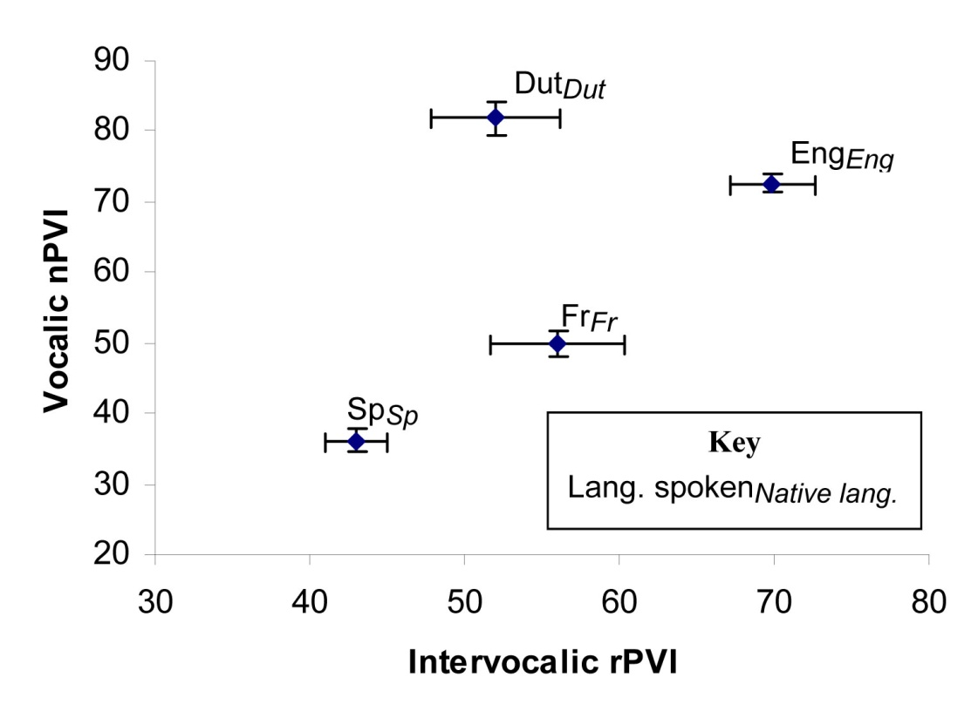
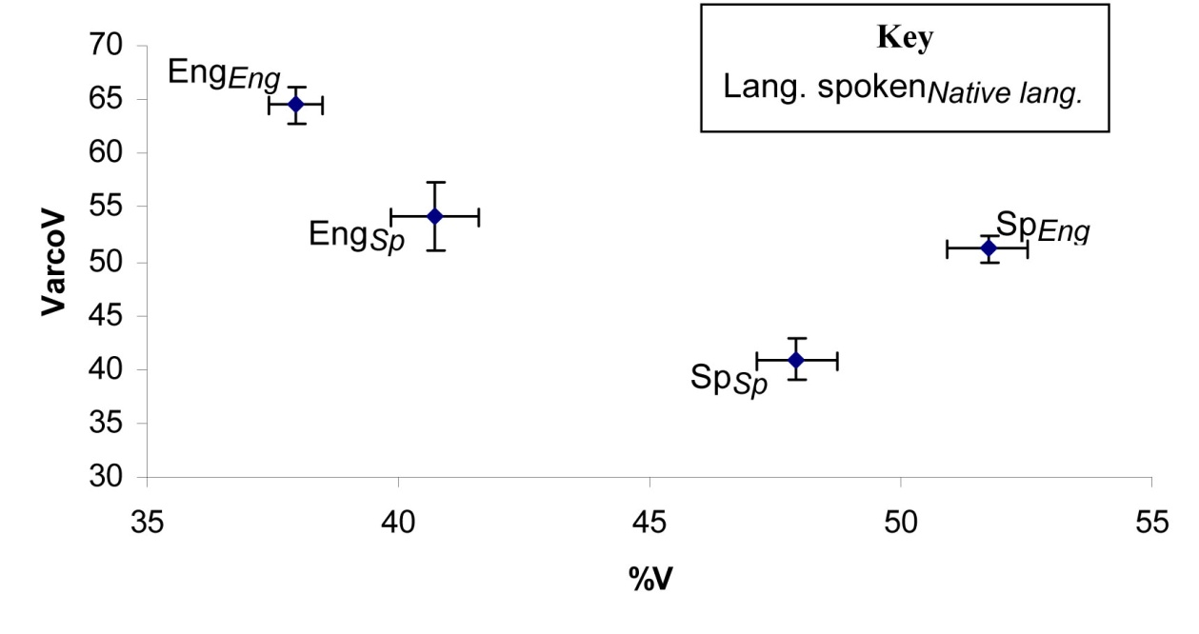
Rhythm Measures for L1 vs. L2 Comparisons

Slide 31
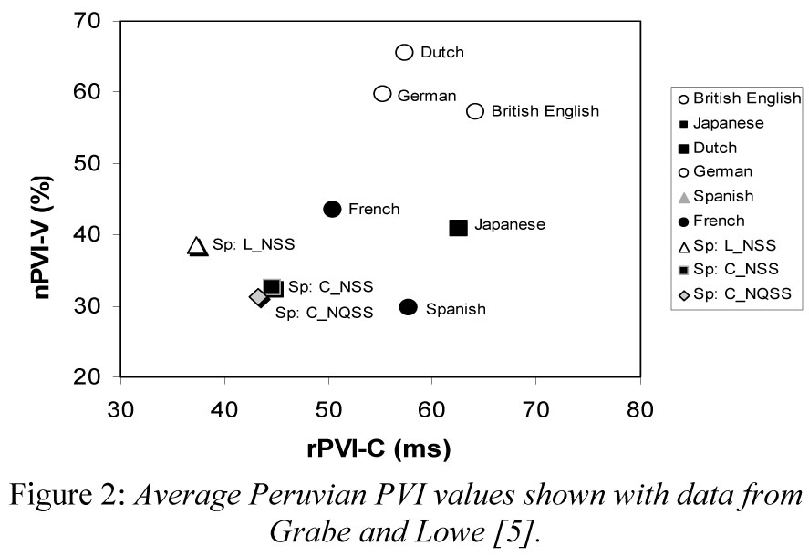
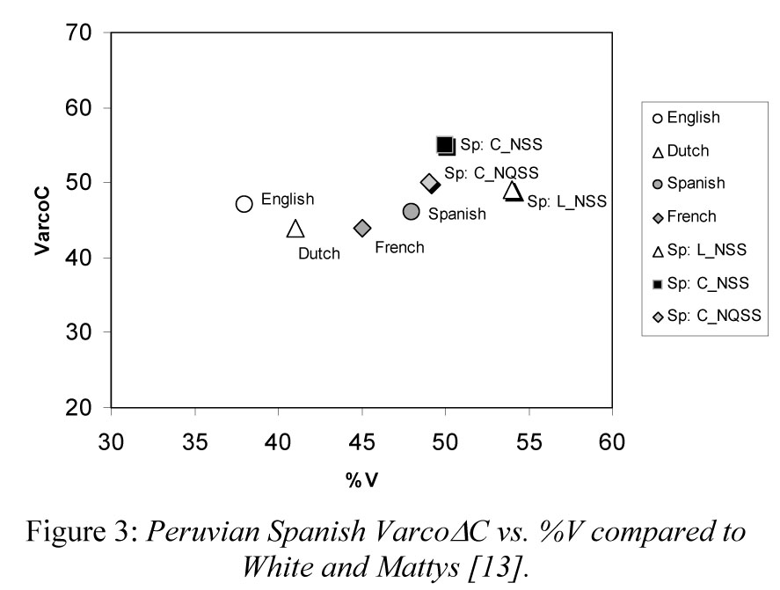
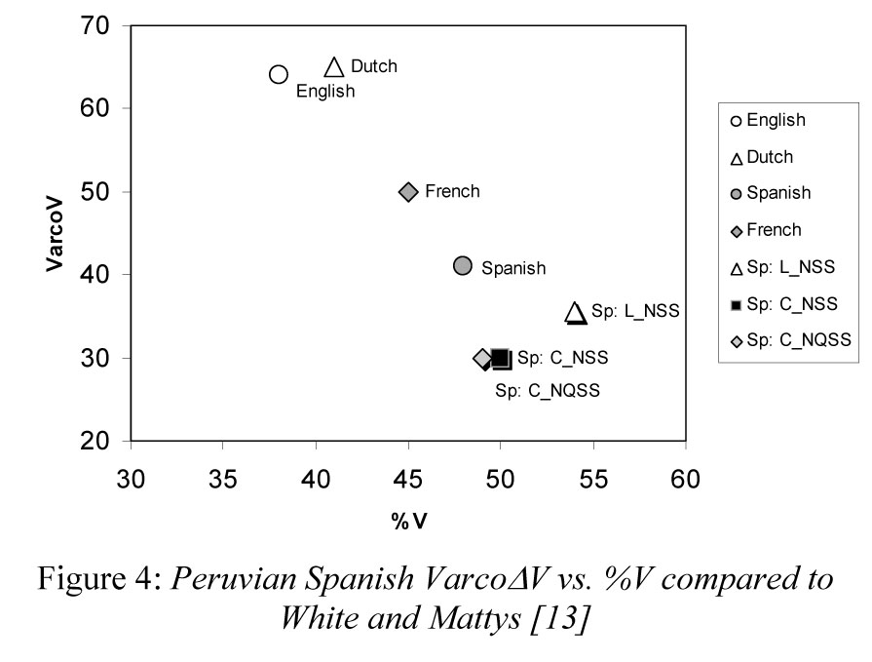
Applications (1)
O’Rourke (2008) compared three varieties of Peruvian Spanish: Lima Spanish, Cuzco native-speaker Spanish, and Cuzco L2 Spanish (with Quechua as L1)

Slide 32
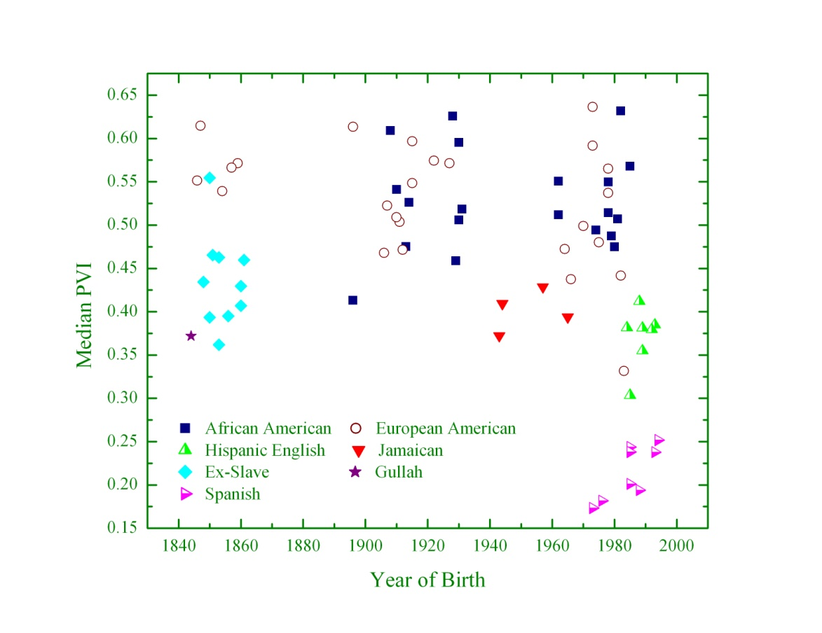
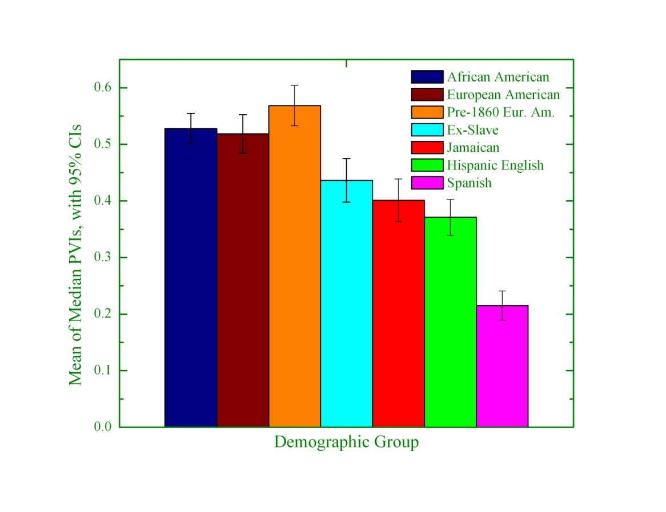
Applications (2)
Thomas & Carter (2006): Showed that earlier AAE was more syllable-timed than EAE or today’s AAE, and was comparable to Jamaican and Hispanic English

Slide 33
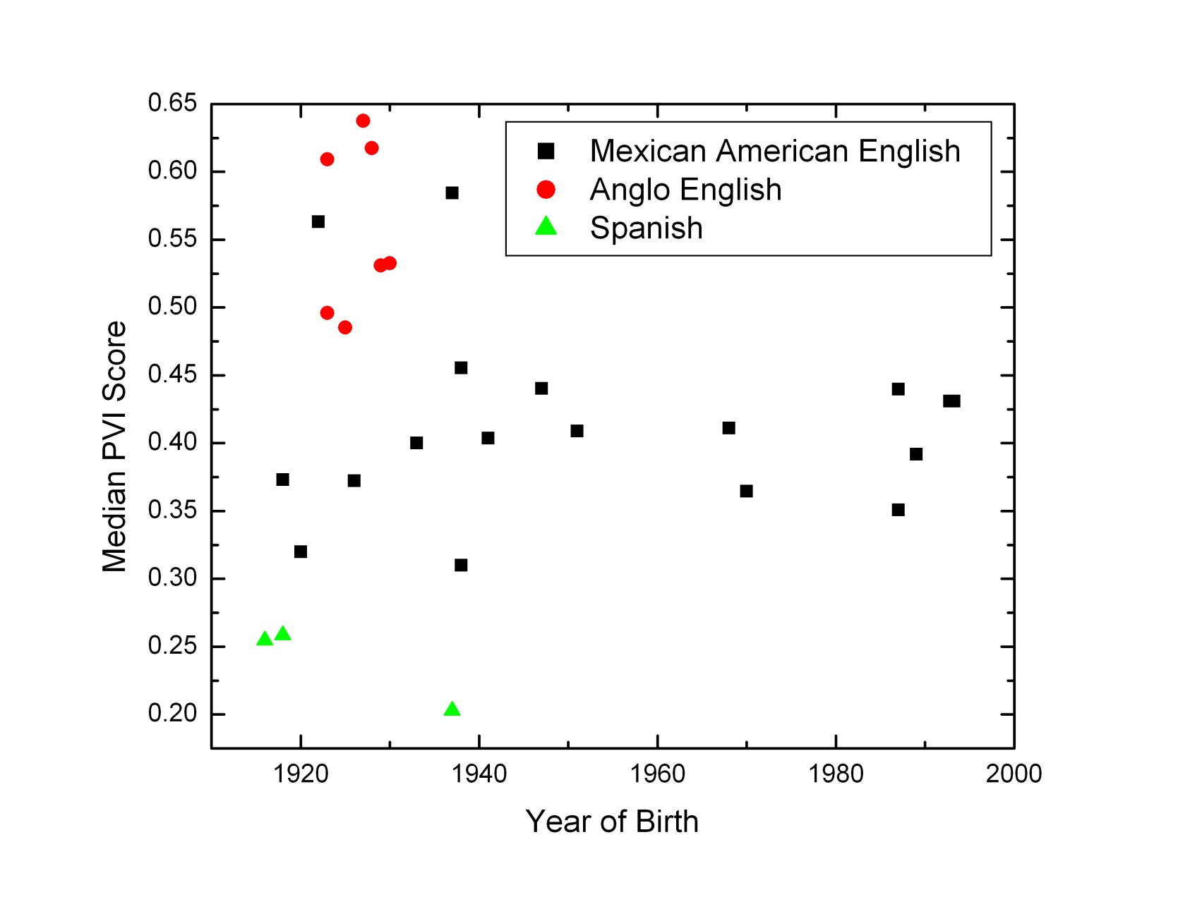
Applications (3)
Latest Pearsall findings
Mexican American English is not catching up with Anglo English for rhythm

Slide 34
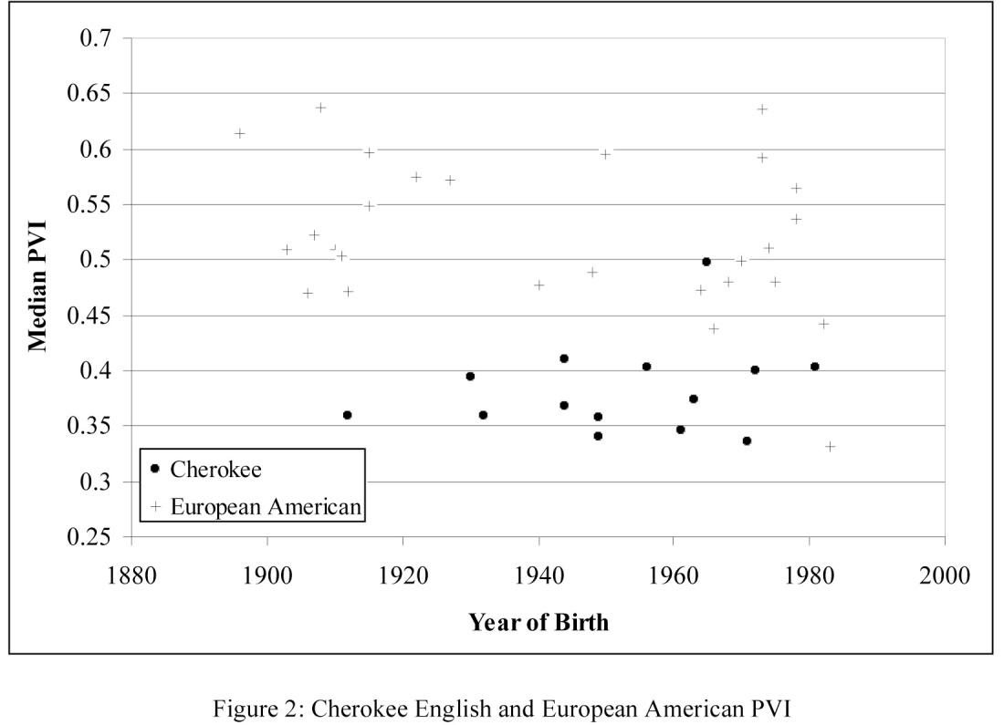
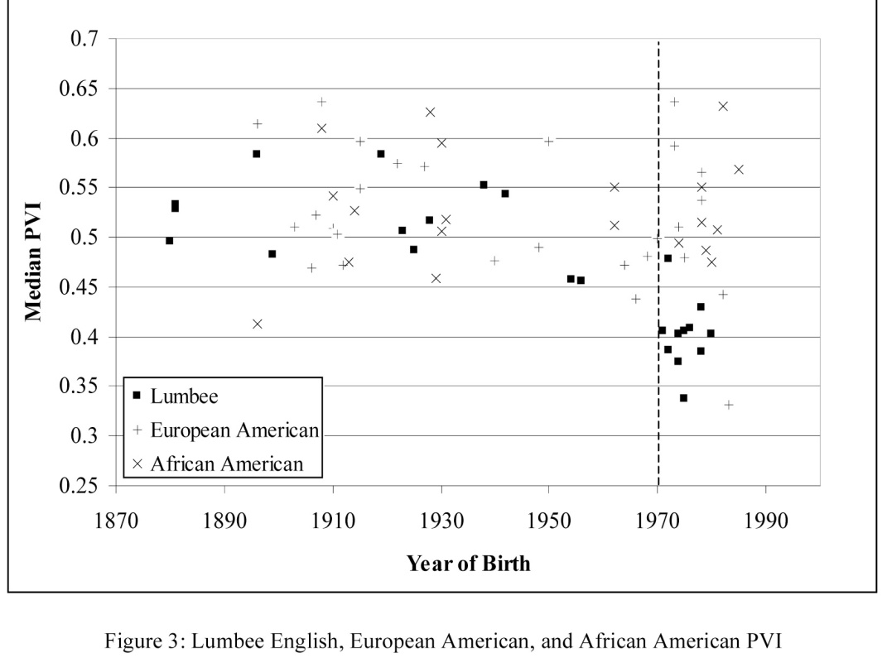
Applications (4)
Coggshall’s (2008) findings on Cherokee and Lumbee English in North Carolina

Slide 35
Applications (5)
White & Mattys (2007b) found that Standard British English was more stress-timed than:
Welsh Valleys English, with a Welsh substrate
Orkney English, with a Norse substrate
Bristol English, with no substrate
Shetland English, with a Norse substrate, was ambiguous

Slide 36
Practice Exercises
Exercises 6.1 and 6.2: We’ll start by learning how to make textgrids. Then we’ll look at pause durations.
Exercise 6.3: Make a textgrid with a tier specifying the tones for each syllable and then take the F₀ and timepoints where the trough, peak, beginning of host syllable, and end of host syllable are.
Exercise 6.4: Make a textgrid, this time with the segments all demarcated. Then we’ll compute some of the rhythm metrics. An Excel spreadsheet is provided for nPVI.

Slide 37
References
The diagrams on slide 5 are taken from:
Kendall, Tyler, and Erik R. Thomas. 2010. Dissecting Rate of Speech: The Effect of Phrase Final Lengthening on Articulation Rate. Poster presented at the Second Pan-American/Iberian Meeting on Acoustics, Cancun, Mexico, 18 November 2010.
The diagram on slide 19 is taken from:
Dankovacová, Jana, and Volker Dellwo. 2007. Czech speech rhythm and the rhythm class hypothesis. Proceedings of the 16th Meeting of the International Conference of Phonetic Sciences, Saarbrücken, Germany, 6-10 August 2007, 1241-44.
The diagrams on slide 30 are taken from:
White, Laurence, and Sven L. Mattys. 2007a. Calibrating rhythm: First language and second language studies. Journal of Phonetics 35:501-22.

Slide 38
References (continued)
Other references:
Bauer, Robert S., Cheung Kwan-Hin, and Cheung Pak-Man. 2003. Variation and merger of the rising tones in Hong Kong Cantonese. Language Variation and Change 15:211-25.
Coggshall, Elizabeth L. 2008. The prosodic rhythm of two varieties of Native American English. University of Pennsylvania Working Papers in Linguistics 14.2:1-9.
Deterding, David. 2001. The measurement of rhythm: A comparison of Singapore and British English. Journal of Phonetics 29: 217-230.
Gut, Ulrike, Eno-Abasi Urua, Sandrine Adouakou, and Dafydd Gibbon. 2002. Rhythm in West African tone languages: A study of Ibibio, Anyi, and Ega. In Ulrike Gut and Dafydd Gibbon (eds.), Typology of African Prosodic Systems, 159-65. Bielefeld: Bielefeld University.
Henderson, Alan, Frieda Goldman-Eisler, and Andrew Skarbek. 1966. Sequential temporal patterns in spontaneous speech. Language and Speech 8:236-42.
Low, Ee Ling, Esther Grabe, and Francis Nolan. 2000. Quantitative characterizations of speech rhythm: Syllable-timing in Singapore English. Language and Speech 43:377-401.

Slide 39
References (continued)
Kendall, Tyler S. 2009. Speech rate, pause, and sociolinguistic variation: An examination through the sociolinguistic archive and analysis project. Ph.D. dissertation, Duke University.
O’Rourke, Erin. 2008. Speech rhythm variation in dialects of Spanish: Applying the Pairwise Variability Index and Variation Coefficients to Peruvian Spanish. Proceedings of Speech Prosody 2008: Fourth Conference on Speech Prosody, Campinas, Brazil, May 6-9, 2008, 431-34. http://aune.lpl.univ-aix.fr/~sprosig/sp2008/papers/id173.pdf
Ramus, Franck, Marina Nespor, and Jacques Mehler. 1999. Correlates of linguistic rhythm in the speech signal. Cognition 73: 265-92.
Stanford, James N. 2008. A sociotonetic analysis of Sui dialect contact. Language Variation and Change 20:409-50.
Thomas, Erik R., and Phillip M. Carter. 2006. Rhythm and African American English. English World-Wide 27:331-55.
White, Laurence, and Sven L. Mattys. 2007b. Rhythmic typology and variation in first and second languages. In Pilar Prieto, Joan Mascaró, and Maria-Josep Solé (eds.), Segmental and Prosodic Issues in Romance Phonology, 237-57. Current issues in linguistic theory series. Amsterdam/Philadelphia: John Benjamins.

