Slide 1
ENG 528: Language Change Research Seminar
Sociophonetics: An Introduction
Chapter 5: Vowels

Slide 2
Duration
Several uses in speech:
phonological contrasts in quantity (i.e., long vs. short vowels, tense vs. lax vowels, single vs. geminate consonants)
as a phonetic cue for other phonological distinctions (especially voiced vs. voiceless consonants, but also fricatives vs. stops, etc.)
word stress
other prosodic functions, especially phrase-final lengthening
overall rate of speech

Slide 3
Determining onsets and offsets
Cues to watch for:
vocal pulsing
appearance or cessation of F₂
aspiration or frication
stop bursts
basically, any discontinuity
adjacent vowels and contiguous vowels and approximants present special problems

Slide 4
Some Examples

Slide 5
Know what formant patterns to expect!
F₁ and F₂ are far apart for high front vowels
F₁ and F₂ are close together for low back and back rounded vowels
F₁ is inversely correlated with height
F₂ is directly correlated with advancement
Lip rounding lowers some formant values

Slide 6
Where do you measure?
It depends on what you want to show:
Are you looking at vowel shifting patterns?
Are you showing means or individual tokens?
Are you interested in dynamic patterns of vowels?
If so, are you looking at general diphthongization, consonantal transitions, or details of formant trajectories?

Slide 7
If you need only one point
for studies of vowel shifting
for comparison of different tokens of a phoneme to check for conditioned allophony
for comparison of different tokens to see how much spread there is or if the spread shows a geometric pattern
to see how much different phonemes overlap (especially if a merger is possible)

Slide 8
Where to measure a single point
Dead center of the vowel: less subjective than other methods, but
no good for diphthongs
doesn’t always represent a vowel’s closest approach to its target
Points where F₁ or F₂ reach extreme values:
usually works, but
problematic if consonantal transition patterns cause the onset or offset to show the most extreme value
extreme F₁ and F₂ patterns don’t always match up
In a steady state
if there is a steady state, that is

Slide 9
If you need more than one point
Used to examine dynamic aspects of vowels
Dynamic aspects include:
Diphthongization: usually, you need only two or three points
Transitions to and from neighboring segments; only two or three points are needed
Sometimes, more local patterns, such as convex/concave patterns, interference from harmonics, etc.; you need a lot of points for these kinds of problems
Be aware that too much data on one graph becomes hard to read

Slide 10
Where to measure multiple points
Two basic approaches:
At even intervals through the vowel (percentages or fractions)
At specified distances in ms from each other or from onset or offset
Each has advantages and disadvantages

Slide 11
An example
word is cloud

Slide 12
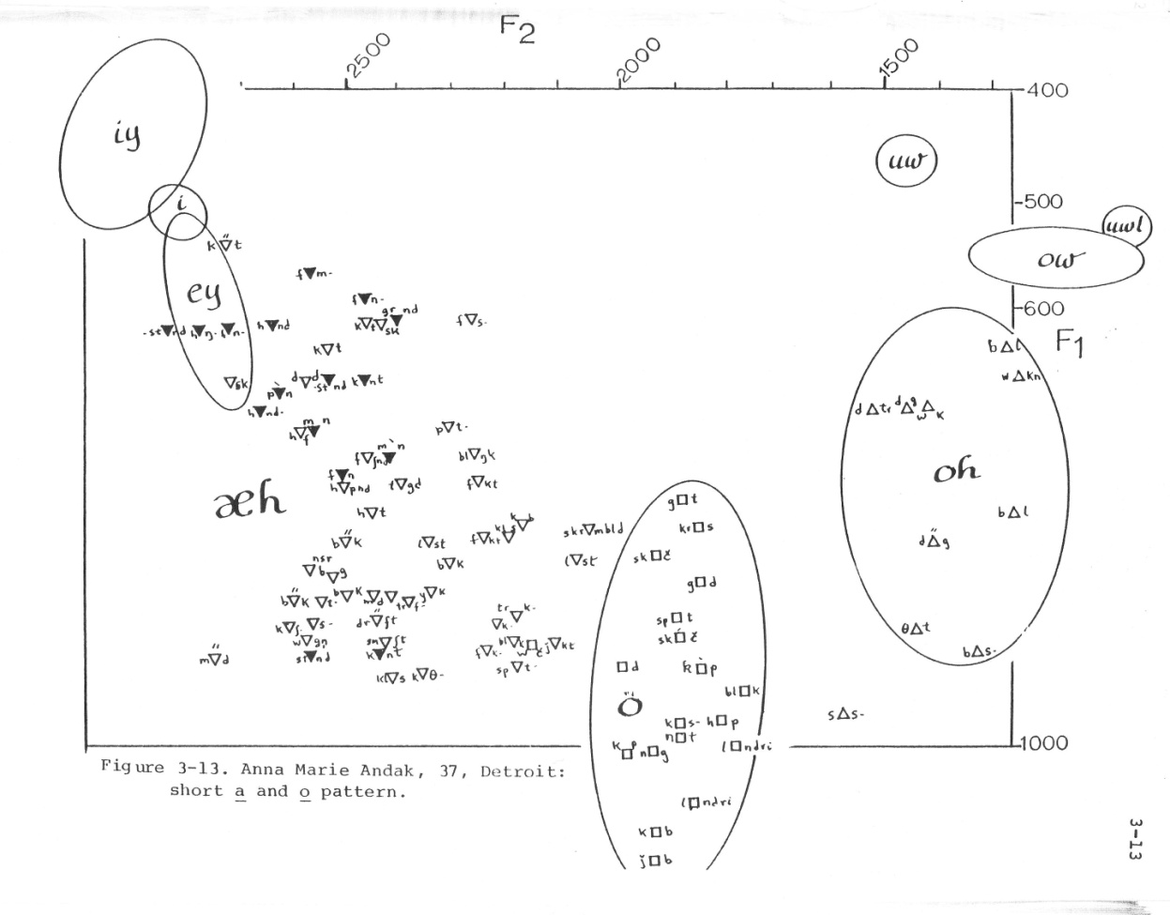
Plotting (1)
Old-fashioned way: from Labov, Yaeger, & Steiner (1972)
Individual tokens with ellipses

Slide 13
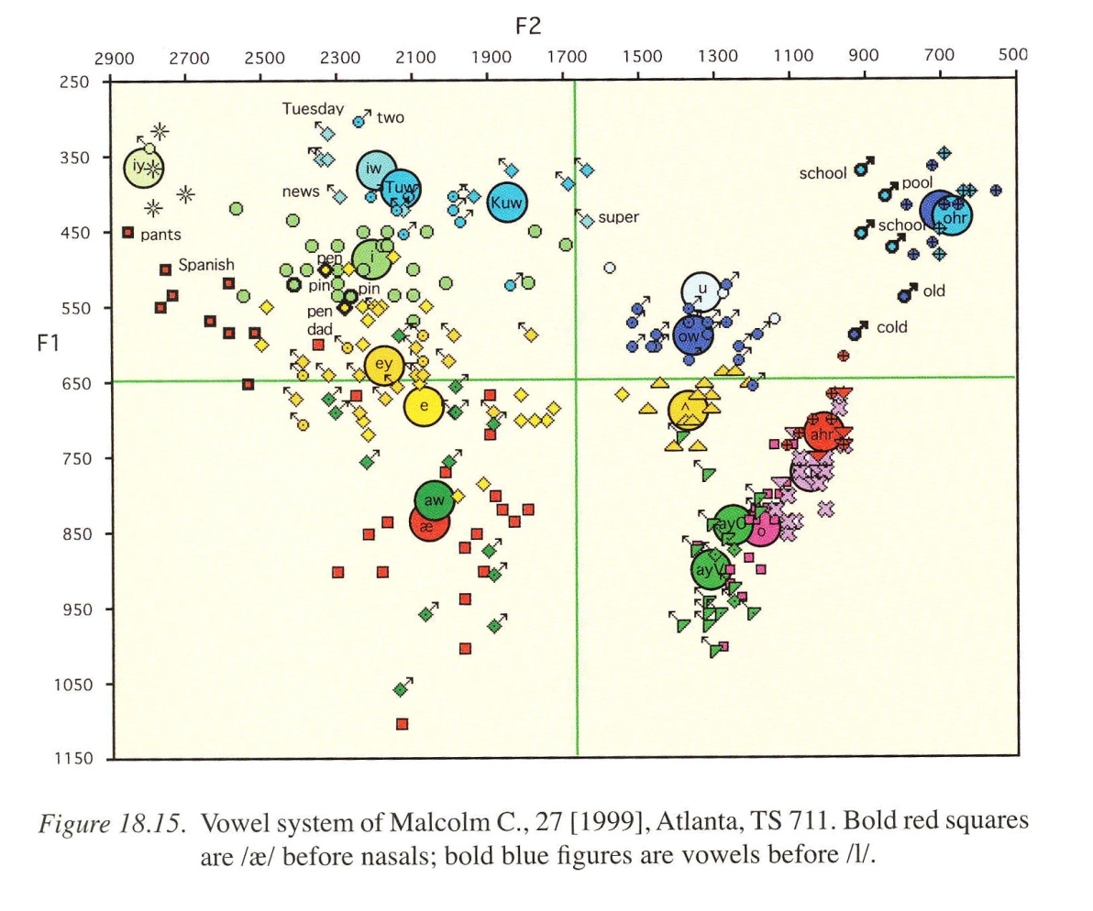
Plotting (2)
A plot from Labov, Ash, & Boberg (2006)
Individual tokens, but no ellipses; utilizes Plotnik

Slide 14
Plotting (3)
Individual tokens are best for:
examining mergers
testing for vowel dynamics
looking at internal configuration of a phoneme

Slide 15
Plotting (4)
Mean values—my favorite method

Slide 16
Plotting (4)
You can try showing standard deviations

Slide 17
Plotting (5)
Trajectories are mainly used to examine vowel dynamics

Slide 18
Vowel Normalization (1)
Aims of normalization
Eliminate variation due to physiological differences
Preserve lectal and linguistic differences
Keep contrastive vowels separate
Reflect how auditory normalization works
Different scholars have different aims, but they don’t always understand that

Slide 19
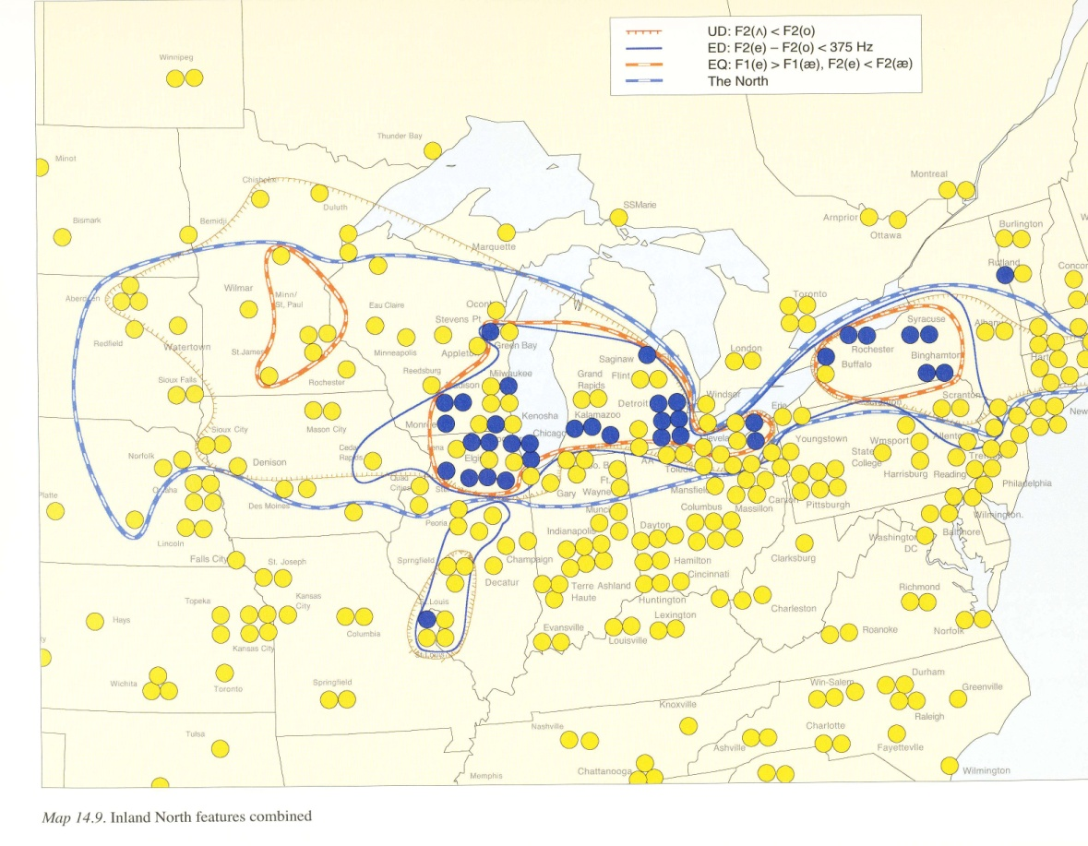
Vowel Normalization (2)
A procedure some sociolinguists use to get around vowel normalization is comparison of two vowels
E.g., for the Southern Shift, compare whether /e/ or // has a higher nucleus
Labov, Ash, and Boberg (2006) made extensive use of vowel comparison to define the Northern Cities Shift area

Slide 20
Vowel Normalization (3)
Lots of mathematical techniques have been developed to perform normalization
One important fact to keep in mind: There’s no such thing as a perfect normalization technique!
We’ll combine section 5.6 in the book with Clopper (2009) in what follows

Slide 21
Vowel Normalization (4)
One way to divide normalization: vowel-intrinsic vs. vowel-extrinsic
Vowel-intrinsic: each vowel is normalized on its own—all information is taken from that vowel
Vowel-extrinsic: vowels are normalized relative to each other—information is taken from multiple vowels

Slide 22
Vowel Normalization (5)
Another division: scale-factor vs. range normalization
Scale-factor: a single scale factor is utilized
Range: the range of formant values that the speaker exhibits is involved

Slide 23
Vowel Normalization (6)
One more division: speaker-intrinsic vs. speaker-extrinsic
Speaker-intrinsic: each speaker is normalized on their own—all information is taken from that speaker. Most methods do this.
Speakers are normalized relative to each other—information is taken from multiple speakers. Labov et al. (2006) did this.

Slide 24
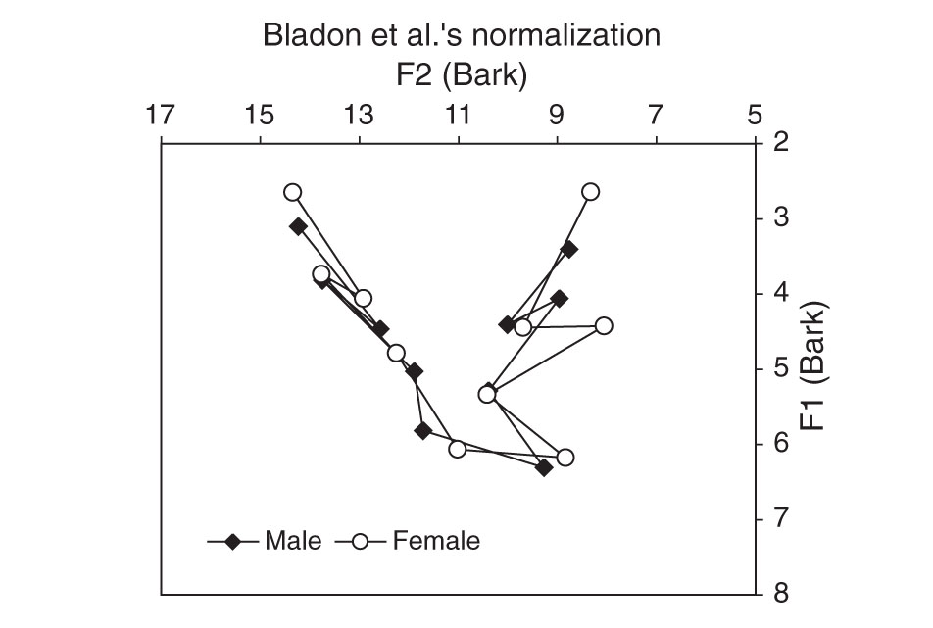
Vowel Normalization (7)
Vowel-intrinsic scale-factor: Bladon et al.
Subtract 1 Bark from all female formants
Problem with F₁

Slide 25
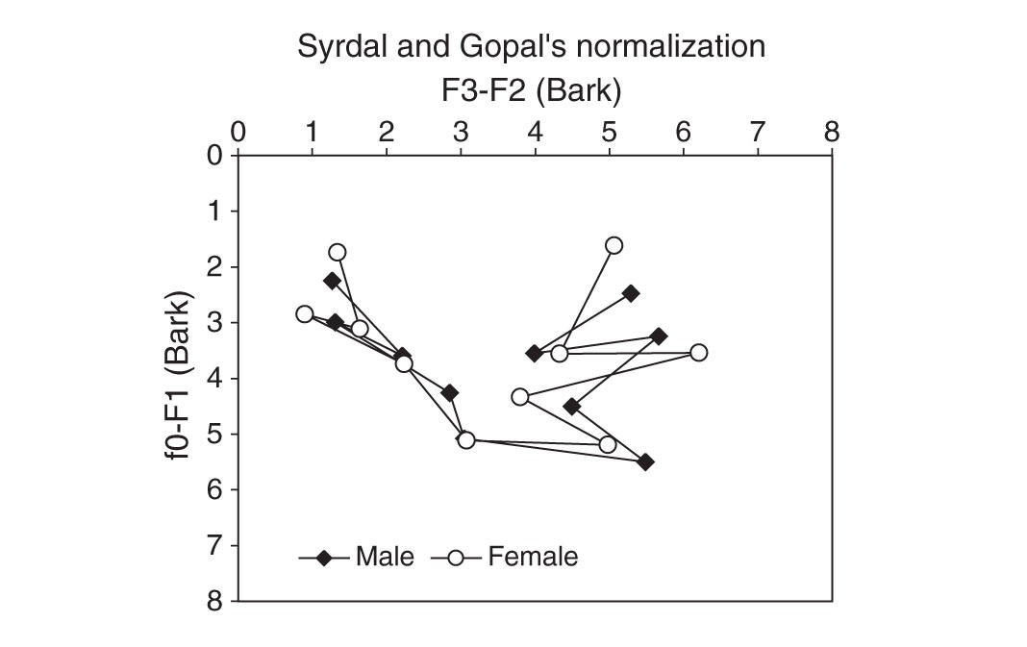
Vowel Normalization (8)
Vowel-intrinsic range: Syrdal & Gopal
Z₁-Z₀ and Z₃-Z₂ (Bark-converted)
Better, but still some trouble with the height dimension

Slide 26
Vowel Normalization (9)
My modification of Syrdal & Gopal
To avoid F₀-related problems, use Z₃-Z₁ and Z₃-Z₂
Still some height distortion

Slide 27
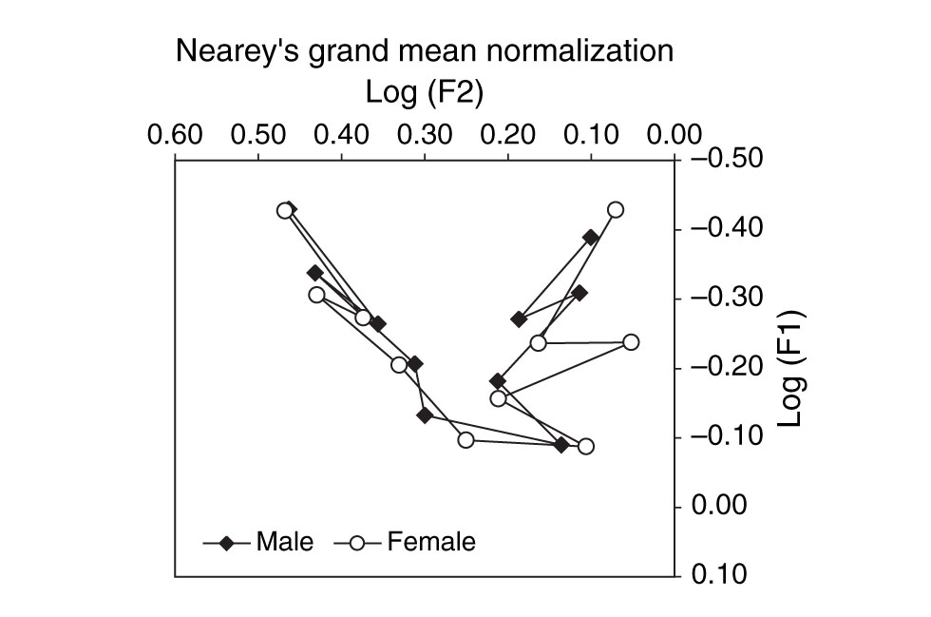
Vowel Normalization (10)
Vowel-extrinsic scale-factor: Nearey, Watt & Fabricius
For Nearey, F*_{n[V]} = anti-log(log(F_{n[V]}) - MEAN_{log}), where F*_{n[V]} is the normalized value for F_{n[V]}, formant n of vowel V, and MEAN_{log} is the log-mean of all F₁s and F₂s for the speaker
Watt & Fabricius compute a single scale for both F₁ and F₂

Slide 28
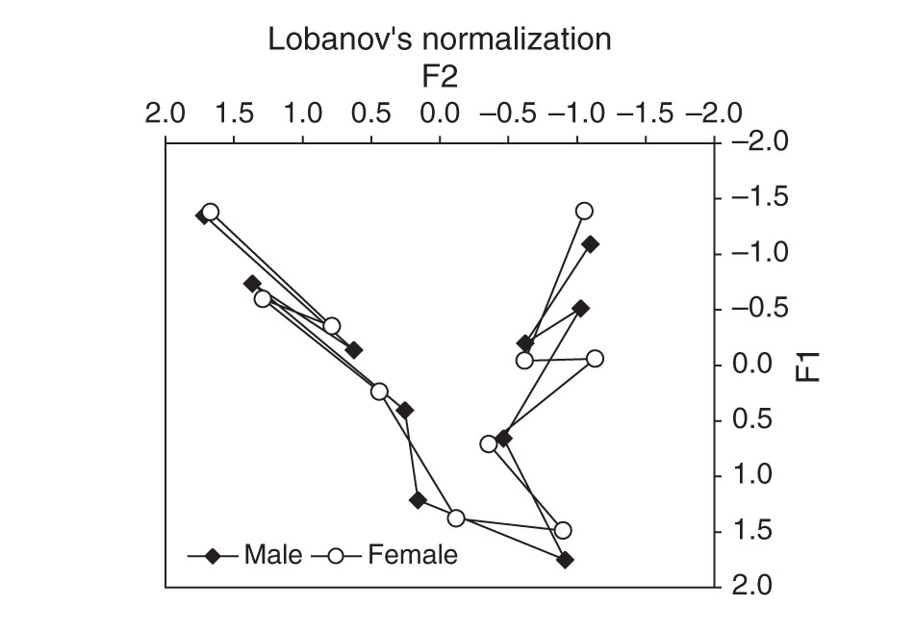
Vowel Normalization (11)
Vowel-intrinsic range: Lobanov
F_{n[V]}^{N} = (F_{n[V]} - MEAN_{n})/S_{n}, where F_{n[V]}^{N} is the normalized value for F_{n[V]} (i.e., for formant n of vowel V); MEAN_{n} is the mean value for formant n for the speaker and S_{n} is the standard deviation

Slide 29
Vowel Normalization (12)
Achilles heel of vowel-extrinsic techniques: they’re thrown off when used to compare very different vowel inventories

Slide 30
Vowel Quality/Voice Quality Interaction
We’ll save this for when we get to chapter 7

Slide 31
Steady-State Patterns (1)
For a fully realized diphthong, besides the transitions at the onset and offset, you can have:
A nuclear steady state
A transition between the nucleus and glide steady states
A glide steady state
Not all diphthongs have both steady states
The steady states can also vary in duration

Slide 32
Steady-State Patterns (2)
aid and day

Slide 33
Steady-State Patterns (3)
Quantifying steady states is a problem
You can look at degree of change in formant values
There are probably statistical procedures for this sort of thing
Steady states can be used for perception experiments: see goodness experiments in Peeters (1991)

Slide 34
Undershoot
This will be next week’s topic

Slide 35
References
Diagrams on slides 13 and 19 are taken from:
Labov, William, Sharon Ash, and Charles Boberg. 2006. The Atlas of North American English: Phonetics, Phonology and Sound Change. A Multimedia Reference Tool. Berlin: Mouton de Gruyter.
Diagrams on slide 14 are taken from:
Thomas, Erik R. Forthcoming. Sociophonetics. The Handbook of Language Variation and Change. Ed. J. K. Chambers and Natalie Schilling-Estes. 2nd edn. Oxford, UK/ Malden, MA: Wiley-Blackwell.
Diagrams on slides 24, 25, 27, & 28 are taken from:
Clopper, Cynthia G. 2009. Computational methods for normalizing acoustic vowel data for talker differences. Language and Linguistics Compass 3:1430-42.
Other references:
Labov, William, Malcah Yaeger, and Richard Steiner. 1972. A Quantitative Study of Sound Change in Progress. Philadelphia: U.S. Regional Survey.
Peeters, Wilhelmus Johannes Maria. 1991. Diphthong dynamics: A cross-linguistic perceptual analysis of temporal patterns in Dutch, English, and German. Ph.D. dissertation, Rijksuniversiteit te Utrecht.

