Slide 1
ENG 528: Language Change Research Seminar
Articles Relating to Consonantal Analysis

Slide 2
Docherty & Foulkes, “Derby and Newcastle: instrumental phonetics and variationist studies” (1)
They start out by giving an overview of Derby, Derby vowels, and Derby consonants. (Newcastle had been covered in the preceding chapter.)
Then they critique sociolinguistic work:
Consonants are almost entirely neglected, in large part because:
auditory analysis is thought to be sufficiently good (well, maybe)
theory—e.g., vowel shifting principles—has focused on vowels (that would be Labov they’re talking about)

Slide 3
Docherty & Foulkes, “Derby and Newcastle: instrumental phonetics and variationist studies” (2)
They studied glottal /t/ in medial environments in Derby.
[] is characterized by creakiness, with (3%) or without (70%) a stop gap.
They noticed some F₂ movement at the transition, indicating weak [t] gestures.
Two types of glottal /t/: Type 1 (without burst) and Type 2 (with burst, indicating that there had been an oral closure for [t]).
They couldn’t tell the difference auditorily, but it was obvious on spectrograms.
Type 2 tokens were most common in male speech in Derby, especially older male speech; in Newcastle, they are mainly found in older male speech (they didn’t give the sociolinguistic distribution of Type 1 tokens).

Slide 4
Docherty & Foulkes, “Derby and Newcastle: instrumental phonetics and variationist studies” (3)
They also studied pre-pausal [t] in Derby and Newcastle.
Three variants: canonical, continued voicing, and extended frication (in which the preceding vowel trails off into alveolar frication)
Canonical variants predominated in Derby
However, continued voicing was common in Newcastle, especially among males
Extended frication was increasing in Newcastle, especially among females
They state that they want to find changes at the foot of the S-curve of change; most sociolinguistic studies catch changes toward the end of the S-curve

Slide 5
Fourakis & Port, “Stop epenthesis in English” (1)
They’re interested in epenthetic stops that seem to eliminate some contrasts, e.g., prince vs. prints
Note their first sentence (p. 197): “…how cognitive grammar makes contact with such realms of the non-linguistic world as muscles and acoustics”
They discussed two previous approaches to the epenthetic stops:
Phonological approach (e.g., Dinnsen)—formal phonological rule of epenthesis
Phonetic approach (e.g., R. Harms, Ohala)—universal phonetics (automatic consequence of how articulators work)

Slide 6
Fourakis & Port, “Stop epenthesis in English” (2)
Lots of details about the exact contexts (/d/ vs. /t/, /n/ vs. /l/, etc.)
The important parts are that:
Americans produced epenthetic stops, South Africans didn’t (disproves the phonetic approach, which expects everybody to have the same articulatory operations)
epenthetic stops were shorter than underlying stops (disproves the phonological approach, which predicts that the epenthetic stop would be just like an underlying stop)
the presence or absence of epenthetic stops is mentally encoded
They also noted some length compensation when there was an epenthetic stop.

Slide 7
Fourakis & Port, “Stop epenthesis in English” (3)

Slide 8
Fourakis & Port, “Stop epenthesis in English” (4)
Other cases of “incomplete neutralization:”
tapped /t/ and /d/ in American English (preceding vowel duration, voicing, etc.—Fox & Terbeek 1977)
devoiced stops in German (timing)

Slide 9
Fourakis & Port, “Stop epenthesis in English” (5)
→Phase rules (a type of “low-level rule”)
timing of different articulatory gestures, e.g., voicing shits off before coronal closure is complete
They’re learned, not automatic consequences of articulation
speakers can adjust their implementation

Slide 10
Thomason & Kaufman, Language Contact, Creolization, and Genetic Linguistics, chapter 3 (Contact-induced language change: An analytic framework) (1)
Background: Two controversies in Historical Linguistics
1. Genetic vs. mixed as primary sources of languages
Max Müller (1871): “There is no mixed language.”
Hugo Schuchart (1884): “There is no fully unmixed language.”
Thomason & Kaufman think that most languages show some foreign influence somewhere in their history.
2. Can you distinguish foreign vs. genetic influences?
Morphology and core vocabulary were once touted as impervious to foreign influence, but Thomason & Kaufman say that there are plenty of counterexamples.

Slide 11
Thomason & Kaufman, Language Contact, Creolization, and Genetic Linguistics, chapter 3 (Contact-induced language change: An analytic framework) (2)
Another point they make before chapter 3 is that linguistic constraints don’t explain transfer patterns.
E.g., the proposal that free morphemes are favored over affixation.
Markedness is also often cited as a linguistic factor.
Thomason & Kaufman say that it’s social factors that determine the outcome, not linguistic factors. (E.g., the intensity of contact or the relationship of speakers of the two languages.)

Slide 12
Thomason & Kaufman, Language Contact, Creolization, and Genetic Linguistics, chapter 3 (Contact-induced language change: An analytic framework) (3)
Borrowing:
language maintenance: no shift
lexicon is affected first: words are borrowed (think of English)
extensive structural borrowing may happen slowly, over several hundred years (but it doesn’t have to—Thomason has changed her mind since she wrote the book).

Slide 13
Thomason & Kaufman, Language Contact, Creolization, and Genetic Linguistics, chapter 3 (Contact-induced language change: An analytic framework) (4)
(Substratum) Interference:
language shift
lexicon is affected least: phonological and morphosyntactic influences are stronger
may happen quickly, as fast as one generation; the faster it happens, the greater the amount of interference.
Note the old mistake that a lack of borrowings means that there wasn’t any substratum.
Example: Indic (Indo-European) and Dravidian. There was a prehistoric shift from Dravidian languages to Indic in northern India.
The result was that Indic languages now show phonological influences like the retroflex-vs.-dental distinction; the surviving Dravidian languages mostly show just borrowed words.

Slide 14
Thomason & Kaufman, Language Contact, Creolization, and Genetic Linguistics, chapter 3 (Contact-induced language change: An analytic framework) (5)
So, what about linguistic factors? →They discuss two:
Markedness: Generally, less marked features will win out, but it depends. They say markedness is more important for interference than for borrowing, and very important for pidginization.
Typological Distance: (Equally important for borrowing and interference.) It’s been proposed that greater similarity between the two languages leads to more morphological interference. Thomason & Kaufman say that there’s some evidence to support that, but they don’t think that typological similarity promotes interference in general.

Slide 15
Thomason & Kaufman, Language Contact, Creolization, and Genetic Linguistics, chapter 3 (Contact-induced language change: An analytic framework) (6)
Thomason & Kaufman mention that you don’t need an exact match to attribute a feature to interference—some things get blurred in the translation.
E.g., The pattern of the loss of the copula in Russian doesn’t match the Uralic pattern exactly, but that shouldn’t rule out a Uralic substratum, even though some historical linguists have thought so.

Slide 16
Thomason & Kaufman, Language Contact, Creolization, and Genetic Linguistics, chapter 3 (Contact-induced language change: An analytic framework) (7)
One final point from Chapter 3:
p. 59: “Since even the most natural changes often fail to occur, it is always appropriate to ask why a particular change happened when it did.”
Keep that in mind. Later in the semester, we’ll compare that with what John Ohala and Uriel Weinreich et al. say about the same issue.

Slide 17
Examples of Interference in American English
Ruth Herold’s study of the merger of // and // in northeastern Pennsylvania. The merger popped up where there were lots of Slavic immigrants, which was where there was lots of anthracite coal mining.
German and Scandinavian: mostly in Pennsylvania and the Upper Midwest.
Monophthongal /e/ and /o/: phonological interference.
“Do you want to come with?”: morphosyntactic interference.
Mexican American English: the most noticeable traits of Hispanic English are phonological.
There are just a few morphosyntactic interference features, e.g. the high incidence of multiple negation.

Slide 18
Dialect Mixture
The best source on this topic is Peter Trudgill’s Dialects in Contact. Paul Kerswill and Ann Williams have also done some excellent work.
Trudgill described documented cases of dialect mixture in Høyanger (a “new town” in Norway) and in Hindi colonies in Fiji and Trinidad. He then applied the model to several historical cases, most notably Australia.
For Australia, he noted that several scholars have said that it’s just transplanted London Cockney English. It does resemble Cockney (or maybe 19th-century Cockney) in several respects. However, there are a few things that don’t add up. Most notable is that the “broad a” of car, start, past, half, etc. is pronounced [a], not [], in Australian English. (Cockney has [] and had it by the early 19th century, when Australian English was being formed, but lots of other dialects in southern England had [a] and some still do today.)
Trudgill thought that that indicated that Australian English resulted from the koineization of southern English dialects in general, not from Cockney in particular.

Slide 19
Dialect Mixture: Paul Kerswill and Ann Williams’s rules
All except rule three were stated earlier by Trudgill:
Phonologically and lexically simple features are adopted.
Majority rather than minority forms found in the mix win out.
Marked regional forms are disfavored.
There is a move from diffuseness to focusing.
There is no normal historical continuity with the locality, either socially or linguistically. As a result, all first generation speakers are oriented toward language varieties originating elsewhere.

Slide 20
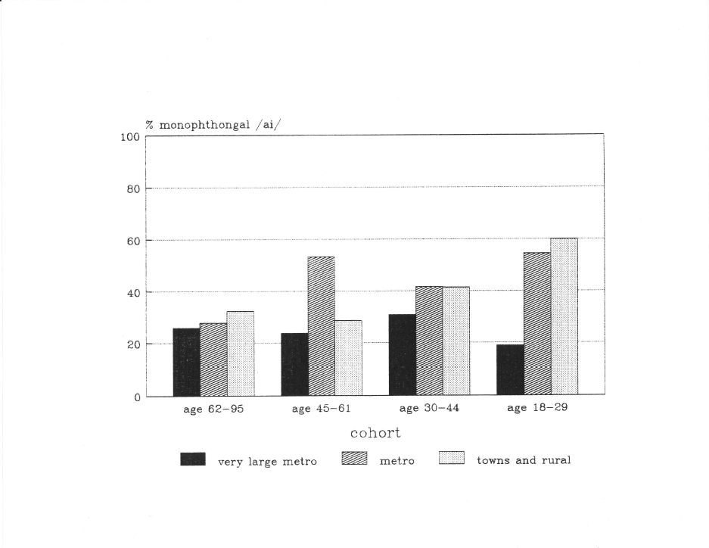
Dialect Mixture in American English (1)
Texas Anglos: Southern features waning in big urban centers
Goes right back to Kerswill and Williams’s rules

Slide 21
Dialect Mixture in American English (2)
How does this apply to the Triangle?
Which communities in the Triangle might be subject to more or less dialect leveling?
How are different ethnic communities affected?

Slide 22
Dialect Mixture in American English (3)
Fudging along a dialect boundary

Slide 23
Vowel Plot Fun

Slide 24
References
The diagram on slide 20 is taken from:
Thomas, Erik R. 1997. A rural/metropolitan split in the speech of Texas Anglos. Language Variation and Change 9:309-32.
The diagram on slide 22 is taken from:
Thomas, Erik R. 2010. A longitudinal analysis of the durability of the Northern-Midland dialect boundary in Ohio. American Speech 85:375-430.
Other references:
Docherty, Gerard J., and Paul Foulkes. 1999. Derby and Newcastle: Instrumental phonetics and variationist studies. In Paul Foulkes and Gerard J. Docherty (eds.), Urban Voices: Accent Studies in the British Isles, 47-71. London: Arnold.
Fourakis, Marios, and Robert Port. 1986. Stop epenthesis in English. Journal of Phonetics 14:197-221.
Fox, Robert A., and Dale Terbeek . 1977. Dental flaps, vowel duration and rule ordering in American English. Journal of Phonetics 5:27-34.
Herold, Ruth. 1997. Solving the actuation problem: Merger and immigration in eastern Pennsylvania. Language Variation and Change 9:165-89.
Kerswill, Paul, and Ann Williams. 1994. A new dialect in an old city: Children’s and adults’ speech in Milton Keynes. Final report submitted to the Economic and Social Research Council.
Thomason, Sarah Grey, and Terrence Kaufman. 1988. Language Contact, Creolization, and Genetic Linguistics. Berkeley: University of California Press.
Trudgill, Peter. 1986. Dialects in Contact. Oxford: Blackwell.

