Slide 1
ENG 528: Language Change Research Seminar
Sociophonetics: An Introduction
Chapter 4: Consonants

Slide 2
Vowel synthesis exercise
1. Record yourself saying a short sentence and digitize it.
2. Apply some sort of filtering (lowpass, highpass, bandpass, or band zeroing) to the signal in a way that would be useful in a perception experiment.
3. Using the “To Manipulation” function in Praat, change the F₀ and timing of the utterance. You may change different parts of the utterance in different ways.
4. Using the “To KlattGrid” function, change some of the formant values enough so that the affected vowels sound like different phonemes.
5. Send me your original digitized utterance and each of the three modified soundfiles. Due October 3.

Slide 3
Field marks for stops
Stops are characterized by “stop gaps.” Voiced stops (right) show a murmur; voiceless stops (left) don’t. As a rule, stops are followed by bursts unless the stop is unreleased.

Slide 4
Field marks for nasals
Nasals show formants in their stop occlusions. They may or may not show a burst. Shown: [m].

Slide 5
Field marks for fricatives
Fricatives show frication noise, though its robustness varies. Shown: [f] (left), [v] (right).

Slide 6
Field marks for affricates
Affricates show a stop gap followed by frication, with a burst in between. Shown: [pf] (left), [bv] (right).

Slide 7
Field marks for approximants
Lack of a stop gap or frication; otherwise, there aren’t any consistent commonalities, as [w] (left) and trilled [r] (right) show.

Slide 8
Featured variables involving manner of articulation
Interdental fricatives vs. stops
Weakening of voiced stops in Spanish after vowels
Tapping/flapping in American & Australian English
Affrication of stops in Scouse and Québec French
Affricate/fricative confusion in Mexican American English

Slide 9
Stopping of word-initial /ð/ after a consonant in Pearsall, Texas
E.g., keep that pronounced [k^{h}ip dæt]
Cases such as had that pronounced [hæd dæt] that are ambiguous between stopping and assimilation are not included in the stopping tally
Ordinary Least Squares Regression used
Ethnicity was a significant predictor (p=.007) and education was close (p=.051), but year of birth and sex were not significant.

Slide 10
Place of Articulation (1)
What—tube models again??!

Slide 11
Place of Articulation (2)
Place of Articulation | General effect on:
 | F₁ | F₂ | F₃
Bilabial | lowered | Lowered | lowered
Labiodental | lowered | lowered | lowered
Dental | lowered | raised next to back rounded vowels, lowered next to front vowels | slightly raised except next to high front vowels
Alveolar | lowered | raised next to central and back vowels, lowered next to mid and high front vowels | slightly raised except next to high front vowels
Retroflex | lowered | raised next to back vowels, lowered next to front vowels | strongly lowered
Palato-alveolar | lowered | raised | raised
Palatal | lowered | strongly raised | slightly raised
Velar | lowered | raised | lowered
Uvular | lowered? | lowered | slightly lowered
Pharyngeal | raised | strongly lowered | strongly lowered

Slide 12
Locus Equations

Slide 13
Featured variables involving place of articulation
Interdental fricatives vs. labiodental fricatives in English (especially British dialects)
Dental, alveolar, and retroflex consonants
Alveolar (or dental) vs. velar nasals

Slide 14
Frication: Peak location
Unsmoothed spectrum of [x]
Comparison of adult male and girl smoothed spectra for sibilants

Slide 15
Frication: Spectral moments
Moment 1=mean frequency; whether the energy is relatively high- or low-frequency
Moment 2=variance; range of energy, i.e., how concentrated the energy is
Moment 3=skewness; gets at spectral tilt
Moment 4=kurtosis; how much of a peak there is in the spectrum

Slide 16
Frication: A_{d}, S_{p}, and S´_{p}
Jesus and Shadel (2002), applied to Portuguese

Slide 17
Featured variables involving fricative spectra
Laminal and apical [s]
Dorsal fricatives: [ç], [x], [], and their voiced counterparts
Aspiration vs. frication: note that formants (including low formants) are visible in aspiration, while only high formants or none at all are visible in frication

Slide 18
Direct measurement of articulation
X-ray microbeams: phoneticians have used them for a long time
Electropalatograph (EPG): useful for contact between tongue and roof of mouth
Ultrasound: mostly for tongue because ultrasound can’t handle air spaces

Slide 19
Voice Onset Time (VOT)
Well-known term in phonetics
Relevant only for syllable-onset or ambisyl. stops
Lead, short-lag, and long-lag VOT

Slide 20
Measuring VOT
Length of time between the burst and the onset of vocal fold vibration
VOT will be negative for lead VOT (pre-voicing) and positive for lag VOT (voiceless, especially aspirated)
Judge onset of vocal fold vibration by onset of F₂
Go with the last burst if there are more than one
For intervocalic stops, measure from offset of F₂ for preceding vowel
Aspiration tends to be shortest for labials and longest for dorsals, with coronals in between

Slide 21
VOT in Pearsall (labials shown)

Slide 22

Glottalization
Important variable for British dialects
Slowed glottal pulsing is the key

Slide 23
Cues for the voicing distinction
property | “voiced” (lenis or non-spread glottis) | “voiceless” (fortis or spread glottis)
adjacent F₀ contour | depressed | elevated
adjacent F₁ contour | strongly depressed | not depressed as much
approach of F₁ to closure | closer | less close
duration of closure | shorter | longer
duration of preceding vowel | longer | shorter
glottal pulsing | may be present | absent
intensity of burst after closure | greater | lesser
associated phonation | aspiration and glottalization less likely | aspiration and glottalization more likely

Slide 24
Stop releases
Main issue is whether release is present or absent

Slide 25
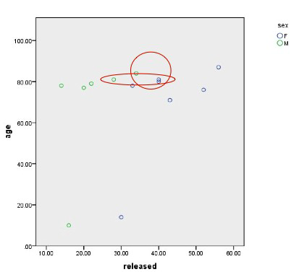
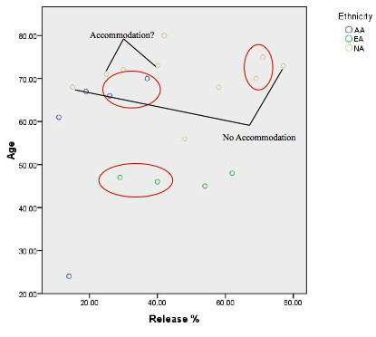
Stop release for Pearsall (left), Robeson County, NC (right)

Slide 26
Laterals: clear and dark /l/
F₂ frequency is the key

Slide 27
Clear and dark /l/ in Pearsall

Slide 28
Other lateral variation
Velar [] vs. vocalized: hard to tell acoustically; F₃ bandwidth is everybody’s best guess now, but in addition F₁ & F₂ may be a tad higher for vocalized
Palatal lateral [] vs. palatal central approx. [j]: [j] shows a higher F₃, maybe a higher F₁

Slide 29
Rhotics
No common features of rhotics—mainly, they’re all spelled with r
Lots of variables in different languages
We’ll focus on a couple of kinds of variation here
Since we won’t cover assibilation, here’s what it sounds like

Slide 30
Uvular /r/ forms
Important if you want to study Continental European languages
Uvularization is characterized by lowering of F₂ and maybe a little raising of F₃
Lots of variation in uvular /r/

Slide 31
Bunched vs. retroflex /r/
Important in English
Frequency of F₄ (!) turns out to be crucial
How do you normalize it for interspeaker variation? (We haven’t covered normalization yet.)

Slide 32
Non-rhoticity
For English, F₃ frequency is the crucial factor
My advice: use a combination of auditory judgment and examination of F₃ on spectrograms (compare with F₃ of nearby vowels)
Pearsall results (unstressed /r/) shown below

Slide 33
Question for discussion
What steps would you take in figuring out how to tell the difference, acoustically, between a pair of sounds not covered in this chapter—for example, velar [k] vs. uvular [q], alveolar [n] vs. palatal nasal [], or lateral fricative [] vs. post-alveolar []?

Slide 34
Formant plot fun

Slide 35
References
The diagrams on slides 9, 21, 27, and 32 are taken from:
Thomas, Erik R., and Janneke Van Hofwegen. 2011. Consonantal Variation in the English of a Spanish-Substrate Community. Paper presented at 14th International Conference on Methods in Dialectology, London, Ontario, 5 August.
The diagram on slide 25 is taken from:
Miller-Newman, Sara E., and Hayley E. Heaton. 2011. Final stop accommodation in married couples. Poster presented at the 161st meeting of the Acoustical Society of America, Seatle, WA, 27 May.
Other reference:
Jesus, Luis M. T., and Christine H. Shadle. 2002. A parametric study of the spectral characteristics of European Portuguese fricatives. Journal of Phonetics 30:437-64.

