Slide 1
ENG 528: Language Change Research Seminar
Sociophonetics: An Introduction
Chapter 3: Perception

Slide 2
Perceptual Scales for Pitch
Pitch=how frequency is perceived
mel: mel=1127(LN(1+Hz/700))
Bark: two formulas in use; Z=converted to Bark
Zwicker & Terhardt Z=13*ATAN(0.76*kHz)+3.5*ATAN(kHz/7.5)^2
Traunmüller Z =((26.81/(1+1960/Hz))-0.53) (but correction formulas needed <2Bark and >20.1 Bark)
ERB: ERB=16.7*LOG(0.006046Hz+1)
semitones: any doubling of pitch=octave; semitone=3.863*LOG(higher/lower)
These transformations can be used with Excel

Slide 3
Perception Experiments
This is how speech perception is studied
After all, you can’t just hook somebody up to a machine and get a perception-gram

Slide 4
Two kinds of perception experiments
1. identification tasks: subjects assign a label to each stimulus they hear

Slide 5
Two kinds of perception experiments
1. identification tasks: subjects assign a label to each stimulus they hear
2. discrimination tasks: subjects tell stimuli apart

Slide 6
Identification Tasks: Open-Ended
Open-ended: subjects write down what they think they hear
Miller & Nicely (1955) study: subjects had to identify what consonant they heard in /C/ frame
confusion matrix was assembled
similarity index= (p_{XY} + p_{YX}) / (p_{XX} + p_{YY})
Can also be used to compare languages and dialects

Slide 7
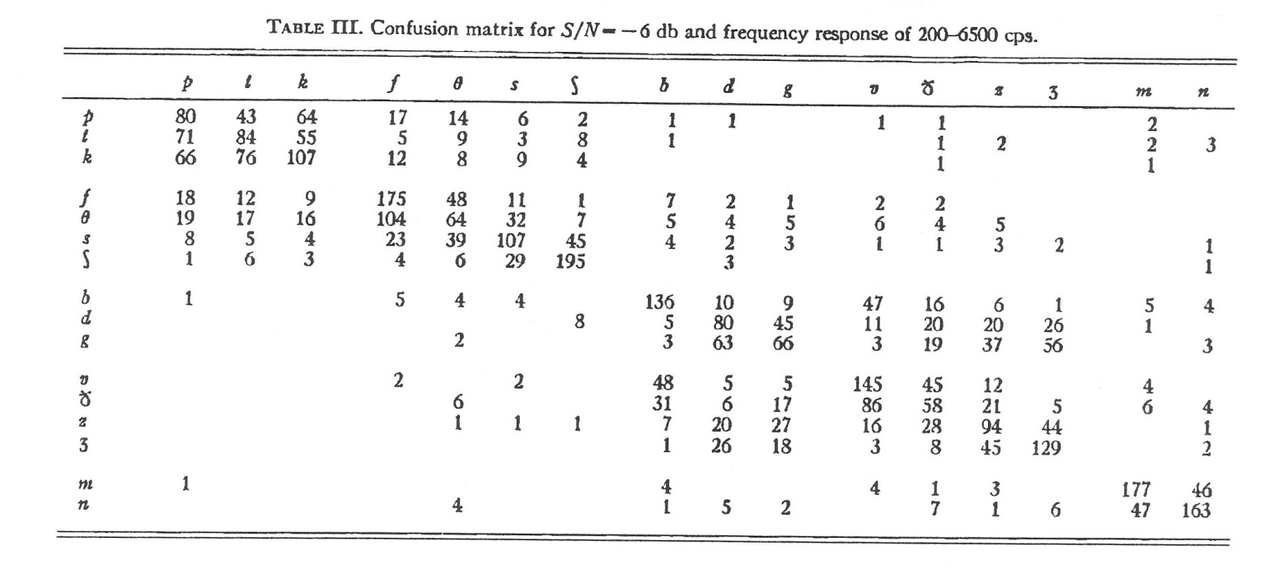
Some Results from Miller & Nicely (1955)
They played stimuli at different signal-to-noise ratios (SNRs); this table shows results for a SNR of -6 dB
Column on left indicates consonant that was played; top row indicates responses by listeners

Slide 8
Identification Tasks: Open-Ended
Another open-ended task: free classification
Subjects put stimuli into groups based on their similarity
Has been used in studies of American English dialect classification

Slide 9
Identification Tasks: Open-Ended
Yet another open-ended task: commutation experiment
Used to study mergers
Listeners are asked to identify words that they hear; difficulty identifying words involved in mergers indicates that the subject has the merger

Slide 10
Identification Tasks: Open-Ended
A new open-ended task borrowed from psychology: the prime/target design
Subjects hear two words. They’re supposed to identify the SECOND one, which is called the target (or sometimes the probe)
The first word, called the prime, may be semantically related or phonologically similar to the target, or neither one
Responses are timed—this is crucial

Slide 11
Identification Tasks: Forced-Choice
Forced-choice: subjects are given choices and they have to pick one
Often used for identification of phonemes
Can be used to study trading relations in phoneme identification (i.e., which phonetic cue is used?)

Slide 12
Identification Tasks: Forced-Choice
McGurk effect: visual stimulus overrides or warps the auditory stimulus
see this website: http://www.wimp.com/mcgurkeffect/
Or try http://www.youtube.com/watch?v=jtsfidRq2tw
Can also be studied with open-ended design
Similar effects are noted when subjects are given misleading or false information

Slide 13
Identification Tasks: Forced-Choice
Goodness ratings: subjects hear stimuli and have to rate how natural the stimuli sound on a scale
Not used as much as it could be

Slide 14
Identification Tasks: Forced-Choice
Ratings of people are commonly done for psychological experiments
Subjective reaction tests: used to get at stereotypes; intelligence, friendliness, and trustworthiness are common traits that are rated
Matched-guise tests are a special type of the above
Intelligibility and Divergence: used to determine how different a dialect is

Slide 15
Discrimination Tasks
Same/different tasks: used for mergers and splits and for determining which phonetic cues are salient
Oddball detection: Which of these does not belong? (Like in Sesame Street)
ABX: Is X more like A or B? Can also be XAB or AXB
Some of the experiments discussed under Identification Tasks can also be set up as Discrimination Tasks

Slide 16
Judgment vs. Functional Testing
Sometimes, a judgment task just can’t get at people’s subconscious knowledge
Then you can set up a functional experiment
Ingenuity can be important
E.g., the famous “coach test” from Labov, Karan, & Miller (1991)

Slide 17
5 general aims of experiments
1. ability of listeners to identify the regional dialect, ethnicity, or social class of a speaker

Slide 18
5 general aims of experiments
1. ability of listeners to identify the regional dialect, ethnicity, or social class of a speaker
2. how stereotypes influence the perception of sounds

Slide 19
5 general aims of experiments
1. ability of listeners to identify the regional dialect, ethnicity, or social class of a speaker
2. how stereotypes influence the perception of sounds
3. presence of mergers or splits in perception

Slide 20
5 general aims of experiments
1. ability of listeners to identify the regional dialect, ethnicity, or social class of a speaker
2. how stereotypes influence the perception of sounds
3. presence of mergers or splits in perception
4. how dialectal differences affect the categorization of phones

Slide 21
5 general aims of experiments
1. ability of listeners to identify the regional dialect, ethnicity, or social class of a speaker
2. how stereotypes influence the perception of sounds
3. presence of mergers or splits in perception
4. how dialectal differences affect the categorization of phones
5. stereotypical attitudes about people

Slide 22
Experimental Treatments (1)
Speech Synthesizer: important for some experiments
Three current kinds of synthesis: synthesis-by-rule (i.e., from scratch) and modification of a model of a real voice, but PSOLA is also still in use
Modeling of real voices and PSOLA are what we mostly use for perception research
Lots of things can be modified; timing and F₀ are easiest, formants and amplitude(?) are harder, aperiodic components are very difficult

Slide 23
Experimental Treatments (2)
Gating: start with a sliver of the signal and add more with each stimulus

Slide 24
Experimental Treatments (3)
Addition of noise or babble: useful to investigate intelligibility (e.g., of a dialect) and to see how salient a particular phonetic cue is

Slide 25
Experimental Treatments (4)
Filtering: very useful for eliminating certain kinds of information, such as one or all formants
Lowpass, highpass, and bandpass filtering and band zeroing; also residual signal in LPC inverse filtering

Slide 26
Experimental Treatments (5)
Modifications of F₀
Monotonization is useful
Addition and multiplication of F₀ are easy
Local modifications of F₀ can also be done, but require more work

Slide 27
Experimental Treatments (6)
Modification of formant values: used when vowel quality is a salient variable
Seems to work better with some voices than with others
Usually, you’ll modify only parts of the signal, not the whole thing

Slide 28
Experimental Treatments (7)
Temporal modifications: compression and prolongation are the main ones, but global vs. local application of them is also a possibility
I won’t go into the minor ones here (bandwidth modification, spectral tilt modification, resplicing, backward playing)

Slide 29
Assembly of Experimental Recording
You need a pause between stimuli
Usually, you’ll put the stimuli into blocks
Blocks should be announced (“set 1,” etc.) so that listeners don’t get lost
Distractor stimuli may be needed
Assume that you’ll have to throw out results from the first several stimuli to account for acclimitization
Make sure your experimental trials aren’t too long
Easy to put stimuli and pauses together in Praat—use the Concatenate function

Slide 30
Administration of Experiments
Get the right kind of listeners
For complicated tasks, familiarization may be needed
Can you use earphones? Better if you can, but make sure they work right and are right volume
Response forms: paper, Scantron, or computerized
Timing responses: if needed, a computer is necessary

Slide 31
Elizabeth Strand (1999) “Uncovering the role of gender stereotypes in speech perception”
Invariance: the notion that there are invariant properties of sounds that allow listeners to identify them consistently
Strand was addressing a phenomenon similar to the McGurk Effect
Using auditory stimuli on a continuum between sod and shod, she found that the boundary changed depending on whether the sound was paired with a video of a male or a video of a female
A follow-up experiment found the same thing for the vowels in hood and hud

Slide 32
Tore Janson & Richard Schulman (1983) “Non-distinctive features and their use”
Comparison of Stockholm and Lycksele dialects of Swedish
Lycksele maintains short /e/-// distinction; Stockholm doesn’t
Synthesized a continuum of vowels representing sitt, sett, sätt, satt
Stockholmers couldn’t differentiate sett and sätt, but most Lyckselers couldn’t, either
Janson & Schulman concluded that Lyckselers didn’t use this distinction in their perception; do you agree?
Follow-up experiment: Stockhomers could identify all four when told they were English words

Slide 33
Vowel Plot Practice These are from last week, if we didn’t have time to cover them then.

Slide 34
Vowel Plot Practice Here are some new ones. What dialectal features do they show?

Slide 35
Practice Time
We’ll change various aspects of the utterance of “We went to the store and got some milk” that I sent all of you
F₀, timing, formant values
Add treatments such as gating, filtering, and noise

Slide 36
References
Janson, Tore, and Richard Schulman. 1983. Non-distinctive features and their use. Journal of Linguistics 19:321-36.
Labov, William, Mark Karan, and Corey Miller. 1991. Near-mergers and the suspension of phonemic contrast. Language Variation and Change 3:33-74.
Miller, George A., and Patricia E. Niceley. 1955. An analysis of perceptual confusions among some English consonants. Journal of the Acoustical Society of America 27:338-52.
Strand, Elizabeth A. 1999. Uncovering the role of gender stereotypes in speech perception. Journal of Language and Social Psychology 18:86-100.
Traunmüller, Hartmut. 1990. Analytical expressions for the tonotopic sensory scale. Journal of the Acoustical Society of America 88:97-100.
Zwicker, E., and E. Terhardt. 1980. Analytical expressions for critical-band rate and critical bandwidth as a function of frequency. Journal of the Acoustical Society of America 68:1523-25.

