Slide 1
ENG 528: Language Change Research Seminar
Sociophonetics: An Introduction
Chapter 2: Production

Slide 2
Acoustic Concepts
3 dimensions of sound:
frequency
amplitude
time
phase might be considered a fourth dimension

Slide 3
Frequency
Frequency is the time it takes the wave to go through its pattern; measured in cycles per second (cps), or Hertz (Hz)

Slide 4
Amplitude
Amplitude is the degree to which a wave deviates from zero sound pressure level during its course; usually seen measured in decibels (dB)

Slide 5
Phase
Waves of the same frequency are in different phases when their zero-crossing points are different
Waves in completely opposite phase cancel each other out, creating antiformants or zeroes

Slide 6
Fourier Analysis (1)
Fourier said that all complex waves can be broken down into a series of simple waves

Slide 7
Fourier Analysis (2)
At one time, it was done through painstaking mathematical calculations
Discrete Fourier Transforms (DFT): use a window and analyze only what’s in the window; window has various shapes, depending on how it’s attenuated (we’ll discuss that next)
Fast Fourier Transforms (FFT): done by computer; everything is digitized; note that you’ll get quantization error, but advantages of FFT make up for it

Slide 8
Fourier Analysis (3)
Steps in Fourier Analysis are shown here

Slide 9
Windowing (1)
Windowing is a necessary part of Fourier Analysis
You have to chop the signal into pieces, called windows, to analyze it
Windows vary in two important ways:
Their length—this is how you get wideband and narrowband spectra and spectrograms
Their shape—this has to do with the windowing method

Slide 10
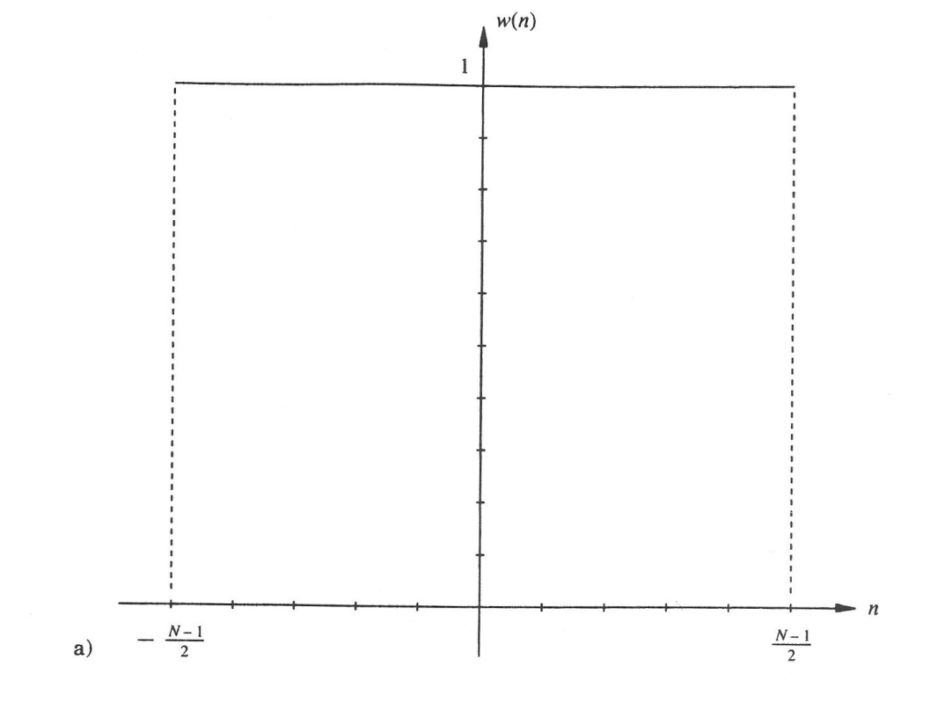
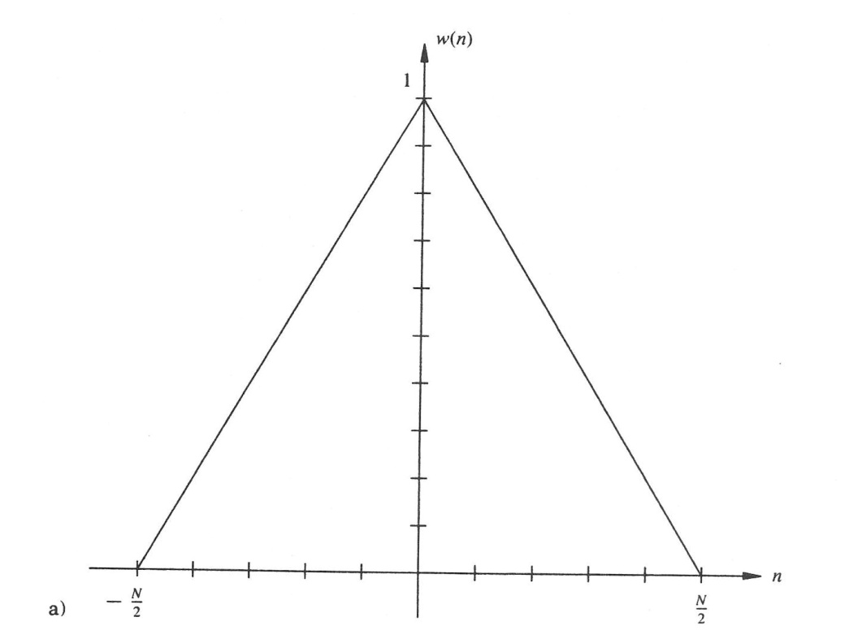
Windowing (2)
Rectangular Window
Triangular (Bartlett) Window

Slide 11
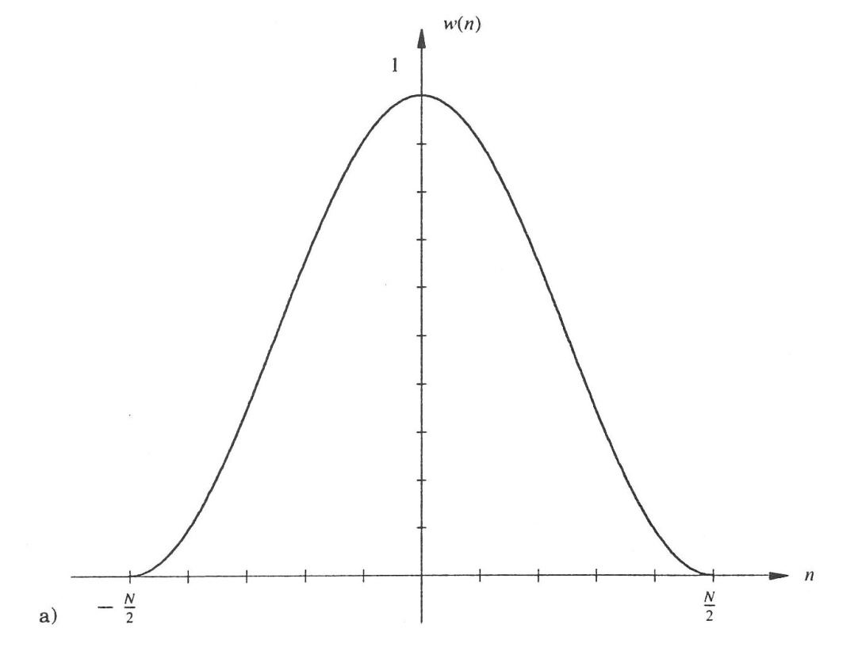
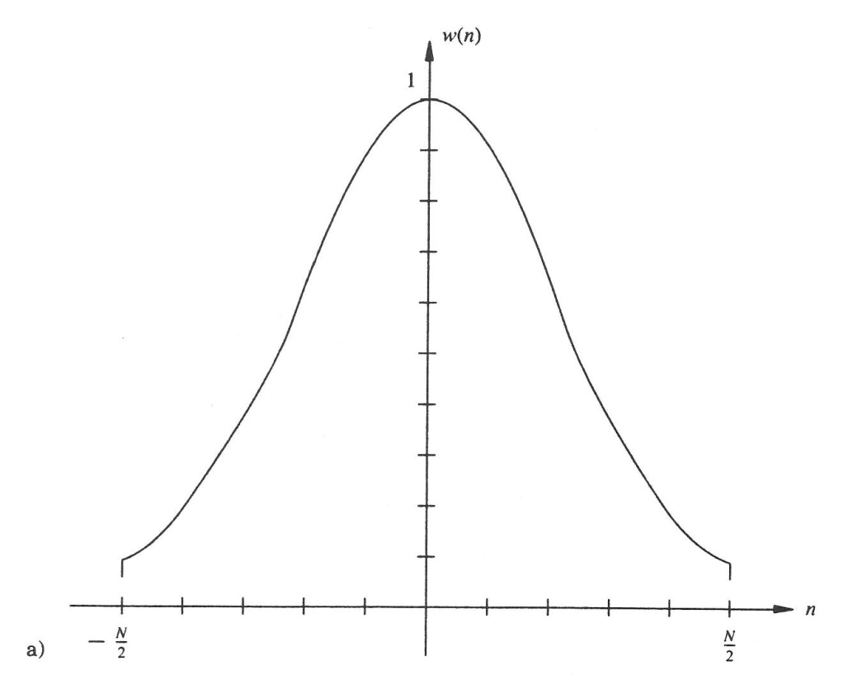
Windowing (3)
Hanning Window
Hamming Window

Slide 12
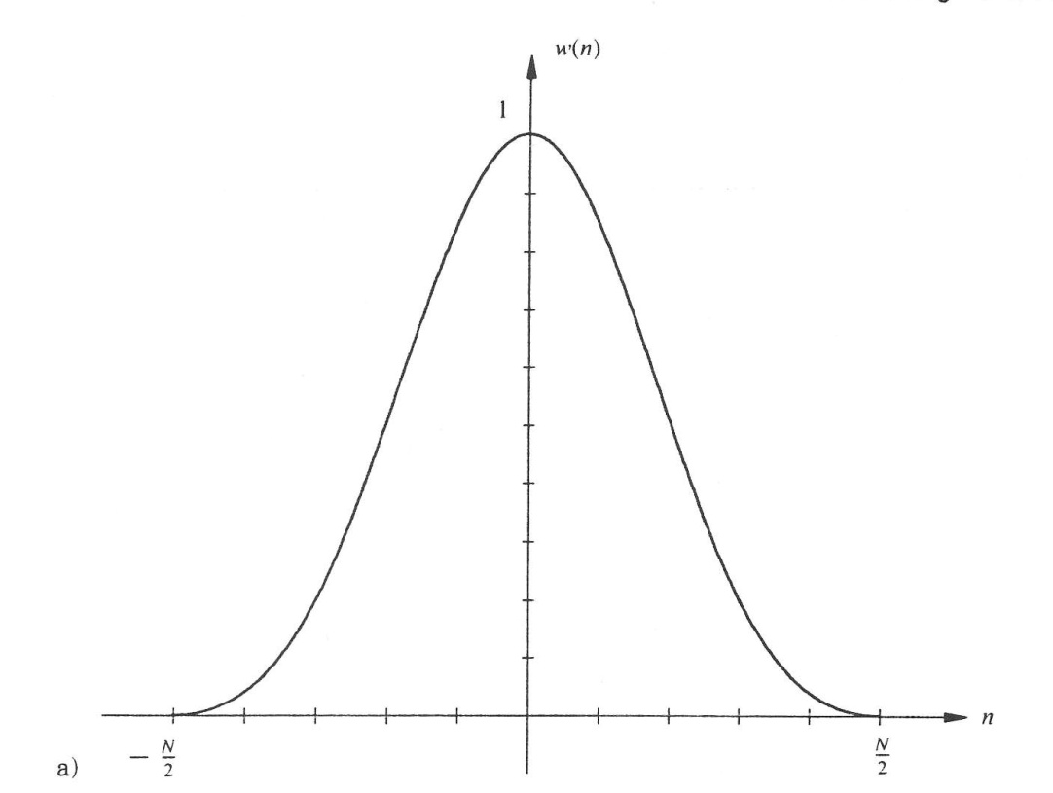
Windowing (4)
Blackman Window

Slide 13
Digitization (1)
Digitization involves sampling the waveform at even intervals of time
The computer extrapolates a waveform from the samples

Slide 14
Digitization (2)
However, the computer can extrapolate phony waves if the digitization is done wrong; this is called aliasing

Slide 15
Digitization (3)
To avoid aliasing, you have to sample at a rate at least twice that of the highest frequency in the signal
That is, the highest frequency in the signal can be no more than half the sampling rate
Half the sampling rate is called the Nyquist frequency
E.g., if sampling rate is 44.1 kHz, Nyquist frequency is 22.05 kHz

Slide 16
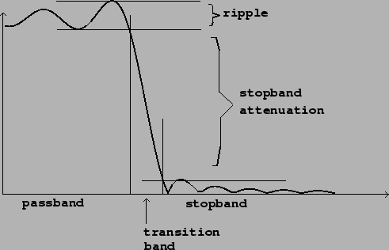
Digitization (4)
Problem: any natural recording will have high frequencies
Solution: filter them out with a lowpass filter
Note how filters have a transition band, so you have to set the filter lower than the Nyquist frequency

Slide 17
Digitization (5)
Next problem: in speech, amplitude falls off as frequency goes up
Solution: pre-emphasis of the signal, which amplifies higher frequencies so they show up on spectrograms
6 dB per octave increase in amplitude
Usually added at a factor, such as 0.85

Slide 18
Digitization (6)
The whole process can be done in two orders:
pre-emphasis, lowpass filtering, digitization
lowpass filtering, digitization, pre-emphasis

Slide 19
Visual Displays
Power spectrum: one point in time; shows frequency against amplitude
Wideband and narrowband spectrograms: we discussed them last week. Note that a spectrogram is a bunch of power spectra lined up side-by-side

Slide 20
The Source-Filter Theory
Vocal fold vibration is the source
Depends on time between vibrations (resulting in F₀ in cycles/s, i.e., Hz)
Harmonics at all multiples of F₀ because they have zero-crossing points at the same places
Configuration of tongue, lips, etc. is the filter; depends on length of cavities, as we’ll see
+ =

Slide 21
Formants (1)
Tube open at one end: F_{n}=(2n-1)c/4L
c=speed of sound, ~34,300 cm/s
Lots of vowels have cavities like this

Slide 22
Formants (2)
Tube closed at both ends: F_{n}=nc/2L
Back cavity often looks like this; front cavity can with lip rounding

Slide 23
Formants (3)
Helmholz resonator: any jug-shaped cavity
Just one resonance: F=(c/2π)√(A_{n})/(V_{b}L_{n}), where A_{n}=cross-sectional area of neck, V_{b}=volume of body, L_{n}=length of neck

Slide 24
Measuring F₀ (1)
Autocorrelation is the matching of sections of a waveform with each other to see where they match up best

Slide 25
Measuring F₀ (2)
Other ways to measure F₀:

Slide 26
Measuring formants (1)
One old method: estimation from wideband FFT power spectra

Slide 27
Measuring formants (2)
Another old method: estimation from narrowband FFT power spectra

Slide 28
Measuring formants (3)
The most common method today: Linear Predictive Coding (LPC)
You’ll get results such as this:
Time_s F1_Hz F2_Hz F3_Hz F4_Hz
0.241506 571.972189 1785.357253 2473.494437 3200.979236

Slide 29
Measuring formants (4)
In LPC, you set the number of poles or coefficients, which determine the number of formants the program expects to find
Improper setting results in bad readings

Slide 30
Bandwidth
One other thing to pay attention to
Two ways to define bandwidth: a) area with half the energy of the curve or b) frequency range at 3 dB below peak
Larger bandwidths can indicate poor recording quality or other factors such as nasality
You’ll get readings such as:
67.96889751316604 Hertz (nearest B1 to CURSOR)

Slide 31
Vowel Formant Exercise #1
Record yourself saying the following words two ways—first, in a normal voice, and second, while yawning: heed, hid, head, had, hod, hawed, HUD, hood, who’d, hold, heard
Measure the first three formants and the fundamental frequency at the center of each vowel and put these measurements in a spreadsheet
Plot F₁ and F₂ in a graph
Turn in the spreadsheet and the graph two class periods from now

Slide 32
Vowel Plot Practice
These first two plots are the ones from last week, in case we didn’t have time to discuss them then.

Slide 33
Vowel Plot Practice
Here are some new plots. Where is each one of these speakers from? How do you know?

Slide 34
References
The windowing diagrams on slides 10-12 came from:
Haddad, Richard A., and Thomas W. Parsons. 1991. Digital Signal Processing: Theory, Applications, and Hardware. New York/Oxford: W. H. Freeman.
The diagram on slide 16 came from:
http://crca.ucsd.edu/~msp/techniques/v0.11/book-html/node129.html

