Slide 1
ENG 528: Language Change Research Seminar
Sociophonetics: An Introduction
Chapter 1: Introduction

Slide 2
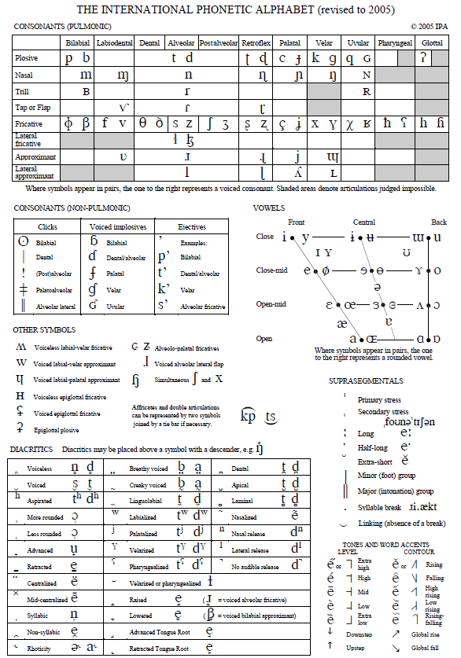
The International Phonetic Alphabet
This is the latest version of the International Phonetic Alphabet (IPA). It was developed beginning in 1886 as a way of representing the sounds of any language. It’s been used ever since for auditory (impressionistic) transcription. Dialectologists and sociolinguists have relied heavily on it.

Slide 3
Use of Impressionistic (Auditory) Transcription
It was always the method of choice for dialect geographers, who used a very narrow transcription system
Sociolinguists also used it, but not such a narrow transcription method
Demonstration: the word code (each class member say the word and I’ll transcribe it narrowly, like dialect geographers did)

Slide 4
Sociophonetics
Much younger than the IPA
Acoustic analyses first used in sociolinguistic studies with Labov’s Martha’s Vinyard study (1963)
First dialect identification experiment was 1952
The name sociophonetics dates from 1974

Slide 5
What is Sociophonetics?
Interface of sociolinguistics and phonetics (but what does that mean?)
Highly empirical, like both of its source fields
Favors bottom-up approaches

Slide 6
Tensions
Sociolinguists aim for “naturalness”
Phoneticians aim for replicability

Slide 7
Discussion Question
What are some of the ways that sociophonetic studies can meet the methodological requirements of both sociolinguistics and phonetics, especially in terms of replicability, getting naturalistic data, and defining the speech community?

Slide 8
General Aims of Linguistics: First Big Question
Why does language change? Historical linguists wondered about this from the beginning
Neogrammarian Hypothesis (Osthoff & Brugman, 1870s)—a milestone
Labov, 1975—“the use of the present to explain the past”

Slide 9
General Aims of Linguistics: Second Big Question
What is the structure of language?
Jumping-off point was Saussure and his notions of langue and parole
Structuralists (Bloomfield and allies) and Prague School (Jakobson and others) were limited by technology
Chomsky: notion of competence; structure of language in the mind/brain emphasized

Slide 10
What is linguistics all about?
1. How and why does language vary and change?
2. How is language structured in the mind/brain?

Slide 11
Discussion Question
Name several ways information on language variation can demonstrate links between variation/change in language and the organization of language in the mind/brain.

Slide 12
Structural vs. Functional Linguistics
Traditionally, functional linguists are those who focused on Big Question #1—essentially, Saussure’s parole
Structural linguists are those who focused on Big Question #2—Saussure’s langue and, later on, Chomsky’s competence

Slide 13
Structure and Function within Sociolinguistics
There’s been a split within the field
Applied areas—mostly education and law (forensics)
Quantitative Sociolinguistics—the Labovian tradition; has dealt with the Two Big Questions, especially the first one; “What does society tell us about language?”
Qualitative Sociolinguistics—might better be a branch of sociology, but sociology is only now accepting it; “What does language tell us about society?”

Slide 14
A Recent Idea
Eckert (2005) proposed that sociolinguistics has consisted of three waves
1st wave=correlations with demographic factors
2nd wave=ethnography, social networks
3rd wave=stylistic variation and projection of identities
But where are the Two Big Questions?

Slide 15
There’s An Alternative
Sociophonetics can be the successor to Labovian quantitative sociolinguistics, which gives signs of running out of gas
Addresses theoretical issues about language, such as the relationship of phonetics to phonology, how sociolinguistic knowledge is mentally linked to language, and Exemplar Theory

Slide 16
Discussion Question
What is the status of functional and structural approaches to linguistics in general and sociolinguistics in particular? Do you agree or disagree with the perspective presented in Chapter 1?

Slide 17
History of Sociophonetics
Started slowly, mainly in 1970s
Sociolinguists who conducted it were mainly Labov and his students
Became more widespread in 1990s
Since 2000, it has really taken off

Slide 18
Hypothesis Testing

Slide 19
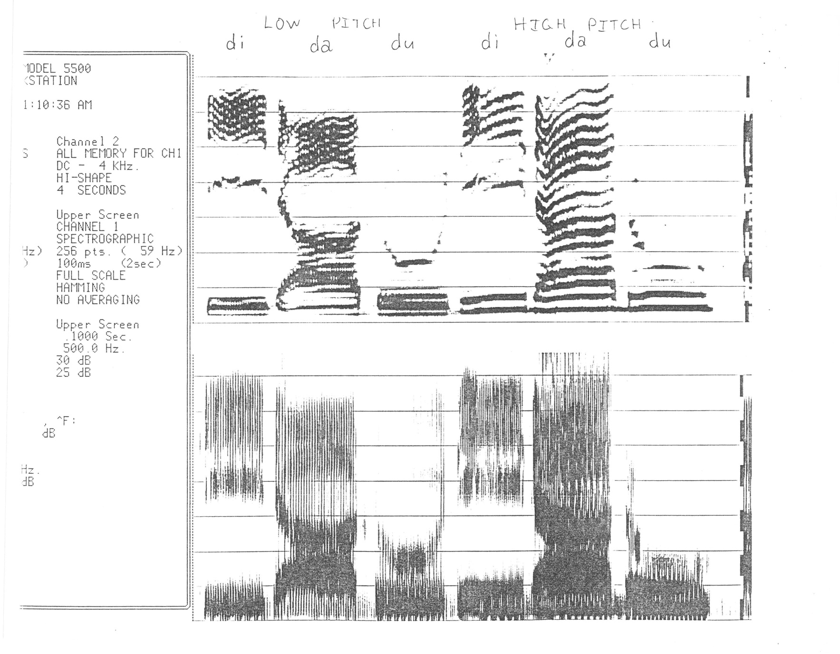
Demonstration of Spectrograms

Slide 20
Demonstration with Praat (1)
Look at:
BAB, DAD, GAG
PIT, SPIT
[s] and [∫]
rolled [r]
bunched-tongue r in [◻]
compare non-nasal and nasal [ε]
S and E spoken by male and female speakers

Slide 21
Demonstration with Praat (2)
WRIT, WIT, LIT, YIT: listen to them, cutting off more and more of the approximant
final /l/
taps
diphthongs; compare /oi/ with /or/
creaky voice
Other things: voiced fricatives; [f] vs. []; octaves

Slide 22
Vowel Plot Practice
These two speakers both have the low back merger. Look at other clues in their vowel configurations and try to guess where each one is from.

Slide 23
References
The IPA chart came from the following website: http://www.langsci.ucl.ac.uk/ipa/IPA_chart_%28C%292005.pdf
Eckert, Penelope. 2005. Variation, convention, and social meaning. Paper presented at the annual meeting of the Linguistic Society of America, Oakland, CA, 7 January. Accessed 9 January 2008 from http://www.stanford.edu/~eckert/.
Labov, William. 1963. The social motivation of a sound change. Word 19:273-309.
Labov, William. 1975. On the use of the present to explain the past. In Luigi Heilmann (ed.), Proceedings of the Eleventh International Congress of Linguists, Bologna-Florence, Aug. 28-Sept. 2, 1972, vol. 2, 825-51. Bologna: Il Mulino.

